Slide 1


Subject Handbook
Reading

Slide 2

Our Reading Curriculum
Intent
We aim to provide children with a literacy-rich environment, with high quality texts to share and inspire learning opportunities, which will help them to:
Apply a knowledge of structured synthetic phonics in order to decode unfamiliar words with increasing accuracy and speed;
Gain a life-long enjoyment of reading and books.
Read accurately, fluently and with good understanding;
Be able to read with expression, clarity, fluency and confidence;
Develop a good linguistic knowledge of vocabulary and grammar;
Read and respond to a wide range of different types of texts;
Develop a deeper level of emotional intelligence and empathy;
Read fluently, and with confidence, in any subject in their forthcoming education.

Slide 3
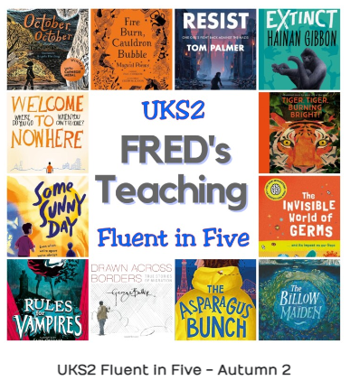

Our Reading Curriculum
Implementation
We ensure consistent early reading and phonics instruction in FS and KS1 through our Sounds Write approach.
Children receive phonics-aligned books and are encouraged to read daily at home.
We cultivate a text-rich environment to foster a reading culture and enjoyment.
High-quality teaching enhances skills, while exposure to diverse texts expands vocabulary and comprehension.
Reading skills are integrated into the wider curriculum.
Classrooms feature topic-related books, and daily reading sessions with teachers occur.
Disciplinary reading is used across the curriculum to give children the opportunity to read across disciplines.
Additional support for KS2 students is provided through various interventions.

Slide 4

Our Reading Curriculum
Impact
By the time children leave St John’s, they will be competent readers who can recommend books to their peers, have a thirst for reading a range of genres including poetry, and participate in discussions about books, including evaluating an author’s use of language and the impact this can have on the reader.
They will read books to enhance their knowledge and understanding of the world and communicate their research to a wider audience.
They will be ready to read with accuracy, speed, confidence, fluency and understanding which will help access the secondary school curriculum.
All pupils will make at least good progress from their starting points and achieve at least in line with national expectations for attainment.

Slide 5


SoundsWrite
EYFS
At St. John the Baptist School we know that the teaching of phonics plays a key role in helping children learn to read, write and spell. We teach phonics using Sounds-Write, a linguistic phonics programme validated by the DfE. Sounds-Write is a very highly structured, multi-sensory and code-oriented instructional approach to teaching children to read and spell.
Our aim is for the vast majority of children to be confident readers by the end of KS1, fully equipped to tackle and succeed the KS2 curriculum. Sounds-Write phonics also teaches children how to spell words, helping them to become successful, confident writers.
This programme is successful in teaching children to read and spell because it starts with what all children know from a very young age – the sounds of our spoken language. Then, using a very systematic approach, it teaches them how these sounds are coded within our writing system.

Slide 6
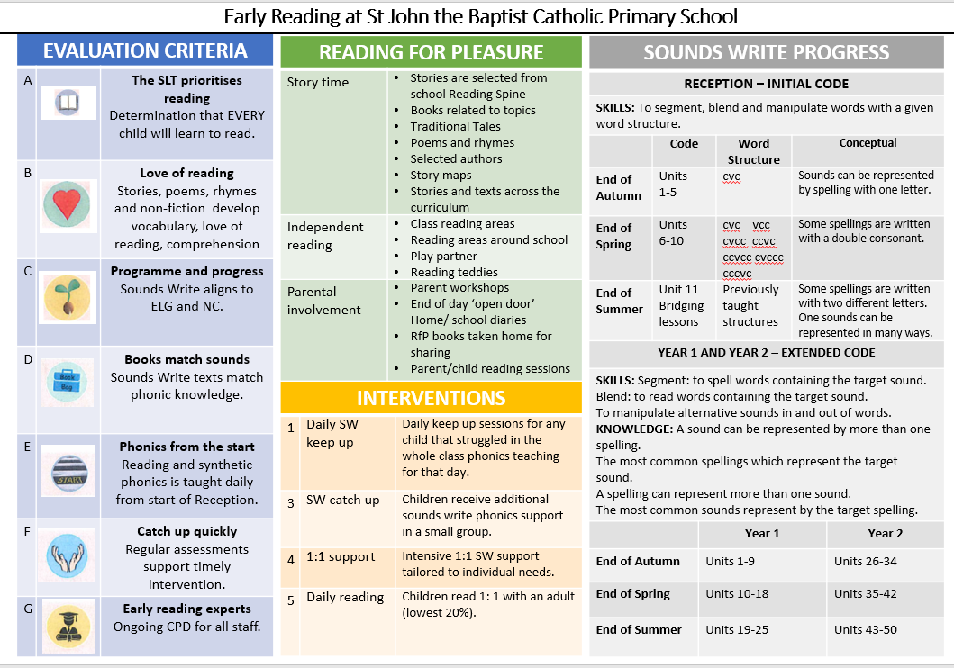
SoundsWrite

Slide 7
SoundsWrite
Key Concepts
The four key concepts children are taught are:
letters are symbols that represent sounds
sounds can be spelled using 1, 2, 3 or 4 letters
the same sound can be spelled in different ways
the same spelling can represent different sounds

Slide 8
SoundsWrite
EYFS
The three key skills children need to master are:
blending
segmenting
phoneme manipulation
Children in our Early Years Foundation Stage begin with the Initial Code where they practice all 3 key skills whilst learning the 1:1 sound-spelling correspondences and securing their understanding of key concept 1. This builds up confidence and phonic knowledge in a truly reversible system, enabling them to decode and encode a wide range of words and sentences.
At first, children learn to read and write simple one syllable words with a CVC structure. Complexity of word structure systematically builds up so that children apply their code knowledge to monosyllabic words with up to 6 sounds.

Slide 9
SoundsWrite
Lesson Structure
A typical Sounds-Write lesson is broken up into three parts; new learning, review and recap and skills and spelling. These three specific parts can be taught in any order within a unit of study.
In Early Years, children have a 25-minute phonics session every day.
In KS1, children have a 30-minute phonics lesson every day.
In KS2, children have a 15-minute spelling lesson at least 3 times per week, as part of their English lesson.
Phonics teaching in Year 1 is organised to ensure that all children are given sufficient exposure to the letter-sound correspondences that they will meet in the Year 1 Phonics Screening Check.
Children are given fully decodable reading books that match their phonic knowledge. Their phonic knowledge is also reinforced and practised through whole class and group reading sessions. Word lists are sent home each week for children to practise reading and writing at home.

Slide 10
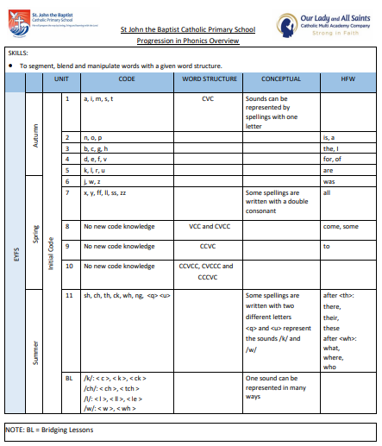
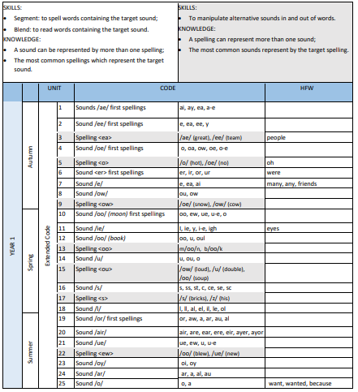
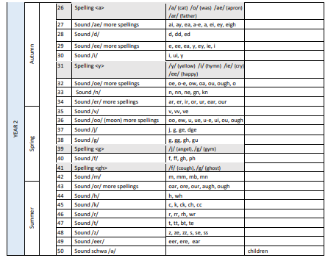
SoundsWrite
Progression Documents

Slide 11
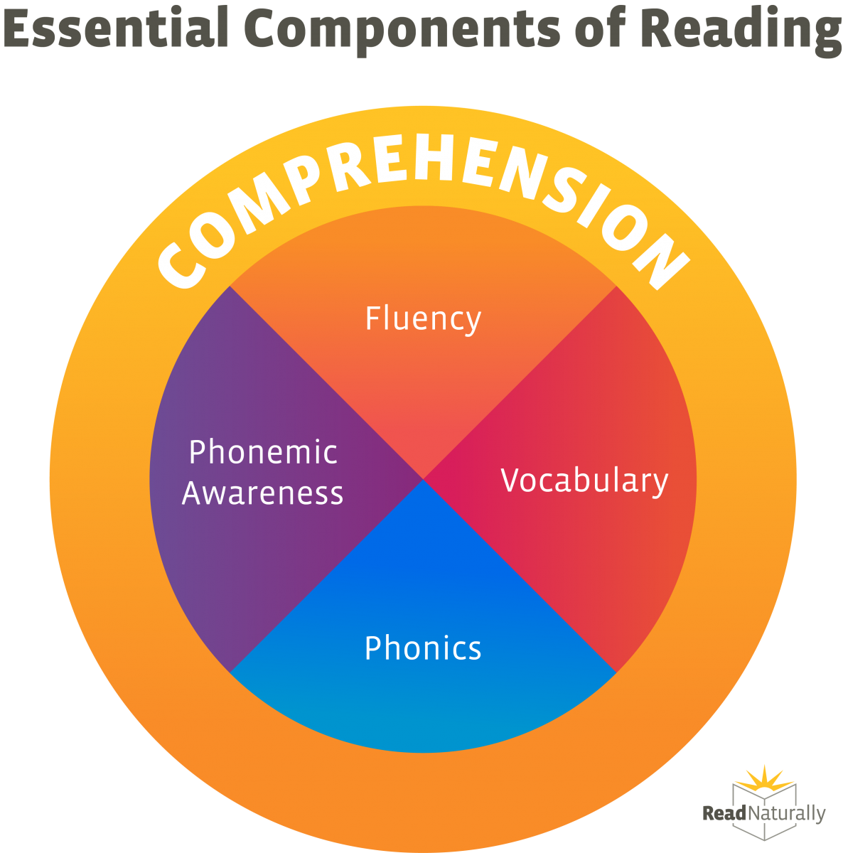
Early Reading
EYFS
In EYFS and KS1, reading lessons take the format of group reading. Children will either be reading with an adult, or completing an independent activity based on one of the essential components of reading.

Slide 12
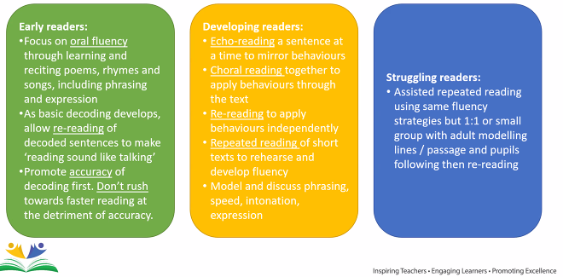
Fluency

Slide 13
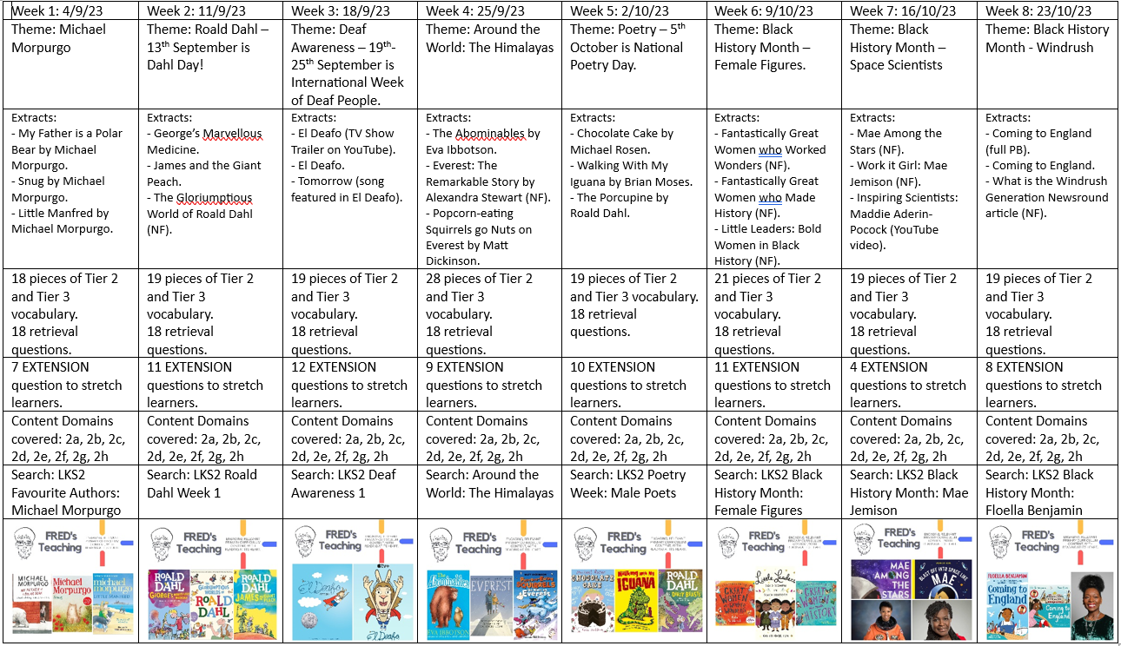
Year 3
Curriculum Overviews
Autumn 1

Slide 14
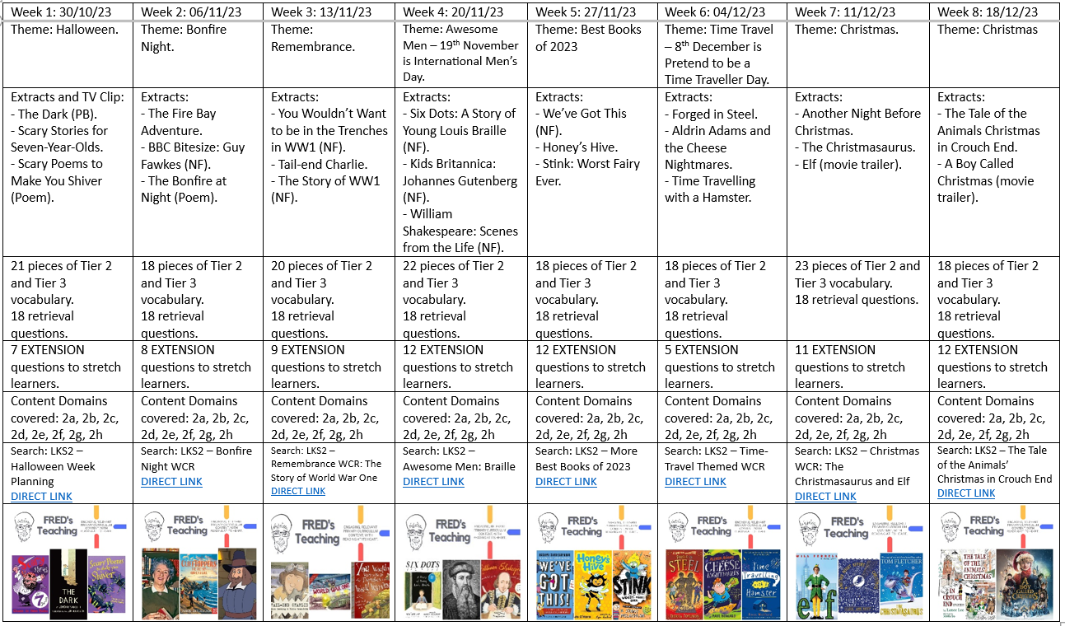
Year 3
Curriculum Overviews
Autumn 2

Slide 15
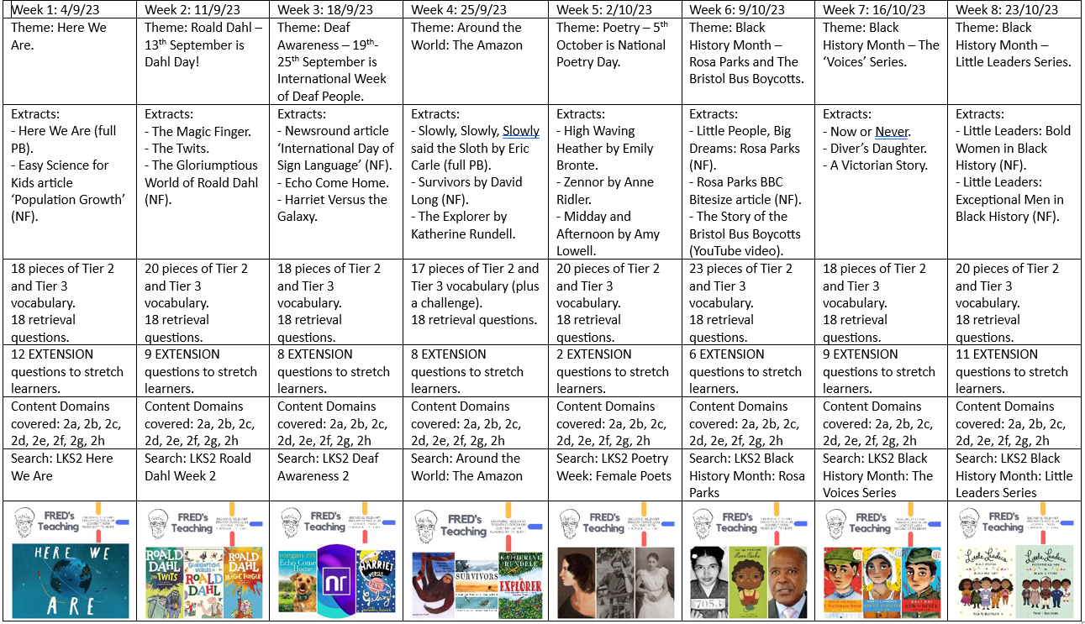
Year 4
Curriculum Overviews
Autumn 1

Slide 16
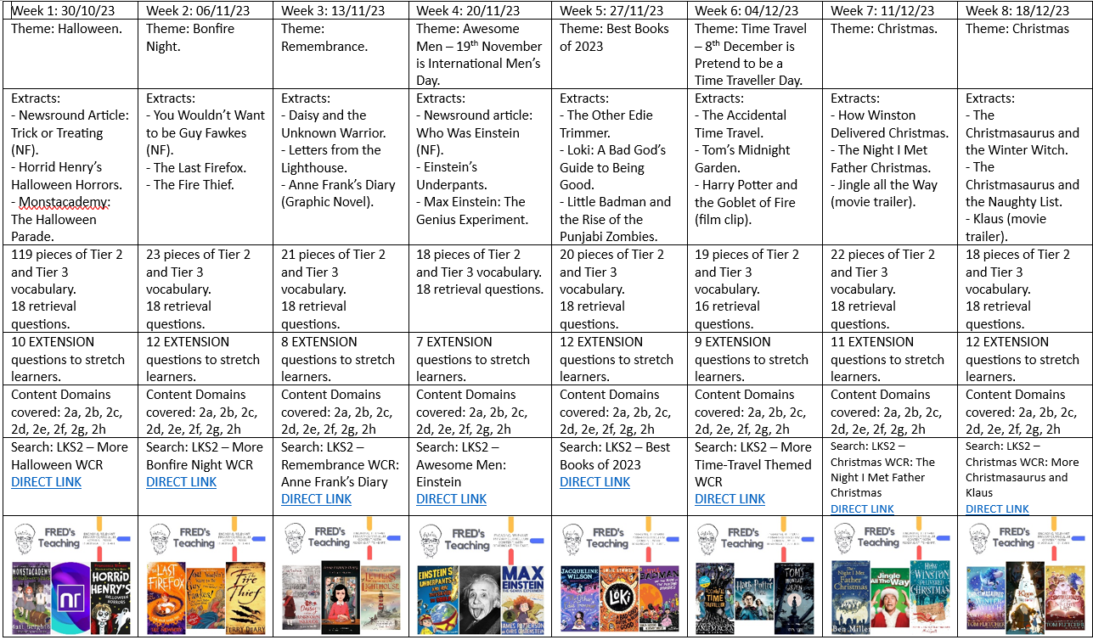
Year 4
Curriculum Overviews
Autumn 2

Slide 17
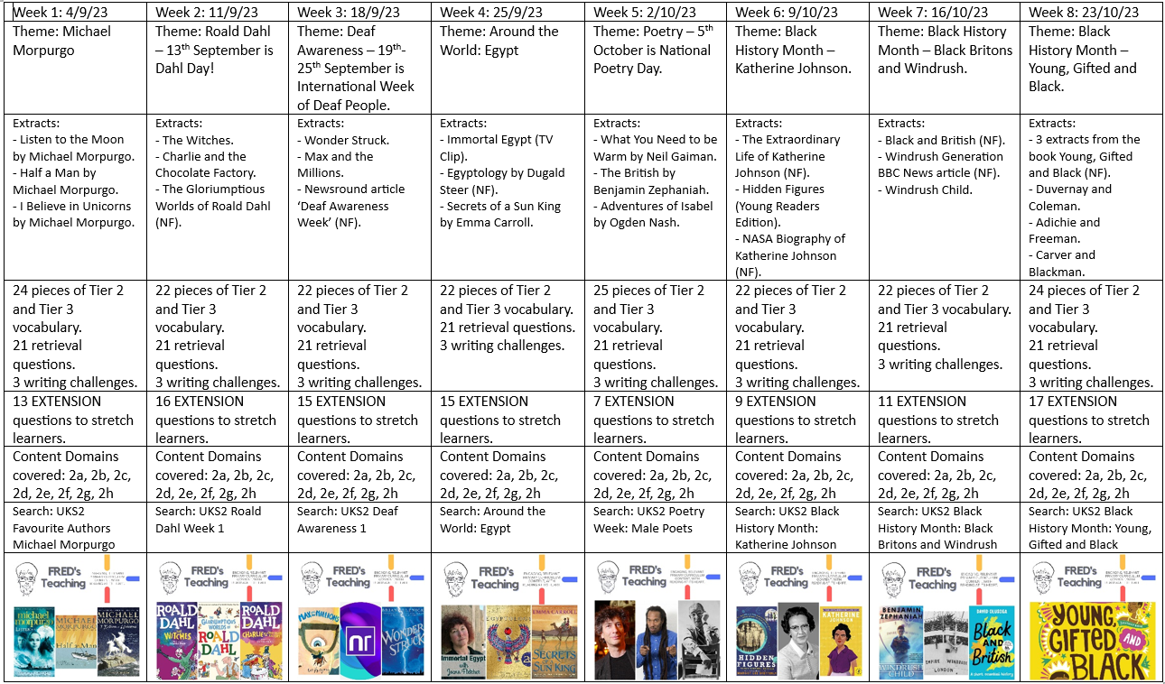
Year 5
Curriculum Overviews
Autumn 1

Slide 18
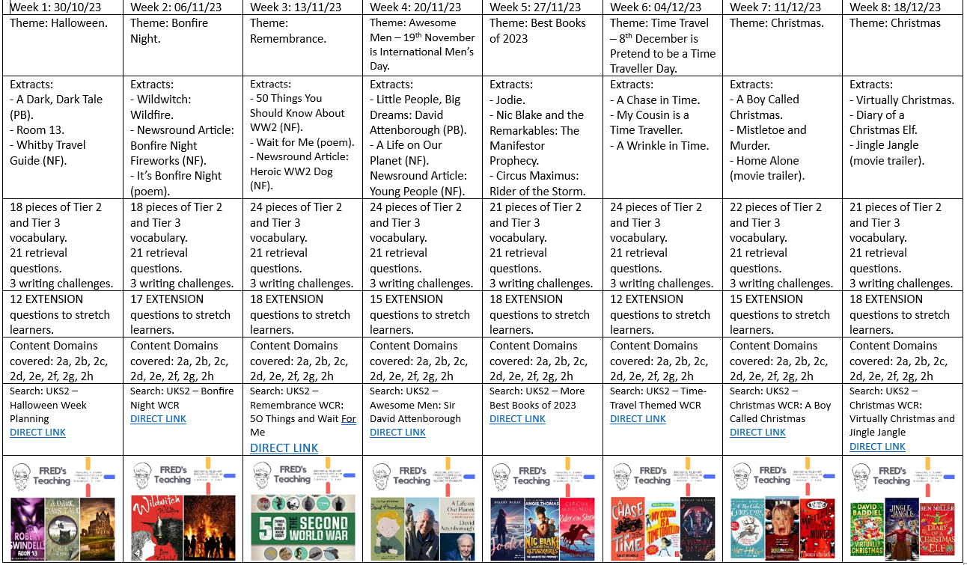
Year 5
Curriculum Overviews
Autumn 2

Slide 19
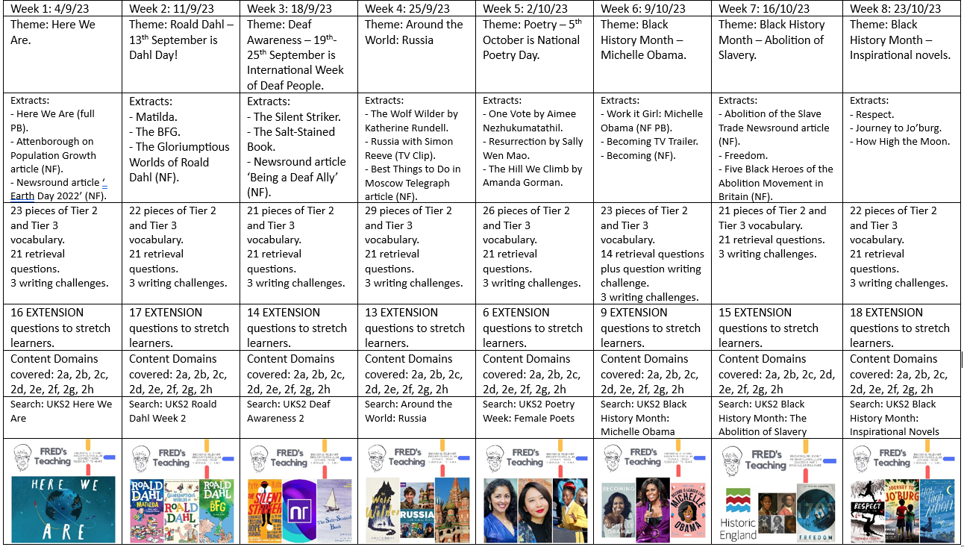
Year 6
Curriculum Overviews
Autumn 1

Slide 20
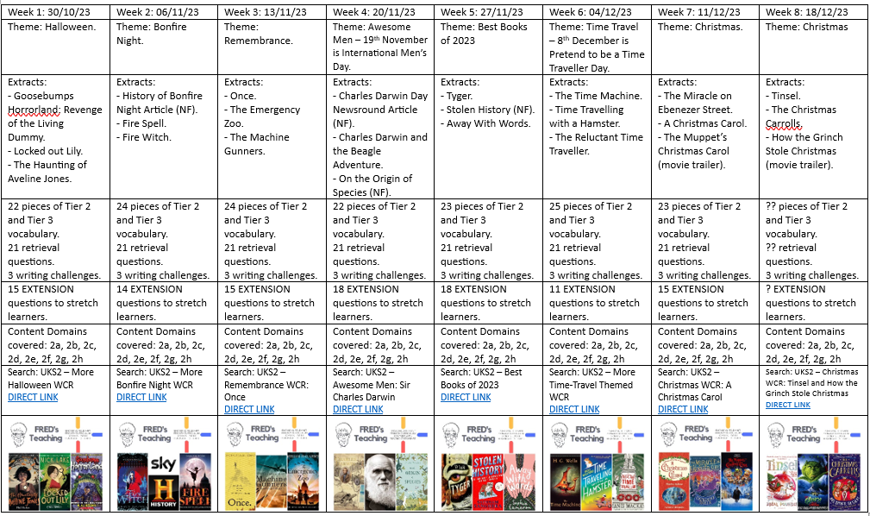
Year 6
Curriculum Overviews
Autumn 2

Slide 21
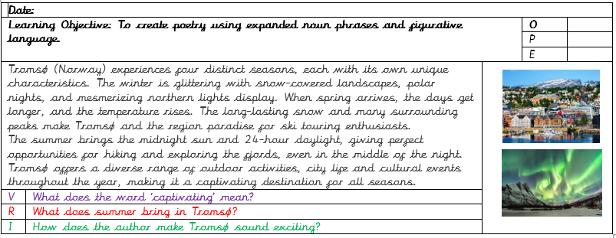
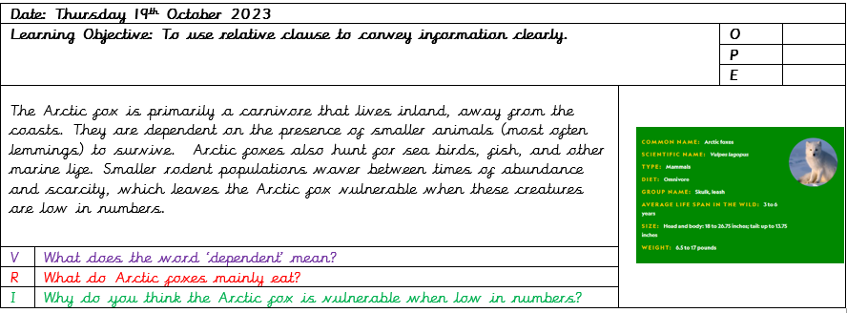
Disciplinary Reading
Children making connections between their English work and their Spatial Sense geography unit involving midnight sun and polar nights.
Children making connections between their English work and their science work – animals and their habitats.

Slide 22
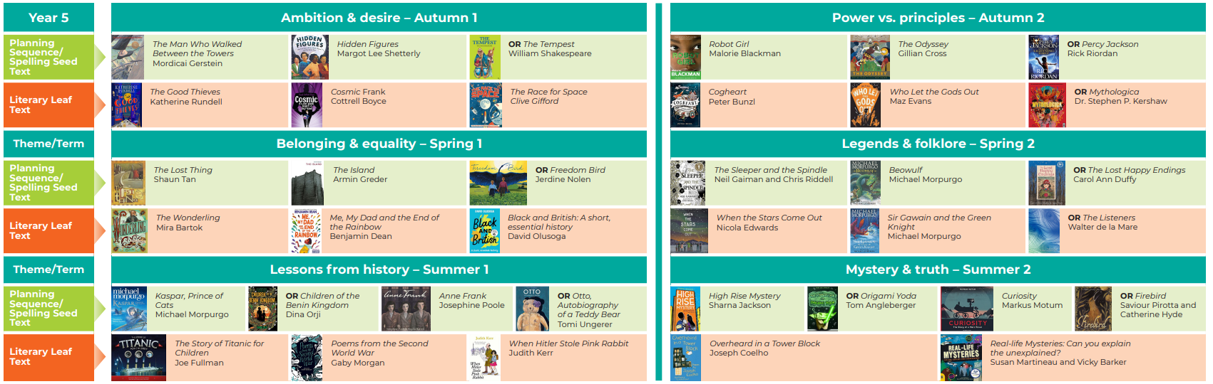
Cross-Curricular
Using our English Curriculum, teachers will seek to take advantage of opportunities to make cross-curricular links, providing children with a variety of fiction and non-fiction books which closely link to the theme. The English curriculum has been carefully planned and selected to ensure children are exposed to a range of high-quality literature that focuses on a diverse range of topics and themes. With these links in mind, teachers will plan for pupils to practise and apply the skills, knowledge and understanding acquired through Reading lessons to other areas of the curriculum. This may include teacher modelling and shared reading activities.
Black History Month
Supports pre-learning for Year 5 (Slavery)
Supporting
pre-learning for Year 6
(WW2 P)

Slide 23



KS2 Whole Class Reading Journey
Day 1 – Text 1 | Day 2 – Text 1 | Day 1 – Text 2 | Day 2 – Text 2 | Day 1 – Text 3
Make connections Prediction Vocabulary Modelled reading Echo reading Paired reading Oracy task Retrieval questions | Vocabulary recap Modelled reading Echo reading Paired reading Oracy task 2a, 2b, 2c, 2d, 2e, 2f, 2g, 2h | Prediction Vocabulary Modelled reading Echo reading Paired reading Oracy task Retrieval questions | Vocabulary recap Modelled reading Echo reading Paired reading Oracy task 2a, 2b, 2c, 2d, 2e, 2f, 2g, 2h | Prediction Vocabulary Modelled reading Echo reading Paired reading Retrieval questions Oracy task 2a, 2b, 2c, 2d, 2e, 2f, 2g, 2h
Fluency and ‘thinking out loud’ is modelled by the class teacher.
Children are given the opportunity to develop fluency and oracy during every session.

Slide 24


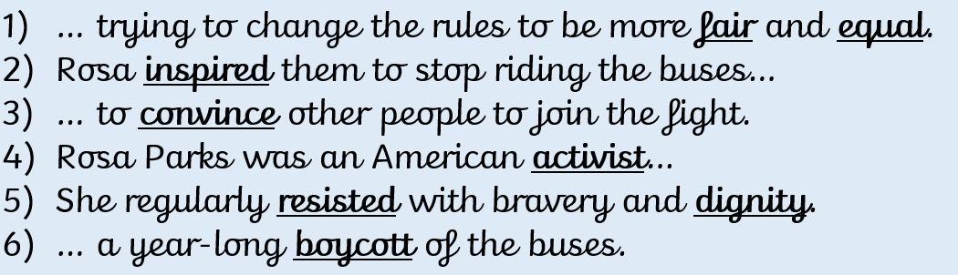
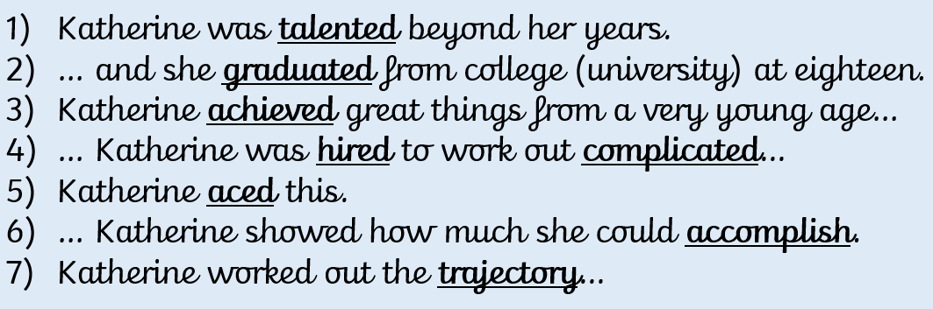
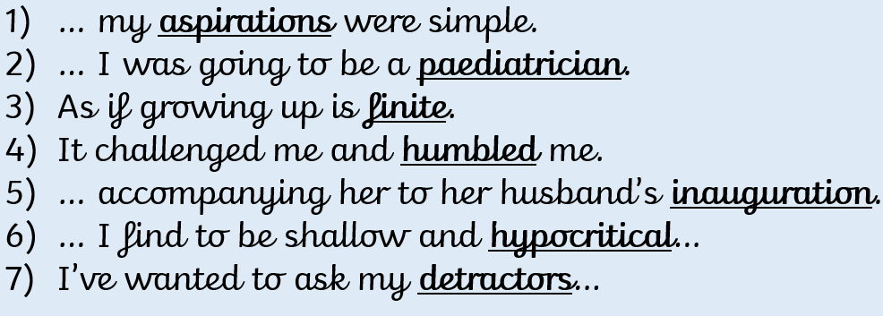
Vocabulary Progression
Year 3
Black History Month - 2023
Year 4
Year 5
Year 6

Slide 25
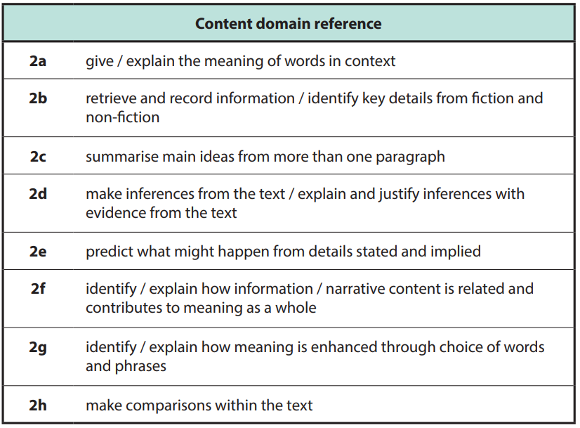
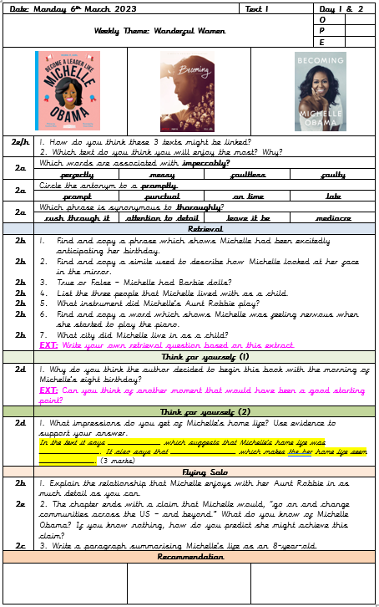
Progression of Skills

Slide 26
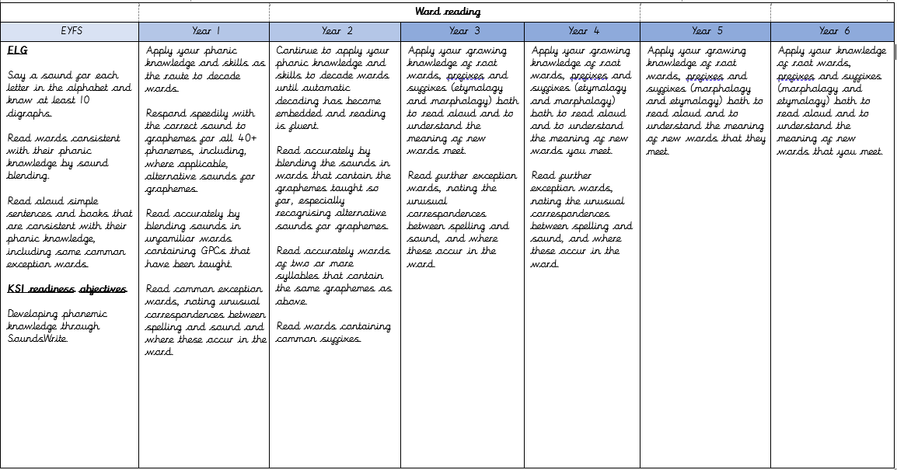
Progression of Skills

Slide 27
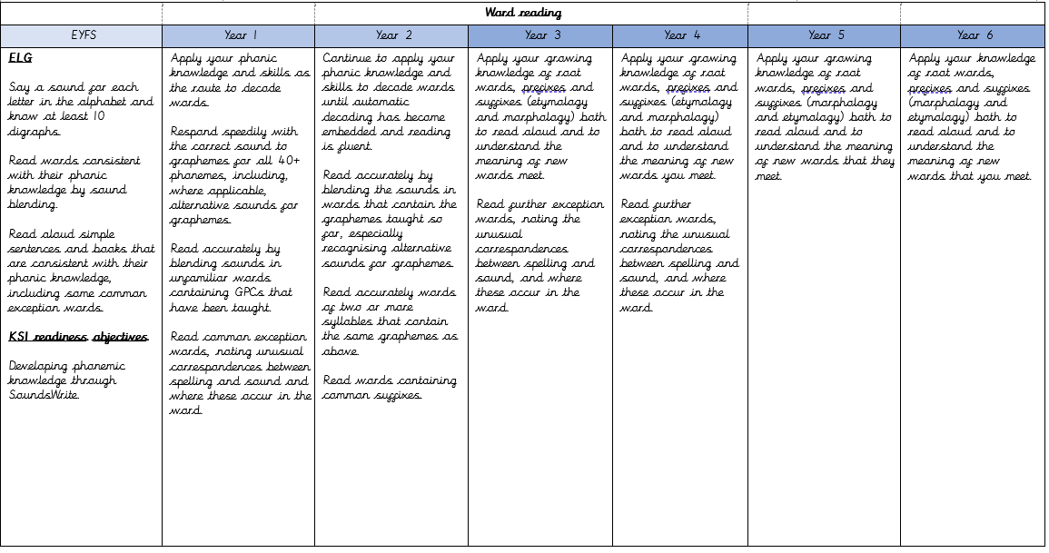
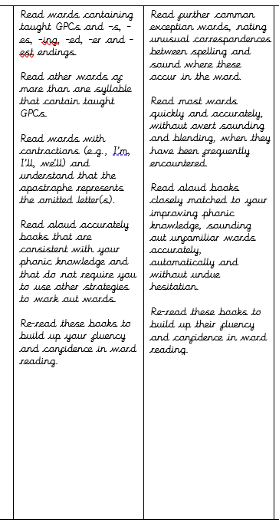
Progression of Skills
Word Reading
Year 1 and 2

Slide 28
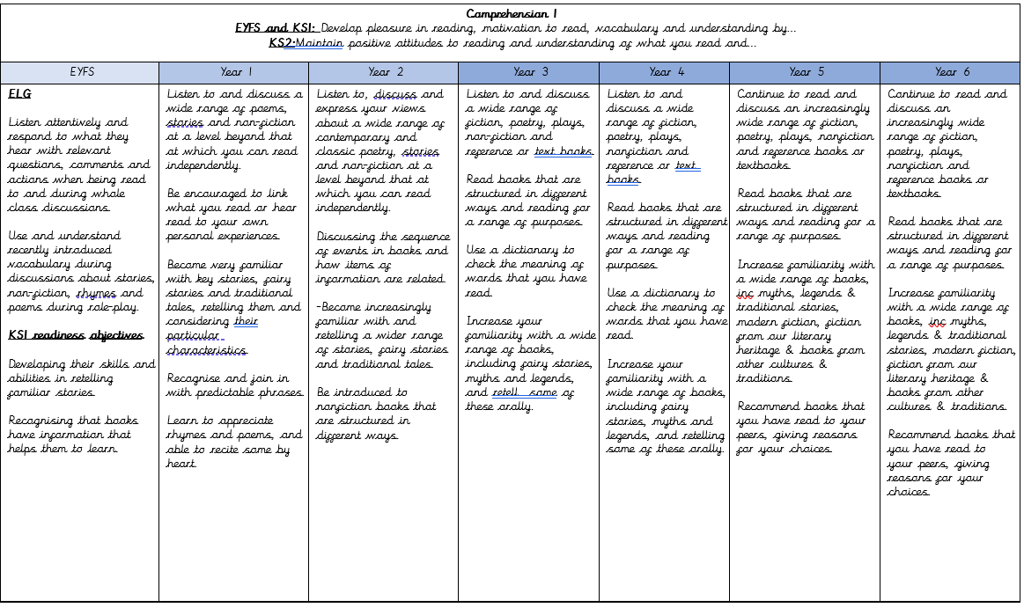
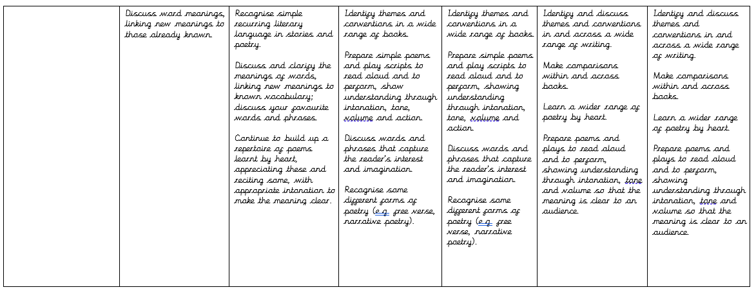
Progression of Skills
Comprehension Skills

Slide 29
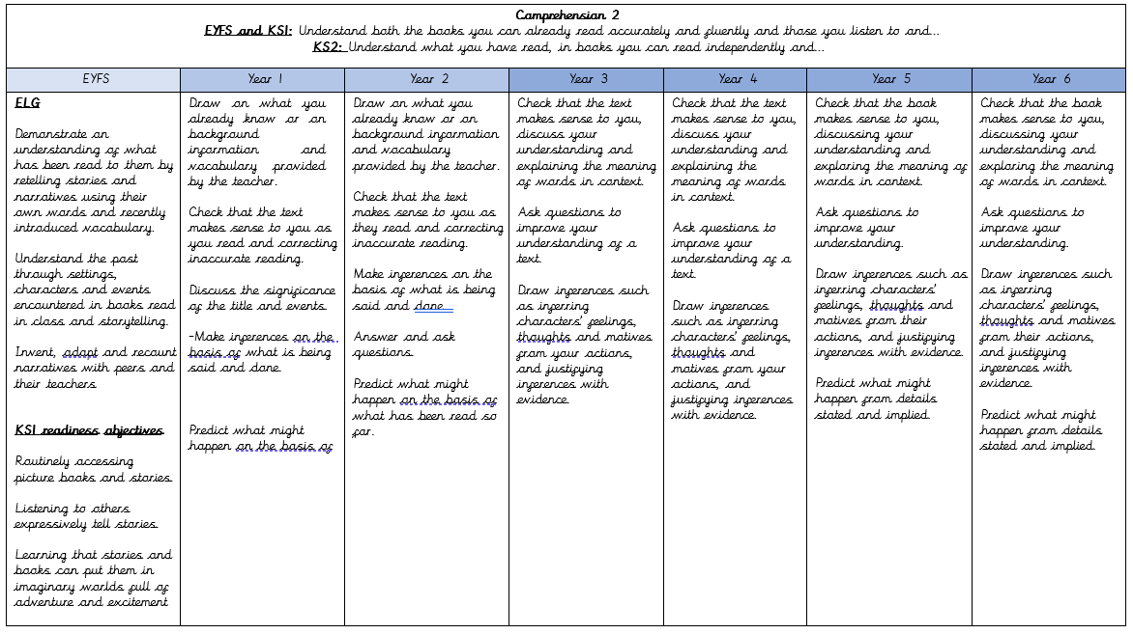
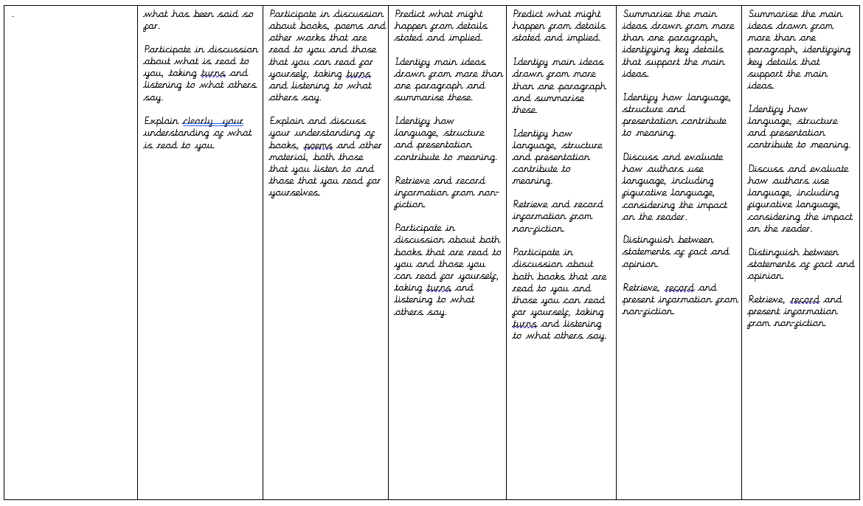
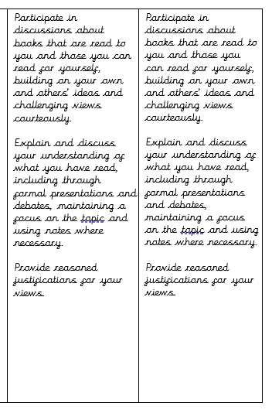
Progression of Skills
Comprehension Skills
Year 5 and 6

Slide 30

Assessment
Assessment is continuous through teacher judgements of phonics skills (supported by SoundsWrite diagnostic assessments and practice phonics screening tests) and the use of Accelerated Reader and Star Reader regular tests (after each reading book is completed).
Assessments are completed more formally each term through written comprehension papers and FFT fluency assessments to give standardised scores and reading/fluency ages to enable monitoring of progress.
KS2 staff use the ‘Simple View of Reading’ to assess children’s word recognition and comprehension skills.
For these children, particularly in Key Stage 2, we implement a targeted intervention strategy called Fred's Fluent in 5. This intervention, which aligns with our KS2 reading curriculum and approach, is designed to enhance reading fluency and comprehension skills. This daily practice helps improve their reading accuracy, speed, and understanding.
Children falling behind are also heard read daily with their read with Accelerated Reader books.

Slide 31
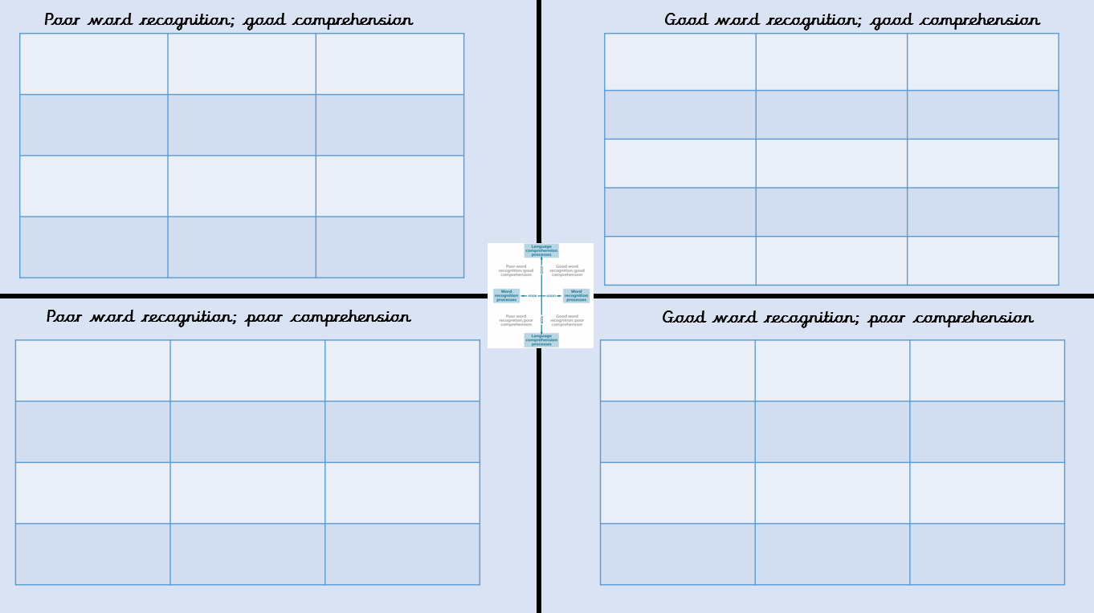
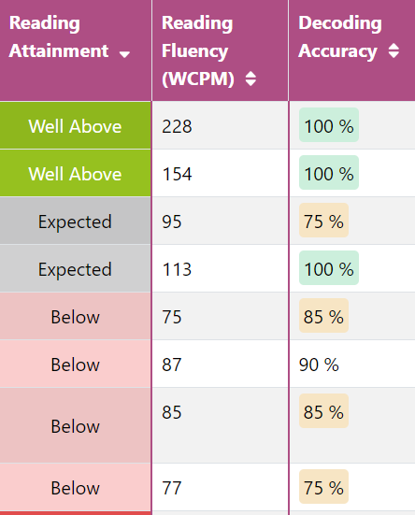
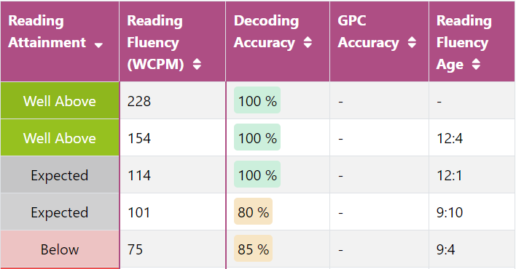
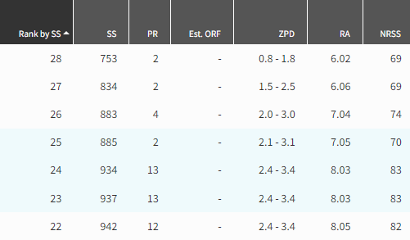
Assessment
Simple View of Reading
Use of FFT to identify key target groups
SEND
FSM Boys
Accelerated Reader
Informs ‘Bottom 20%’ intervention groupings and focus

Slide 32

Inclusion
Our reading curriculum is intentionally designed to be highly inclusive, with a strong emphasis on equality and diversity.
Diverse Text Selection: Our reading curriculum includes a wide range of texts that reflect diverse cultures, backgrounds, and experiences. This ensures that children from various backgrounds see themselves represented in the literature they read and fosters an inclusive learning environment.
Differentiated Instruction: We recognise that students have varying reading abilities. To cater to this diversity, our curriculum incorporates differentiated instruction techniques. This means that lessons are adapted to meet the unique needs of each child. Children with SEND receive additional support and accommodations as needed.
Adult Intervention: For children with SEND, adult intervention plays a crucial role. We work closely with SEND children to provide one-on-one or small-group support.
In-Class Fluency Activities: Our curriculum integrates in-class fluency activities that benefit all children, including those with SEND. These activities are designed to improve reading fluency, comprehension, and engagement.
Pre-Teaching: Prior to introducing a new text, we employ a pre-teaching approach for children with SEND. This involves preparing them for the content and vocabulary they will encounter. It may include introducing key concepts, discussing relevant background information, or teaching essential vocabulary. Pre-teaching ensures that all children can access and engage with the text.

