Slide 1


Subject Handbook
English

Slide 2

Our English Curriculum
Intent
At St. John the Baptist Catholic Primary School, our English curriculum is designed to develop children’s love of reading, writing and discussion and prepare our learners for life as successful, valuable and socially responsible citizens.
We inspire an appreciation of our rich and varied literary heritage and a habit of reading widely and often.
We nurture a culture where children take pride in their writing, can write clearly, imaginatively and accurately and adapt their language and style for a range of contexts.
We inspire children to be confident in the art of speaking and listening and to use discussion to communicate and further their learning in all areas of the curriculum.
We believe that children need to develop a secure knowledge-base in English, which follows a clear pathway of progression as they advance through the primary curriculum. our carefully sequenced, broad and balanced curriculum, underpinned by inclusive practice, aims to provide our children with the opportunity to build on their experiences in order to achieve their goals.
We believe that a secure basis in literacy skills is crucial to a high-quality education across the curriculum.

Slide 3

Our English Curriculum
Implementation
Our English curriculum is implemented using rich texts from the Literary Curriculum, chosen to enthuse and engage our children. Texts are carefully selected to link with the topics children are learning about and these are used as a springboard to inspire children to read and write.
Our English curriculum provides many purposeful opportunities for reading, writing and discussion, with children being given the opportunity to write in short-burst and ‘longer writes’, spanning a variety of genres, with a sharp focus on purpose and audience.
We aim for all of our children to be proficient readers, writers, spellers and speakers, who can transfer their English skills to other curriculum subjects.
Our English lessons develop pupils’ spoken language, reading, writing, grammar and vocabulary, teaching them how to write within specific genres and which structural and language features to include to be successful.
High-quality teaching and modelling of writing and thinking out loud are deployed as a bridge so the children can see inside an expert writer’s’ thought process and intent.
Lessons also focus on teaching specific spelling (through the SoundsWrite approach), grammar and punctuation skills, to enable our pupils to apply the skills they have been taught to their extended writing and writing across the curriculum.

Slide 4
Our English Curriculum
Impact
Children will leave St. John the Baptist Catholic Primary School as happy, confident learners who have developed a love of reading and writing with the key skills and knowledge necessary for the next stage of their learning. They will have high aspirations and be confident in the art of speaking and listening, able to successfully use discussion to communicate and further their learning.
We also have the following aims:
Pupils enjoy reading and writing across a range of genres.
Pupils enjoy reading regularly, for information and for enjoyment.
Pupils discuss books with excitement and interest.
Pupils enjoy writing and use the features of different genres and styles.
Pupils can confidently write for different purposes and audiences.
Pupils have a wide vocabulary that they use within their writing.
Pupils have a good knowledge of how to adapt their writing based on the context and audience.
Pupils leave primary school being able to apply spelling rules and patterns they have been taught.
Parents and carers will have a good understanding of how they can support pupils’ reading.
% of pupils working at ARE within each year group will be at least in line with national averages.
% of pupils working at Greater Depth within each year group will increase year-on-year.
There will be no significant gaps in the progress of different groups of pupils.

Slide 5

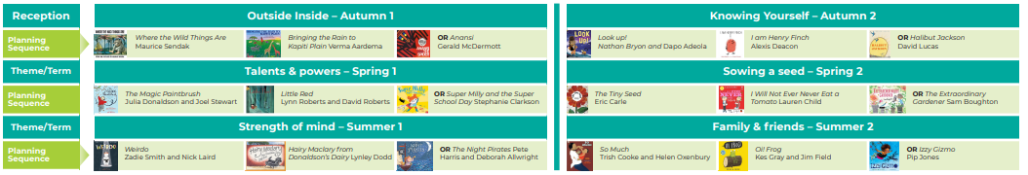
EYFS
Curriculum Overviews

Slide 6
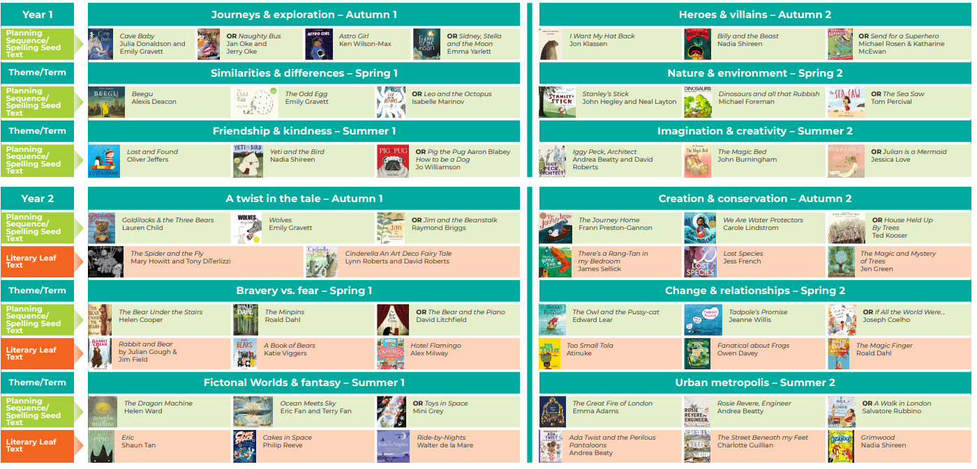
KS1
Curriculum Overviews

Slide 7
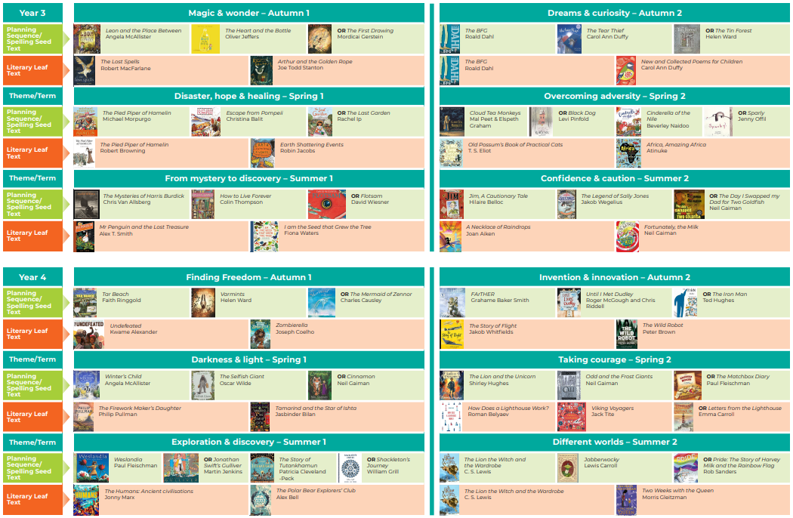
LKS2
Curriculum Overviews

Slide 8
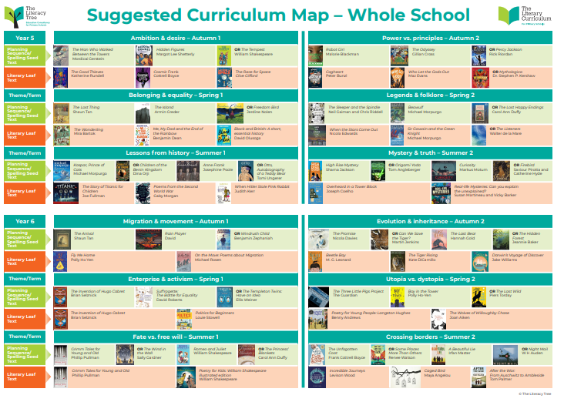
UKS2
Curriculum Overviews

Slide 9
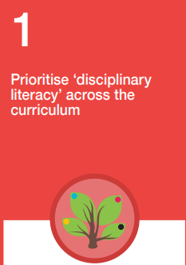
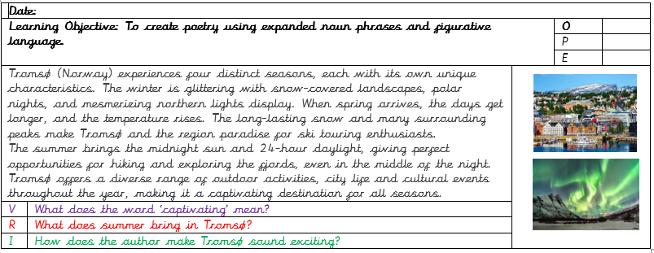
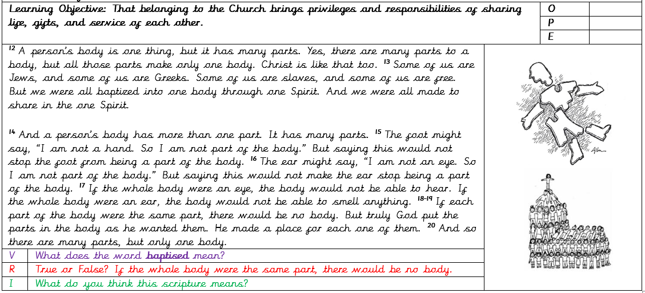
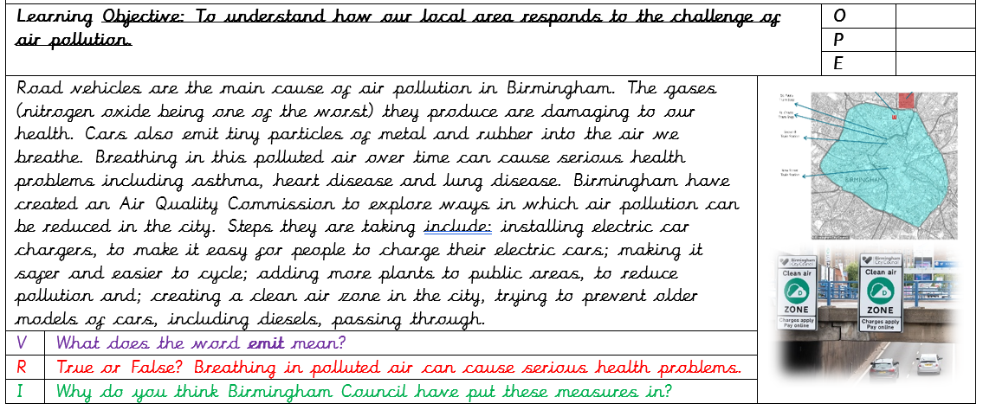
Disciplinary Reading

Slide 10
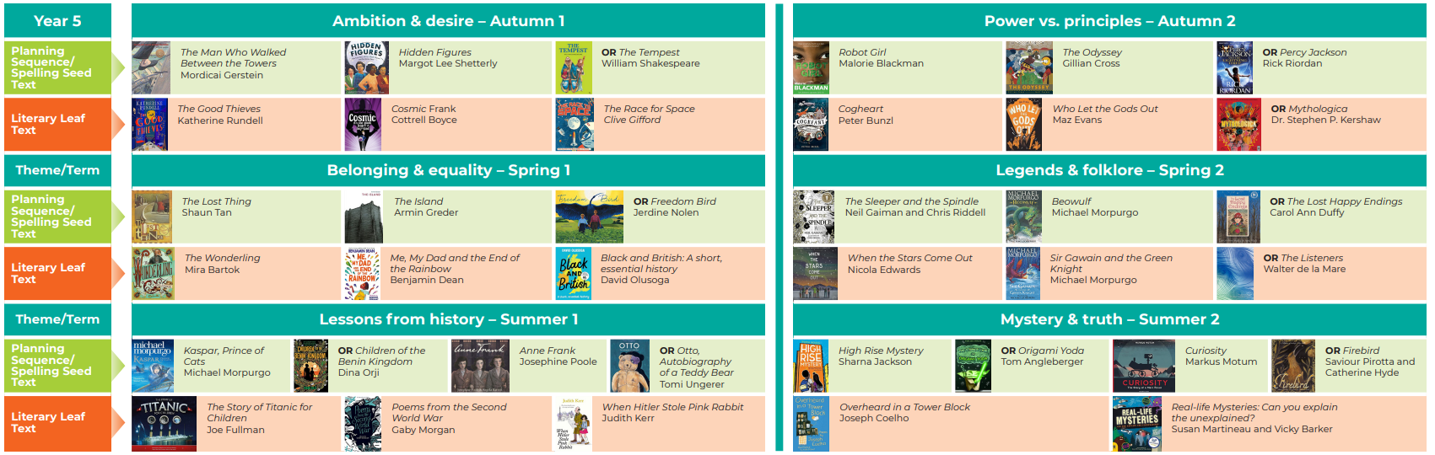
Cross-Curricular
Using our English Curriculum, teachers will seek to take advantage of opportunities to make cross-curricular links, providing children with a variety of fiction and non-fiction books which closely link to the theme. The English curriculum has been carefully planned and selected to ensure children are exposed to a range of high-quality literature that focuses on a diverse range of topics and themes. With these links in mind, teachers will plan for pupils to practise and apply the skills, knowledge and understanding acquired through Reading lessons to other areas of the curriculum. This may include teacher modelling and shared reading activities.
Black History Month
Supports pre-learning for Year 5 (Slavery)
Supporting
pre-learning for Year 6
(WW2 P)

Slide 11

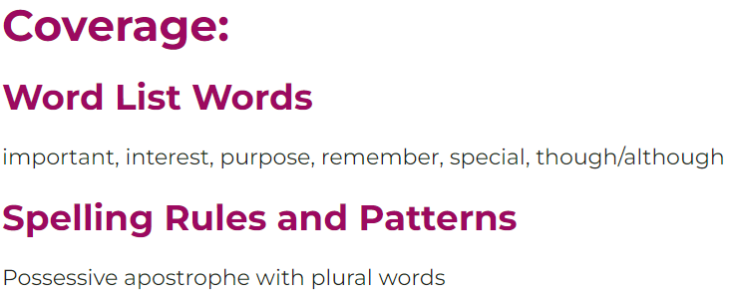
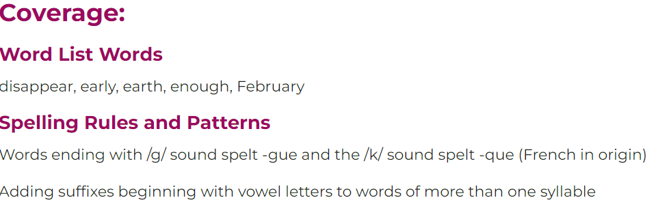
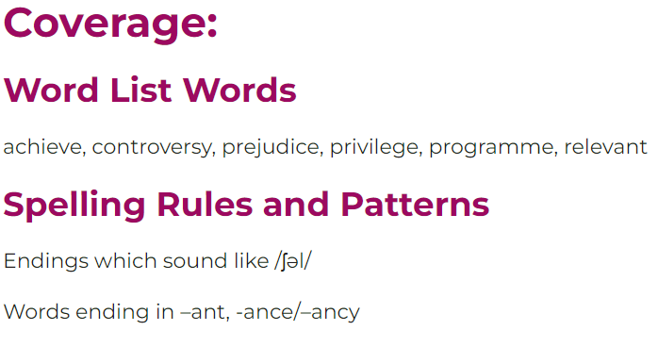
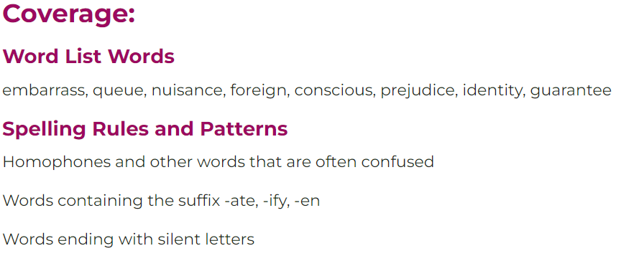
Vocabulary Progression
Year 3
Selection of Vocabulary
Year 4
Year 5
Year 6

Slide 12
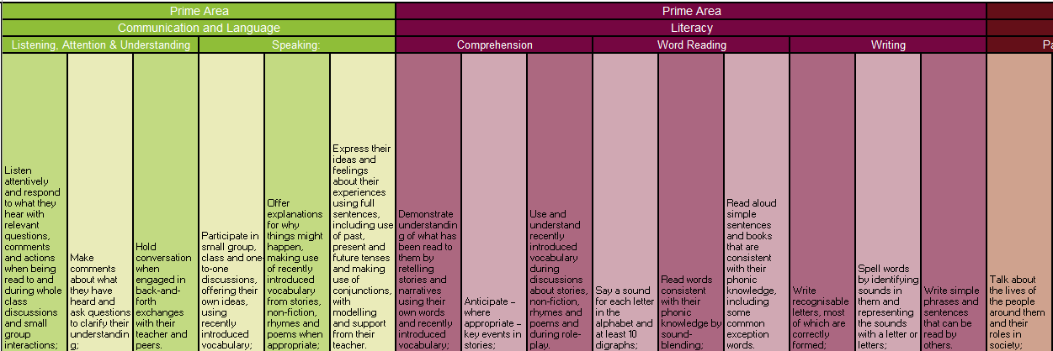
Progression of Skills
EYFS

Slide 13
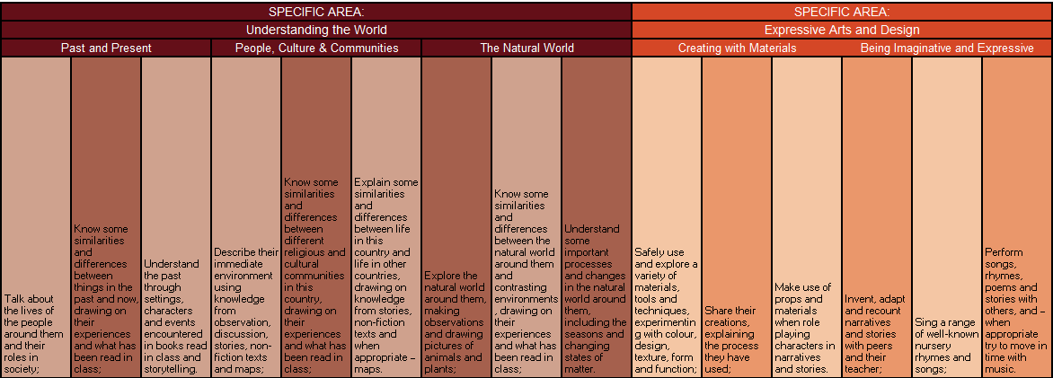
Progression of Skills
EYFS

Slide 14
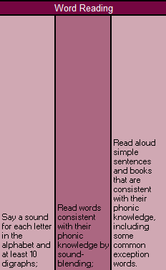
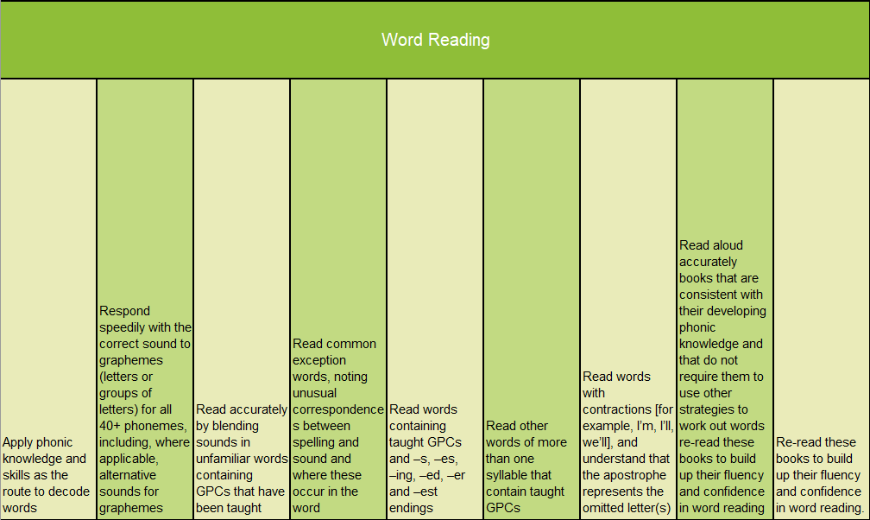
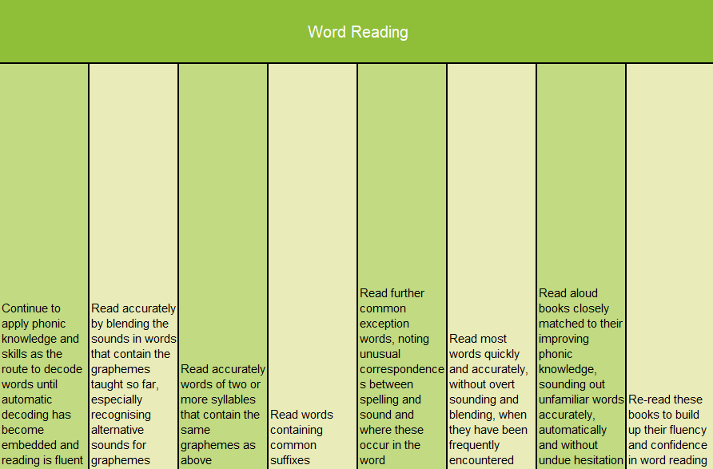
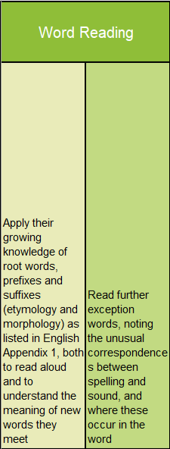
Progression of Skills
Word Reading
EYFS
Year 1
Year 2
Year 3-6

Slide 15
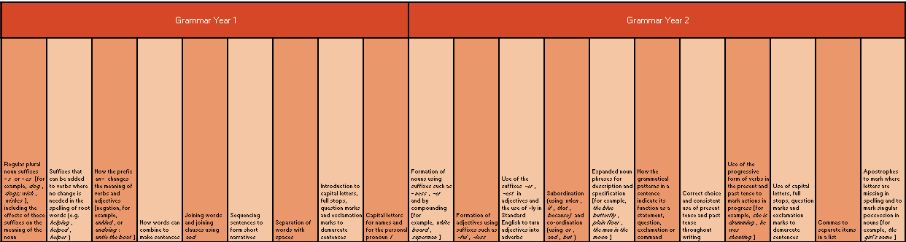
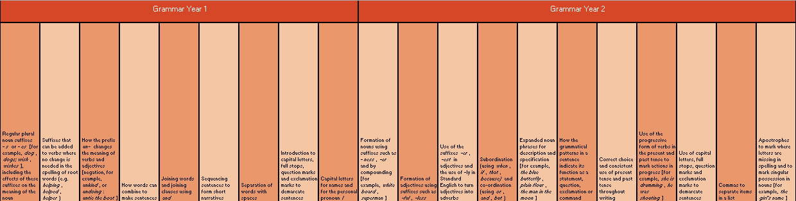
Progression of Skills
Grammar
Year 1
Year 2

Slide 16
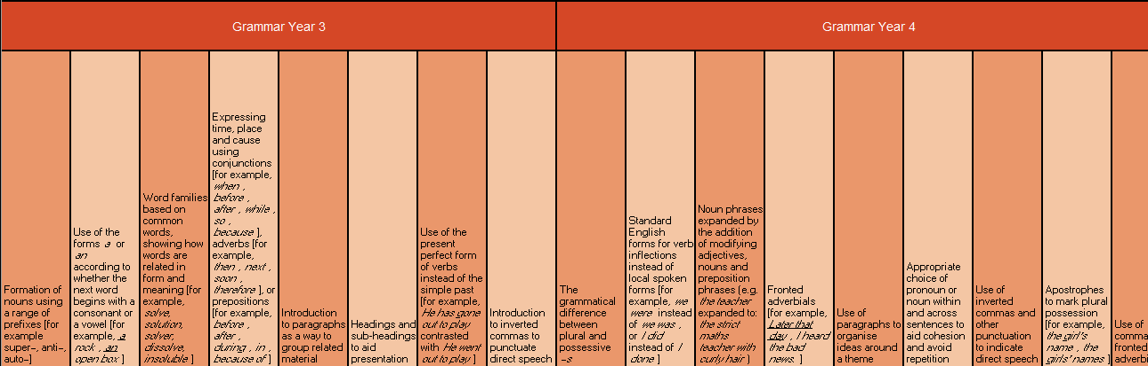
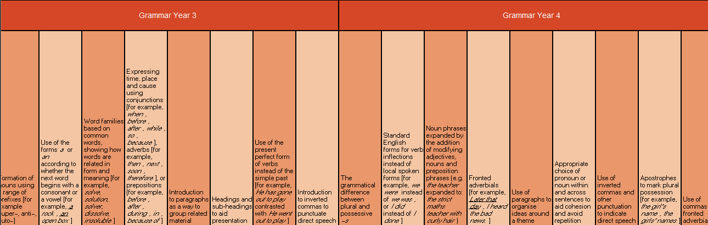
Progression of Skills
Grammar
Year 3
Year 4

Slide 17
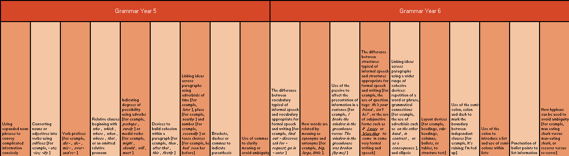
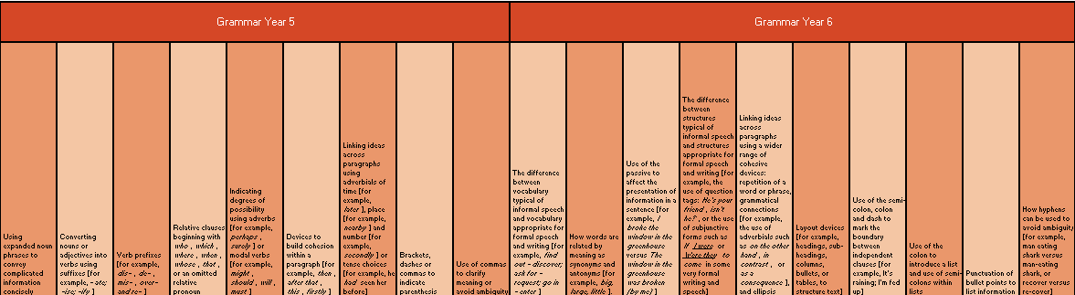
Progression of Skills
Grammar
Year 5
Year 6

Slide 18
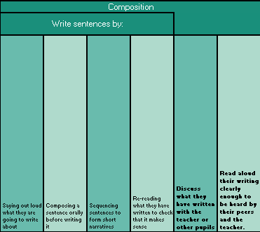
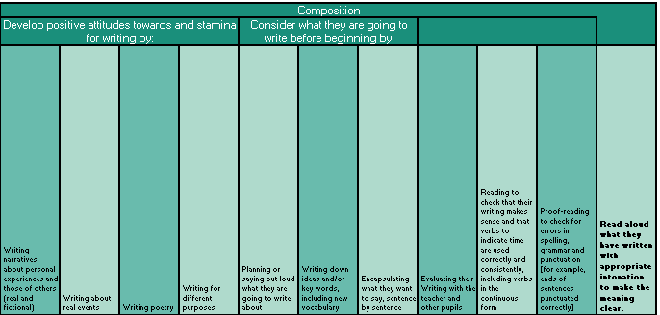
Progression of Skills
Composition
Year 1
Year 2

Slide 19
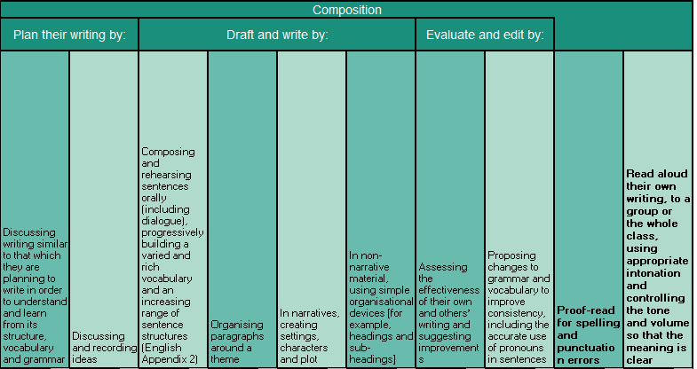
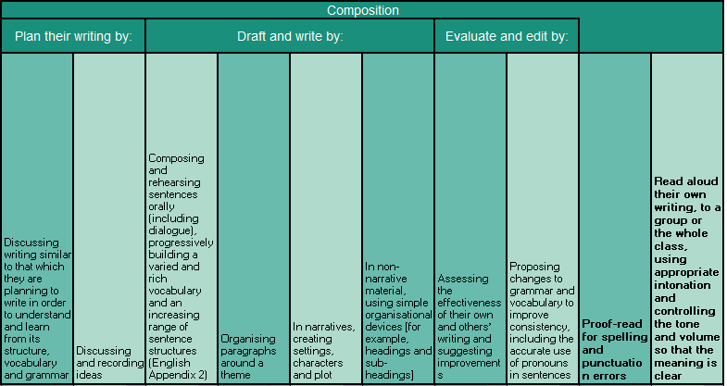
Progression of Skills
Composition
Year 3
Year 4

Slide 20
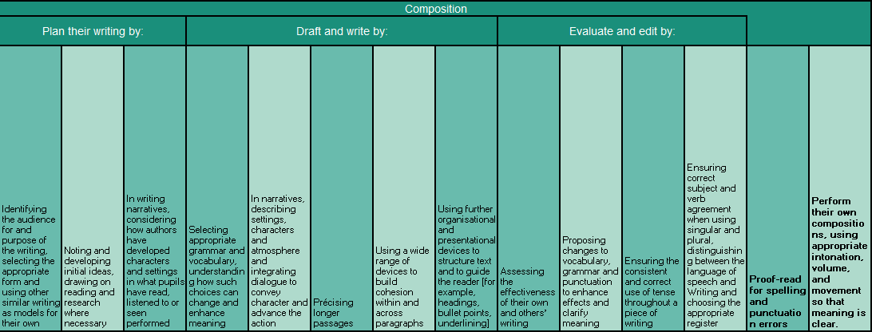
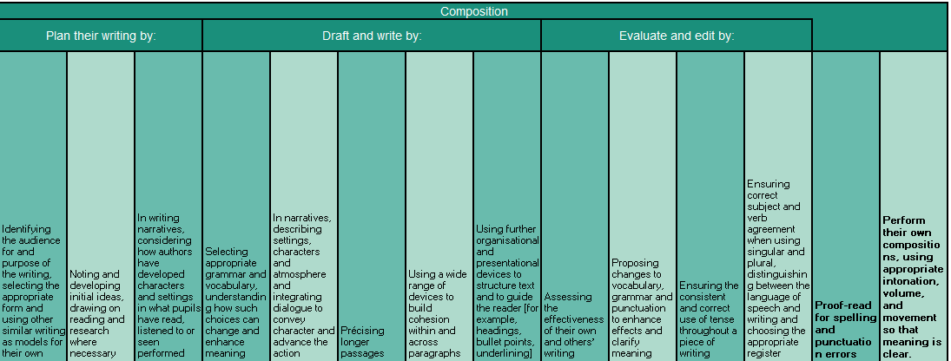
Progression of Skills
Composition
Year 5
Year 6

Slide 21
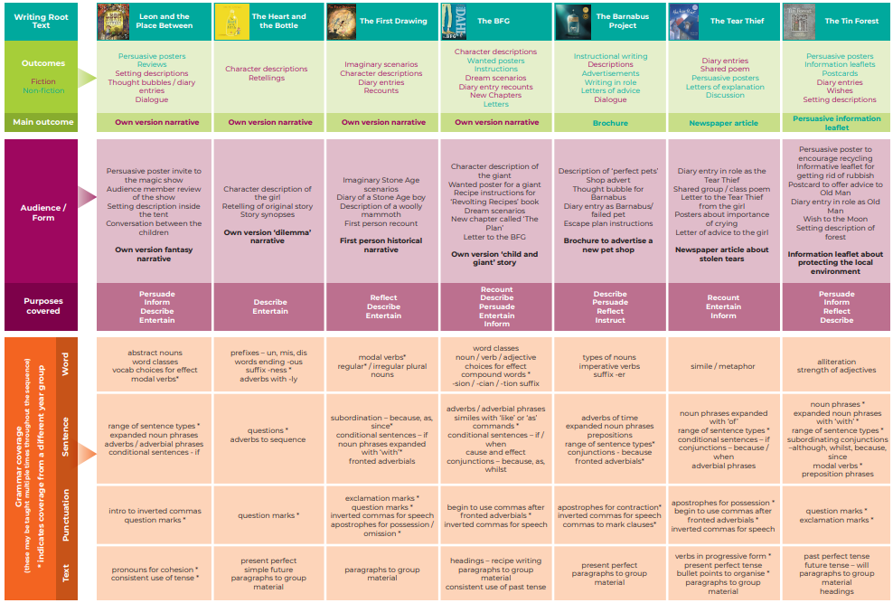
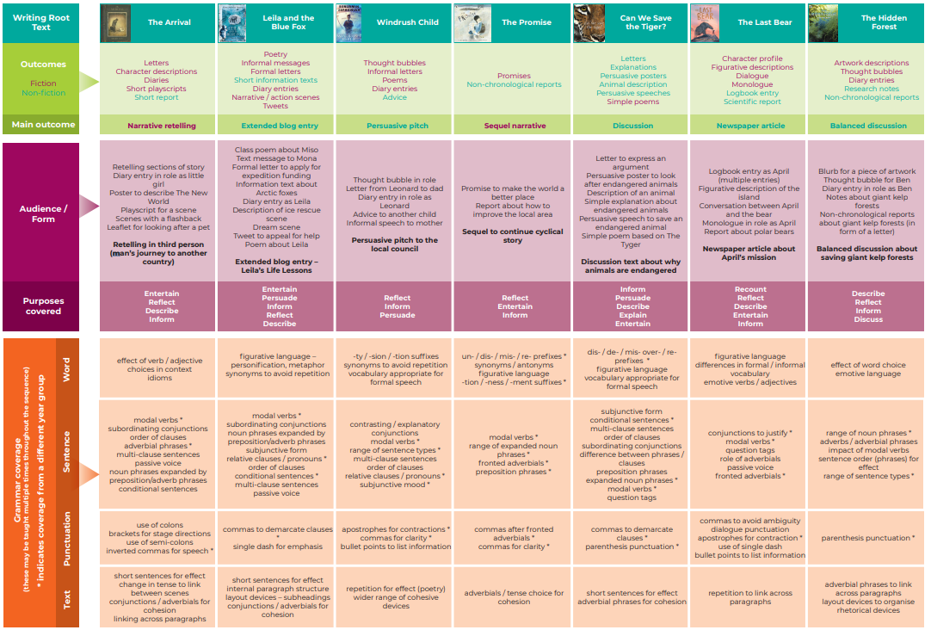
Coverage of Skills
Year 3
Year 6

Slide 22

Grammar Non-Negotiables

Slide 23
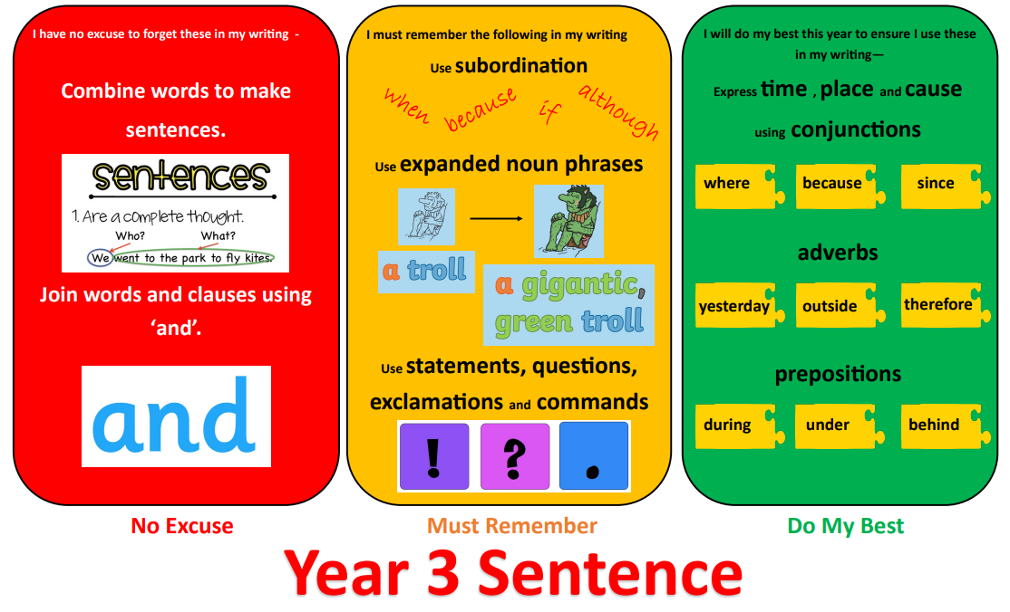
Grammar Non-Negotiables

Slide 24
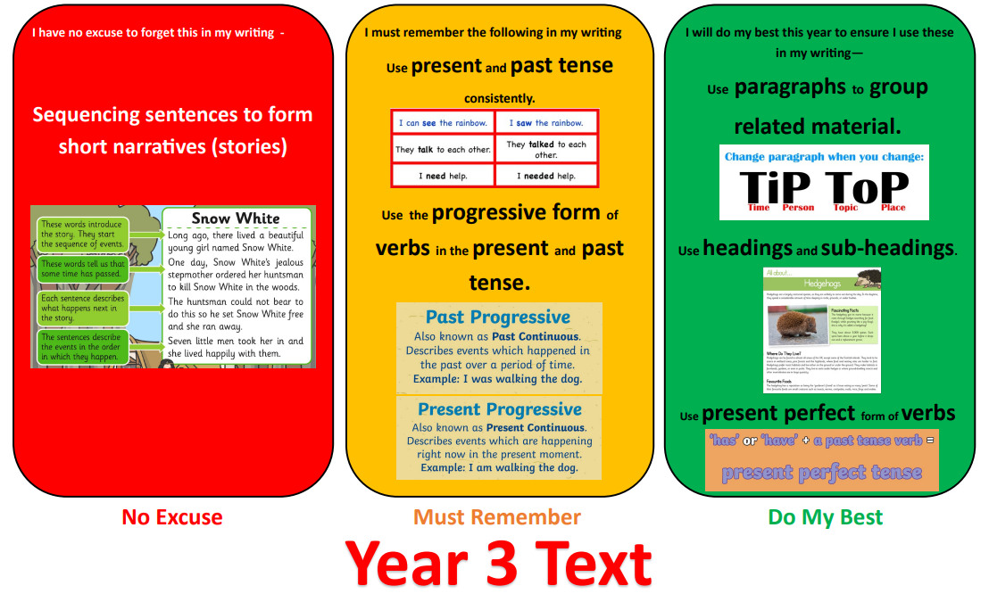
Grammar Non-Negotiables

Slide 25

Grammar Non-Negotiables

Slide 26
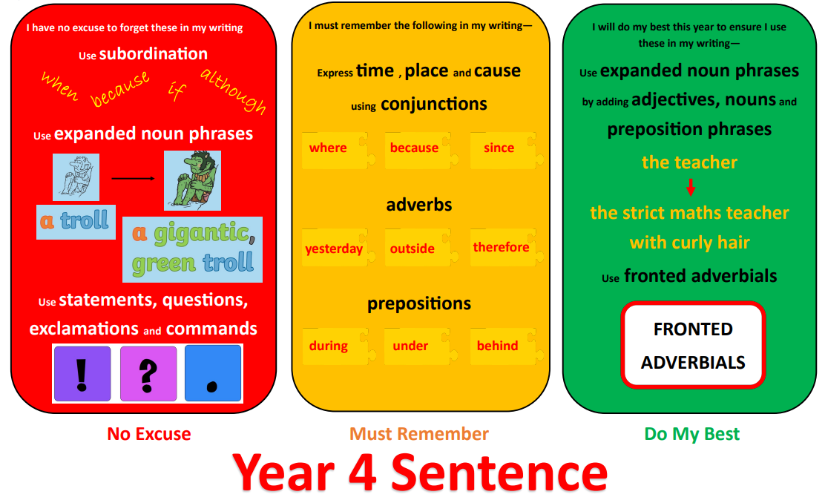
Grammar Non-Negotiables

Slide 27

Grammar Non-Negotiables

Slide 28
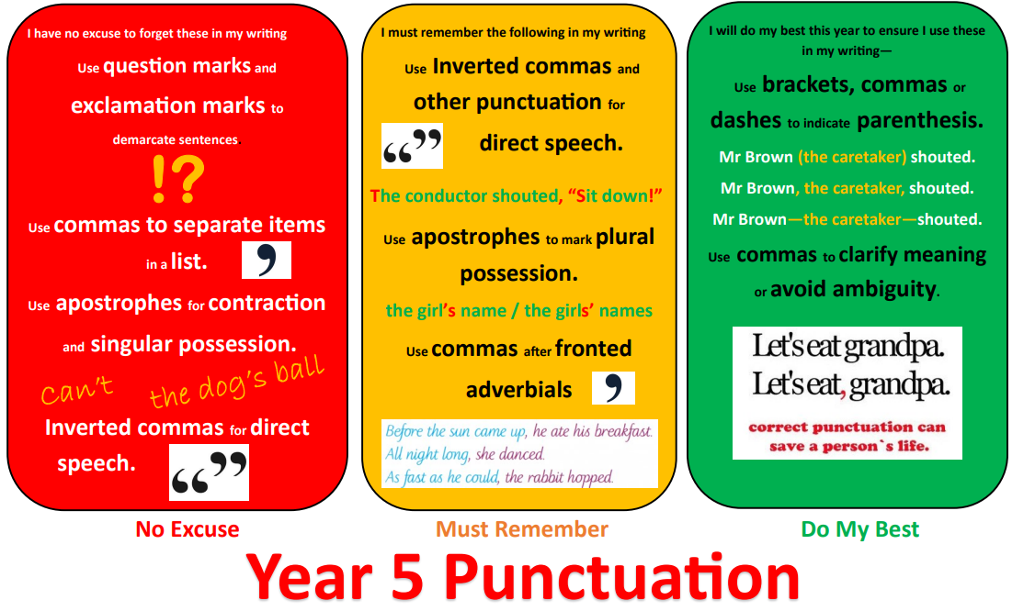
Grammar Non-Negotiables

Slide 29
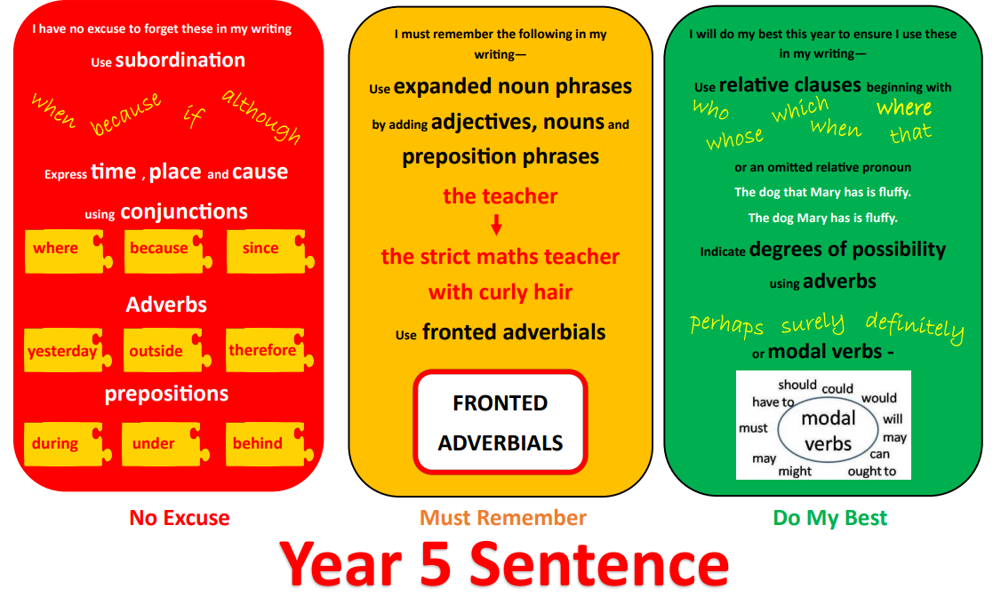
Grammar Non-Negotiables

Slide 30
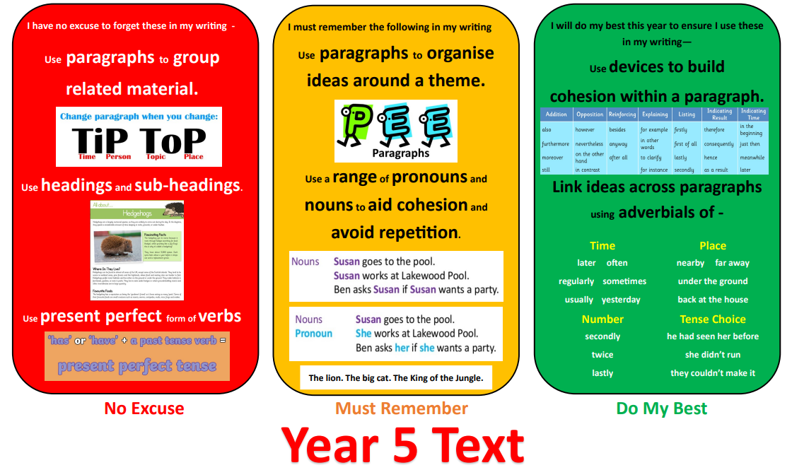
Grammar Non-Negotiables

Slide 31
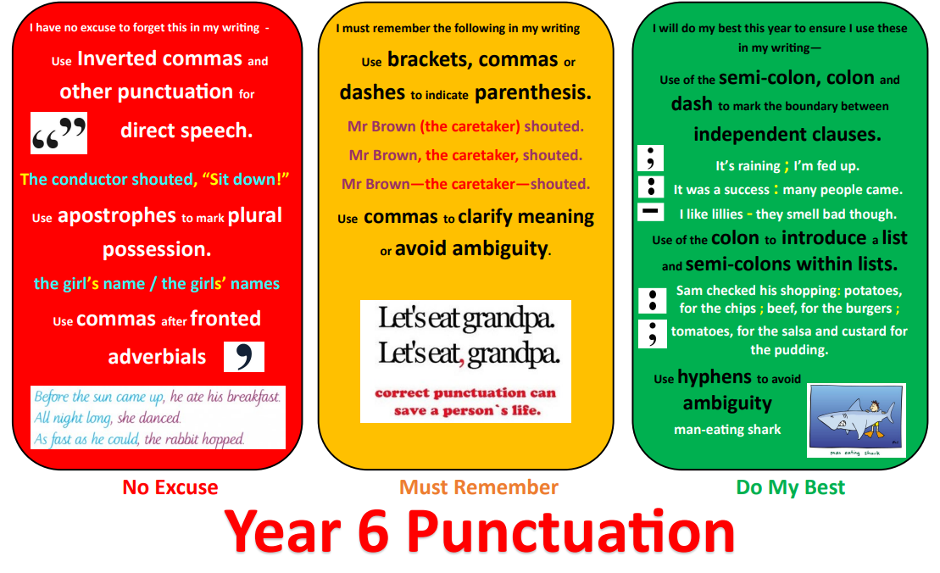
Grammar Non-Negotiables

Slide 32
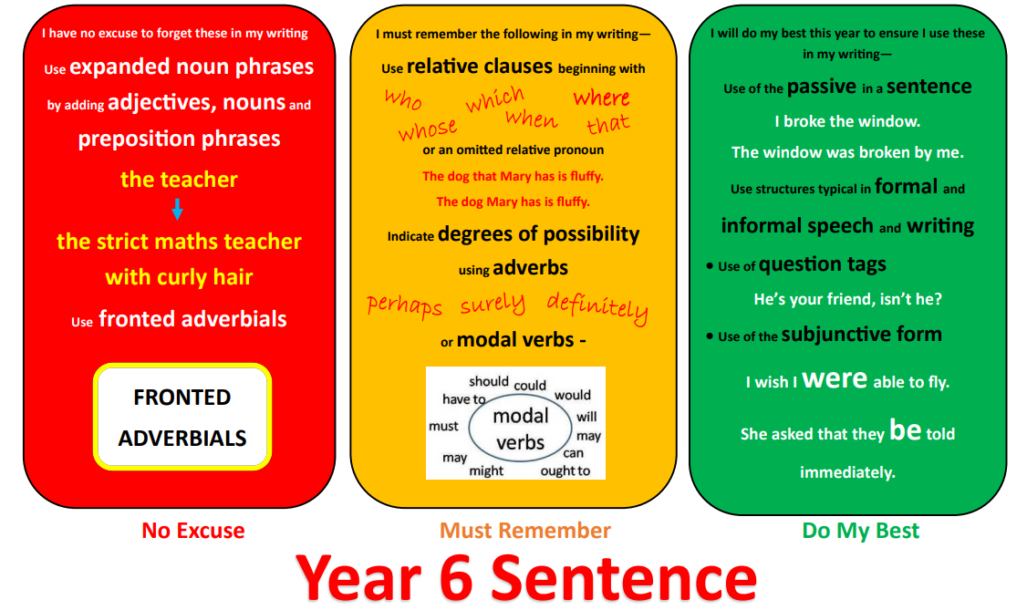
Grammar Non-Negotiables

Slide 33
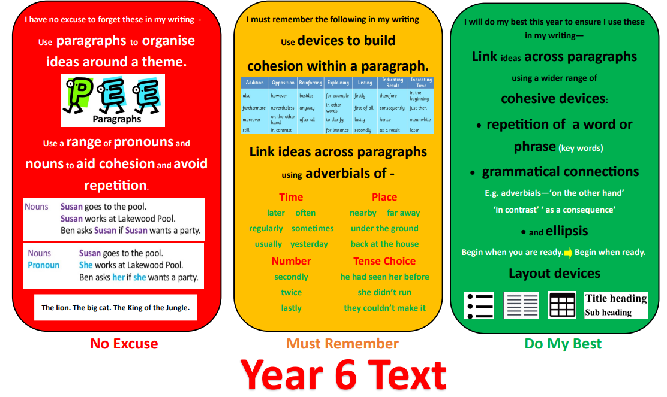
Grammar Non-Negotiables

Slide 34

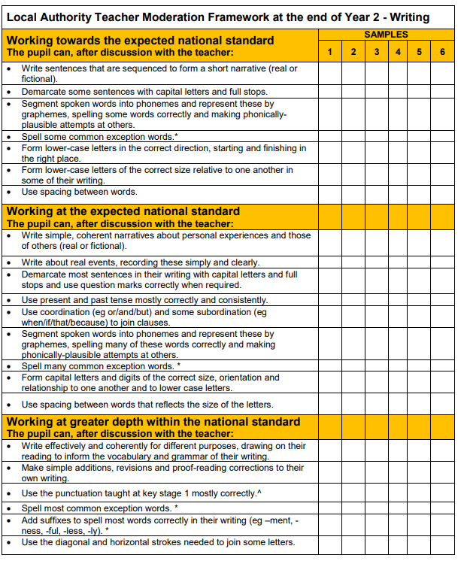
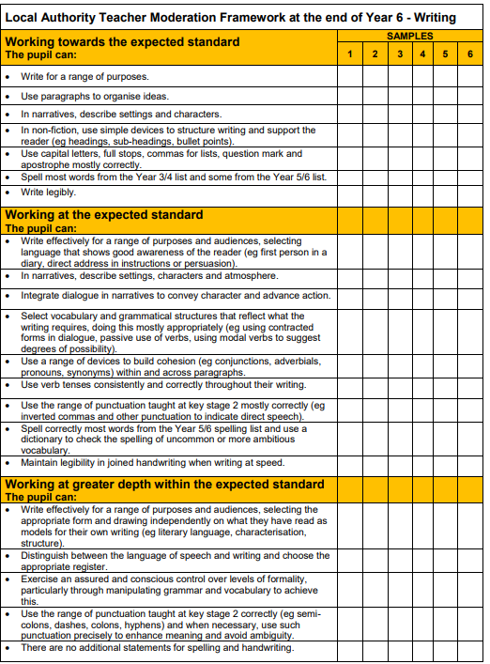
Assessment
Formative Assessment: Teachers use formative assessment strategies to gather ongoing information about students' writing skills. This will include observations, discussions, and analysis of students' written work. Teachers will provide regular, constructive feedback to support students' progress.
Summative Assessment: At the end of each term, teachers will use the end point TAFs to make a summative assessment of each student's writing abilities. This assessment will be based on a range of writing tasks completed throughout the term, including narrative and non-fiction writing.
Moderation: Moderation will be carried out within the school, across the MAC and across the borough to ensure consistency and accuracy of assessment. Teachers will participate in moderation meetings, where they will discuss and assess a sample of students' work in order to accept and challenge assessments against the TAFs.
Record-Keeping: Assessment data will be recorded using Family Fisher Trust. This will allow us to monitor individual progress, track trends, and identify any areas where additional intervention may be required. Assessment records will be securely maintained and regularly reviewed.

Slide 35

Inclusion
Collaborative Learning: Collaborative learning activities, including Kagan structures, are embedded across English lessons. This enables students to learn from and with their peers, develop their communication and oracy skills, and benefit from the diverse experiences and perspectives within the classroom.
Use of Assistive Technology: We make effective use of assistive technology to support students with SEND, including text-to-speech software for reading support, voice recognition software for writing, and interactive whiteboards to enhance classroom engagement. This ensures that all students can access the curriculum and contribute to their learning.
Varied Resources: Teachers use a wide range of resources, including books, e-books, audio materials, visual aids, and online platforms to cater to different learning styles and abilities. This enables students to engage with literature and language in varied and meaningful ways, promoting inclusion and addressing individual needs.
Assessment for Learning: Regular formative assessment is embedded in English lessons to identify the strengths and areas for development of each student. Teachers provide timely feedback, set targets, and encourage self-reflection.
Cultural Diversity: Our English curriculum reflects the diverse cultures and backgrounds of the world. We incorporate diverse texts and use literature to explore different perspectives, challenge stereotypes, and celebrate the richness of our multicultural society. This promotes inclusivity, fosters empathy, and encourages tolerance and mutual respect.

