Slide 1


Subject Handbook
Music

Slide 2

Our Music Curriculum
Intent
At St John the Baptist Primary School, our music curriculum intends to inspire creativity, self-expression and encourages our children on their musical journeys as well as giving them opportunities to connect with others. We hope to foster a life- long love of music by exposing them to diverse musical experiences and igniting a passion for music. By listening and responding to different musical styles, finding their voices as singers and performers and as composers, all will enable them to become confident, reflective musicians. ‘Music is a universal language that embodies one of the highest forms of creativity’ (The National Curriculum)
The aims of our Music curriculum are to develop pupils who:
Can sing and use their voices individually and in a group
Create and compose music on their own and with others
Have opportunities to learn a musical instrument (Y5 and Y6)
Understand and explore how music is created, produced and communicated
Listen to, review and evaluate the work of great composers and musicians from a range of historical periods, genres, styles and traditions
Enjoy and have an appreciation of a range of different musical styles e.g. Classical, Jazz, Hip Hop, Pop, Rock etc.
Use and understand musical language and include musical features in their own work
Make judgements about the quality of music
Have opportunities to play a variety of instruments
Have different opportunities to take part in performances

Slide 3
Our Music Curriculum
Implementation
The music curriculum ensures students sing, listen, play, perform and evaluate. This is embedded in classroom activities as well as weekly singing assemblies, various concerts and performances, the learning of instruments, and the joining of musical ensembles. The elements of music are taught in classroom lessons so that children are able to use the language of music to discuss it, and understand how it is made, played, appreciated and analysed. In the classroom students learn how to play various un-tuned and tuned percussion instruments. In doing so, they understand the different principles of creating notes, as well as how to devise and read their own musical scores and basic music notation. They also learn how to compose focusing on different dimensions of music, which in turn feeds their understanding when listening, playing, or analysing music. Composing or performing using body percussion, vocal sounds and technology is also part of the curriculum, which develops the understanding of musical elements without the added complexity of an instrument.

Slide 4
Our Music Curriculum
Impact
Whilst in school, children have opportunities to discover areas of strength, as well as areas they might like to improve upon. The integral nature of music and the learner creates an enormously rich palette from which a child may access fundamental abilities such as: achievement, self-confidence, interaction with and awareness of others, and self-reflection. Music will also develop an understanding of culture and history, both in relation to students individually, as well as ethnicities from across the world. Children are able to enjoy music, in as many ways as they choose - either as listener, creator or performer. They can discuss music and comprehend its parts. They can sing, feel a pulse, add rhythms and create melodies in a group; they can then further develop these skills in the future and continue to enjoy and embrace music in their lives. Musical teaching and learning is not linear. The strands of musical learning, presented within the lesson plans are part of the learning spiral. Over time, children can both develop new musical skills and concepts, and re-visit established musical skills and concepts. A “plan-do-check-review” approach is used with teachers making judgements against National criteria after each unit of work.

Slide 5

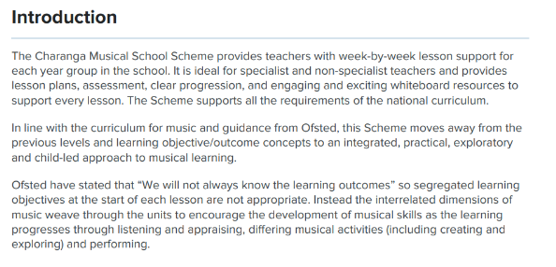
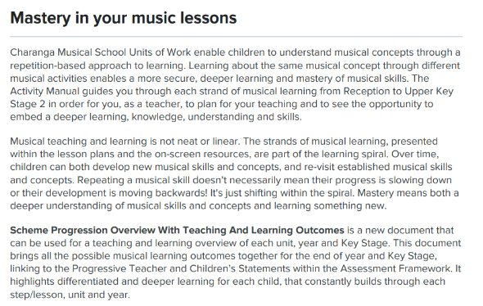

Curriculum Rationale

Slide 6

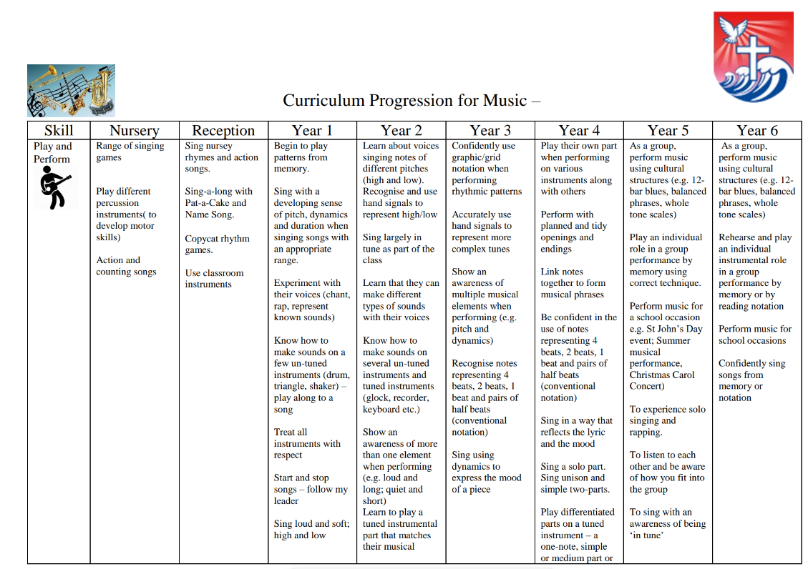
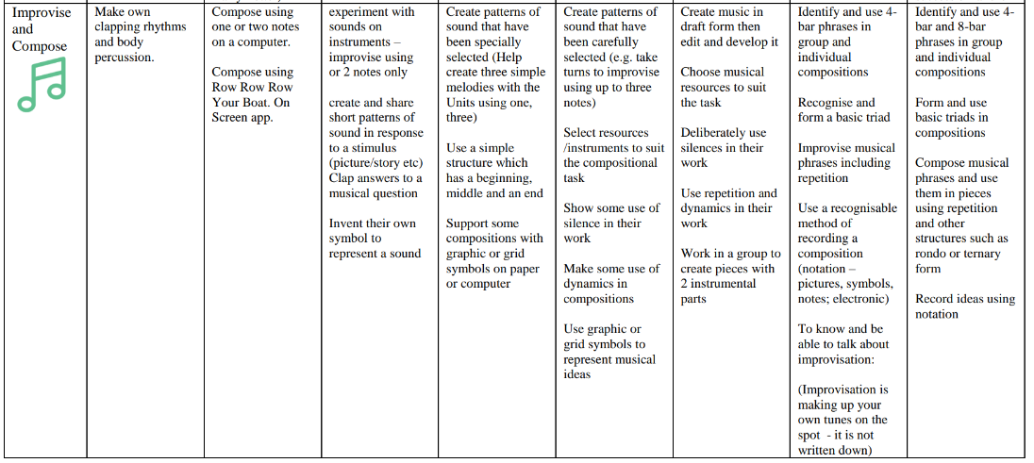
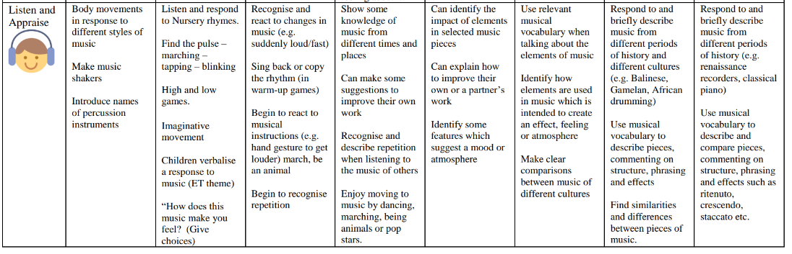
Progression of Skills

Slide 7
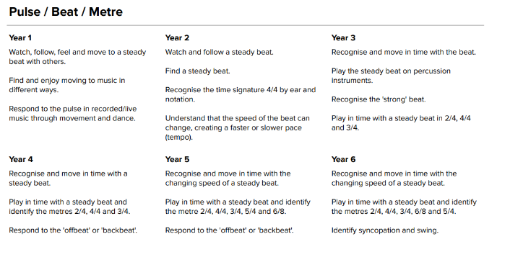
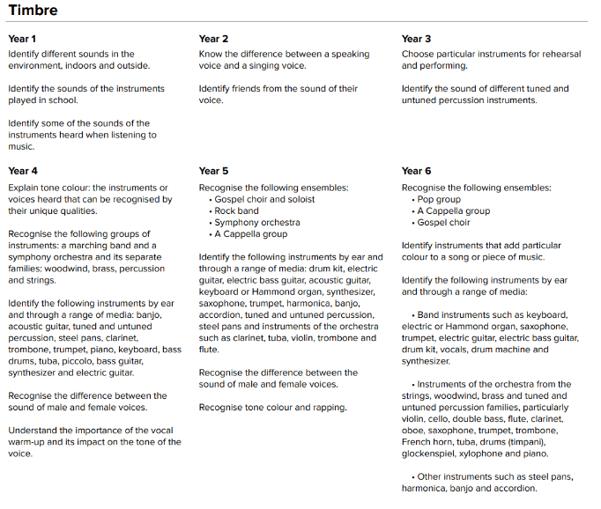
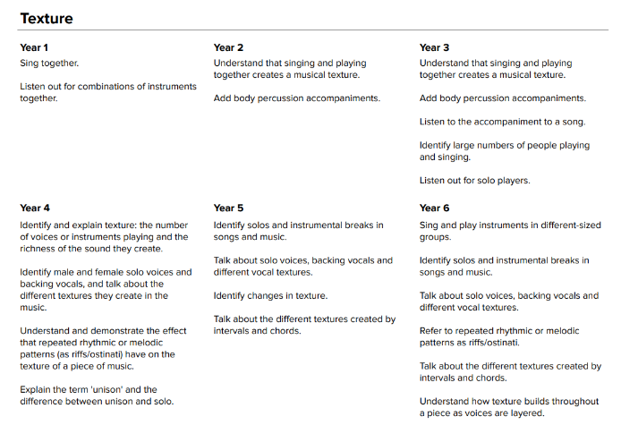
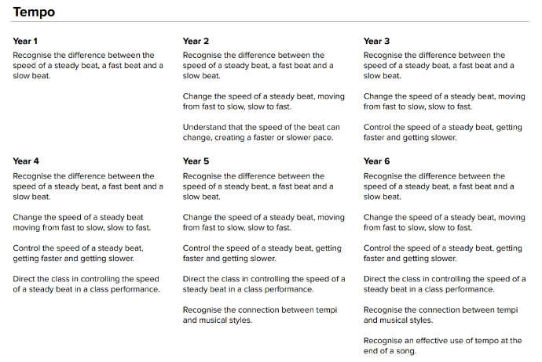
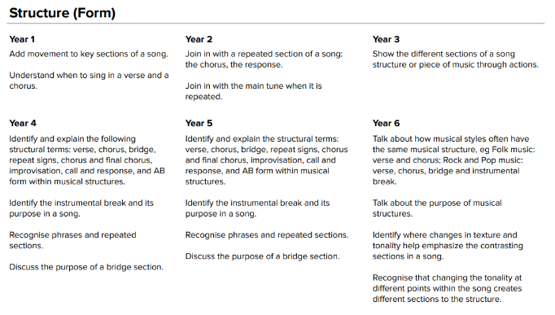
Progression of Elements

Slide 8
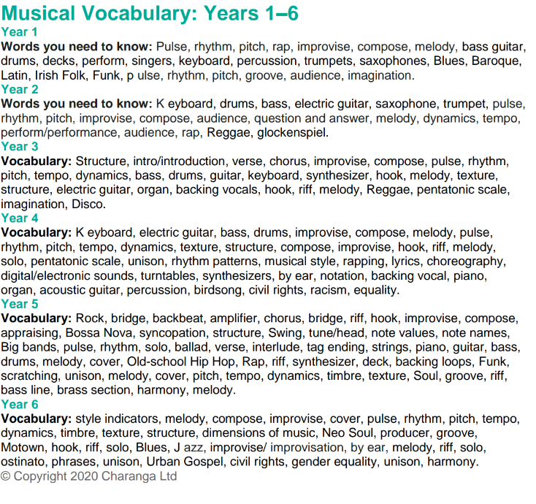
Progression of Vocabulary

Slide 9

Assessment
Musical teaching and learning is not linear. The strands of musical learning, presented within the lesson plans are part of the learning spiral. Over time, children can both develop new musical skills and concepts, and re-visit established musical skills and concepts. A “plan-do-check-review” approach is used with teachers making judgements against national criteria after each unit of work.

Slide 10

Inclusion
Explicit instruction - step-by-step modelling of what we want children to do, chunking the content and introducing new material in small steps
Cognitive and metacognitive strategies – opportunity to recall information to transfer it to our long-term memory
Scaffolding – pre-teaching, visual, verbal, written
Visual scaffolds may support a pupil to know what equipment they need, the steps they need to take, what their work should look like, an aid to access teaching and learning
Verbal scaffolds may involve re teaching a tricky concept to a group of pupils, or using questioning to identify and address any misconceptions
Written scaffolds will be provided for a pupil to support them with an independent written task. It could be notes made on a whiteboard during a discussion, a word bank, a sentence starter, a writing frame, it could even be the child’s own previous work used to support their recall.
Scaffolds provide temporary assistance to pupils so they can successfully complete tasks that they cannot yet do independently. We use scaffolds flexibly, evaluate their effectiveness and gradually remove them once they are no longer needed.
Flexible grouping - peer tutoring, Kagan grouping, flexible grouping
Assistive technology – to support delivery and recording of work
Rosenshine’s Principles of instruction:
Begin a lesson with a short review of previous learning
Present new material in small steps with pupil practice
Ask questions and check responses
Provide models
Guide pupil practice, provide scaffolding and support
Encourage independent practice and check pupil understanding
All children receive a high quality and ambitious education
All learners have access to the same academic opportunities by offering a stimulating and ambitious curriculum, adjusted to the needs of pupils with SEND, so that they are able to reach their full potential
It is vital that our children are equipped with the tools needed to become independent learners
Our curriculum will ensure that all pupils gain a greater understanding of how they learn and the skills of resilience, collaboration, participation, investigation, thinking, creativity, motivation and reflection
We provide an accessible learning environment which is tailored to the individual needs of all pupils
Pupils are supported by adults following a cycle of assess, plan, do, review, making necessary adjustments to the curriculum to meet the needs of all pupils
All learners are respected and acknowledged for their personal contribution

