Slide 1


Subject Handbook
Modern Foreign Languages

Slide 2


Our MFL Curriculum
Intent
St. John the Baptist Catholic Primary School uses the Language Angels scheme of work and resources to ensure we offer a relevant and broad foreign languages curriculum that will inspire and excite our pupils using a wide variety of topics and themes. All pupils are expected to achieve their full potential by encouraging high expectations and excellent standards in their foreign language learning.
The intent is that all pupils will develop a genuine interest and positive curiosity about foreign languages, finding them enjoyable and stimulating. Learning a second language will also offer pupils the opportunity to develop a deeper understanding of other cultures and the world around them with a better awareness of self, others and cultural differences. The intention is that they will be working towards becoming life-long language learners.
The four key language learning skills; listening, speaking, reading and writing will be taught and all necessary grammar will be covered in an age-appropriate way across KS2. This will enable pupils to use and apply their learning in a variety of contexts, laying down solid foundations for future language learning.

Slide 3
Our MFL Curriculum
Implementation
All KS2 classes have access to a high-quality foreign languages curriculum using the Language Angels scheme of work and resources. This will progressively develop pupil skills in foreign languages through regularly taught and well-planned lessons taught by class teachers.
Children will progressively acquire, use and apply a growing bank of vocabulary, language skills and grammatical knowledge organised around age-appropriate topics and themes.
Language Angels units are organised so that they offer the appropriate level of challenge and stretch for the children.
Early Language units are entry level units and are most appropriate for Year 3 pupils or pupils with little or no previous foreign language learning. Intermediate units (for Year 4-5 pupils) increase the level of challenge by increasing the amount and complexity of the foreign language presented to pupils. Progressive and Creative Curriculum units are the most challenging units and are suitable for Year 6 pupils or pupils with a good understanding of the basics of the language they are learning.
Units, where possible and appropriate, will be linked to class topics and cross curricular themes. Children will build on previous knowledge gradually as their foreign language lessons continue to revisit and consolidate previously learnt language. Pupil learning and progression will be assessed at regular intervals in line with school policy.

Slide 4
Our MFL Curriculum
Impact
As well as each subsequent lesson within a unit being progressive, the teaching type organisation of Language Angels units also provides progressive learning and challenge. Units increase in level of challenge and linguistic and grammatical complexity as pupils move from Early Learning units through Intermediate units and into the Progressive units.
Pupils will continuously build on their previous knowledge as they progress in their foreign language learning journey through KS2. Previous language will be revisited and consolidated whenever possible and appropriate.
Teachers will use the planning documents provided to ensure that they know what to teach and how to teach it in each lesson, across whole units and across each scholastic term.
The opportunity to assess pupil learning and progression in the key language skills is provided at the end of each 6-week teaching unit. This information will be recorded and will be monitored by the Foreign Language Subject Leader who can use this data to ensure teaching is targeted and appropriate for each pupil and year group as well as to feedback on progress to SLT. Teachers record, analyse and access this data using the Tracking and Progression Tool that monitors school, class and individual progress in the foreign language.
Children are expected to make good or better than good progress in their foreign language learning.

Slide 5


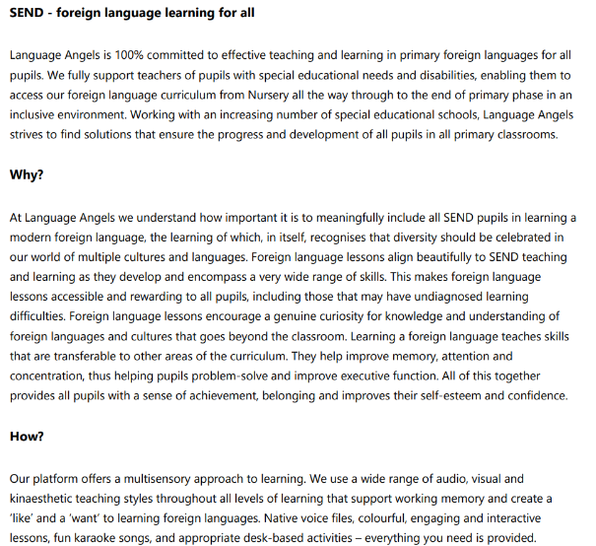
Curriculum Rationale

Slide 6
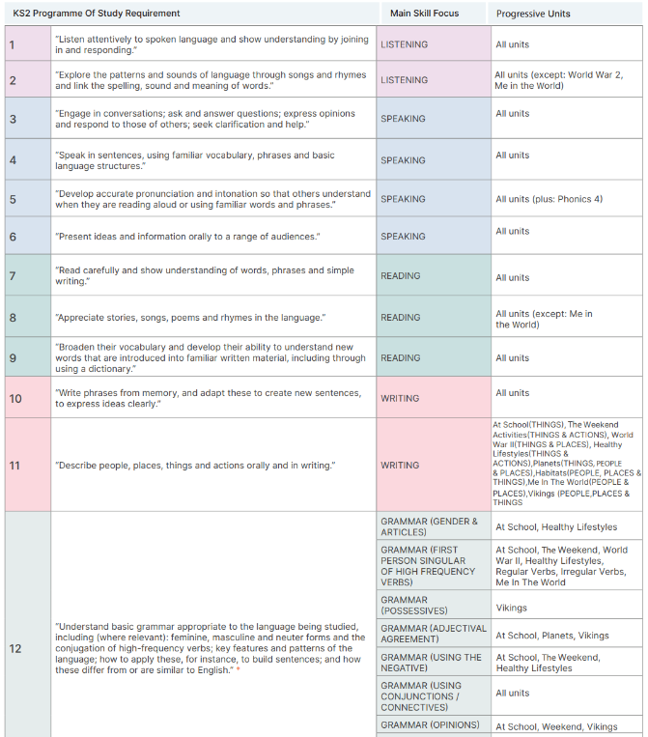
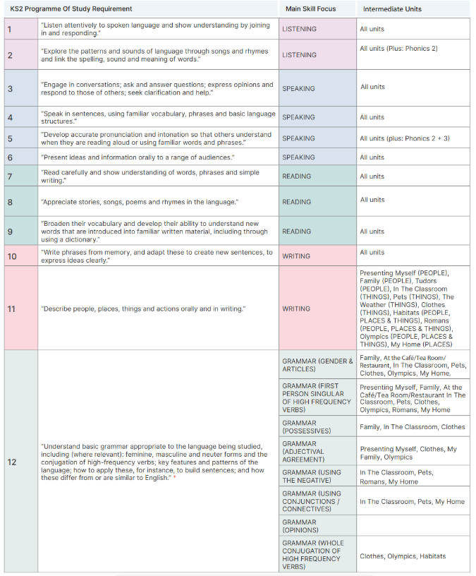
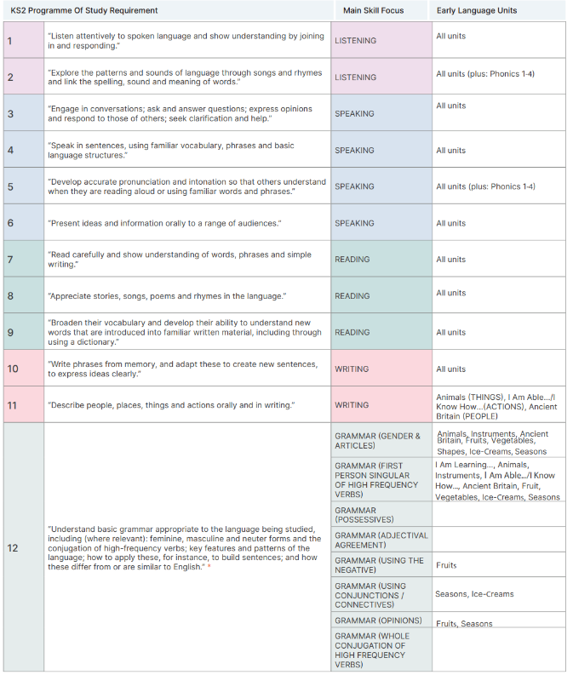
Curriculum Overview

Slide 7
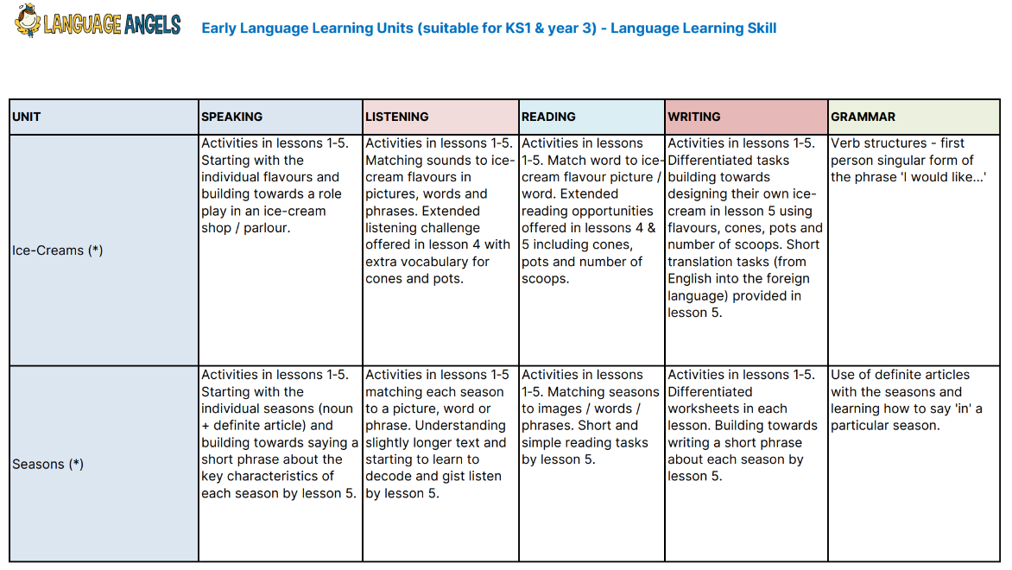
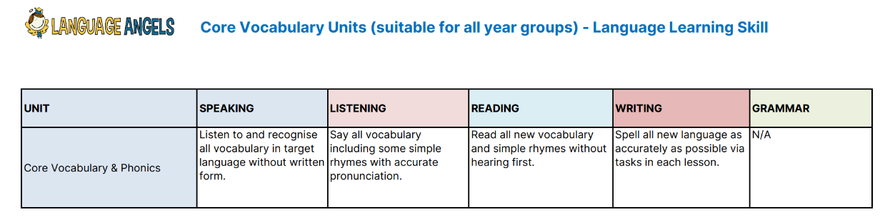
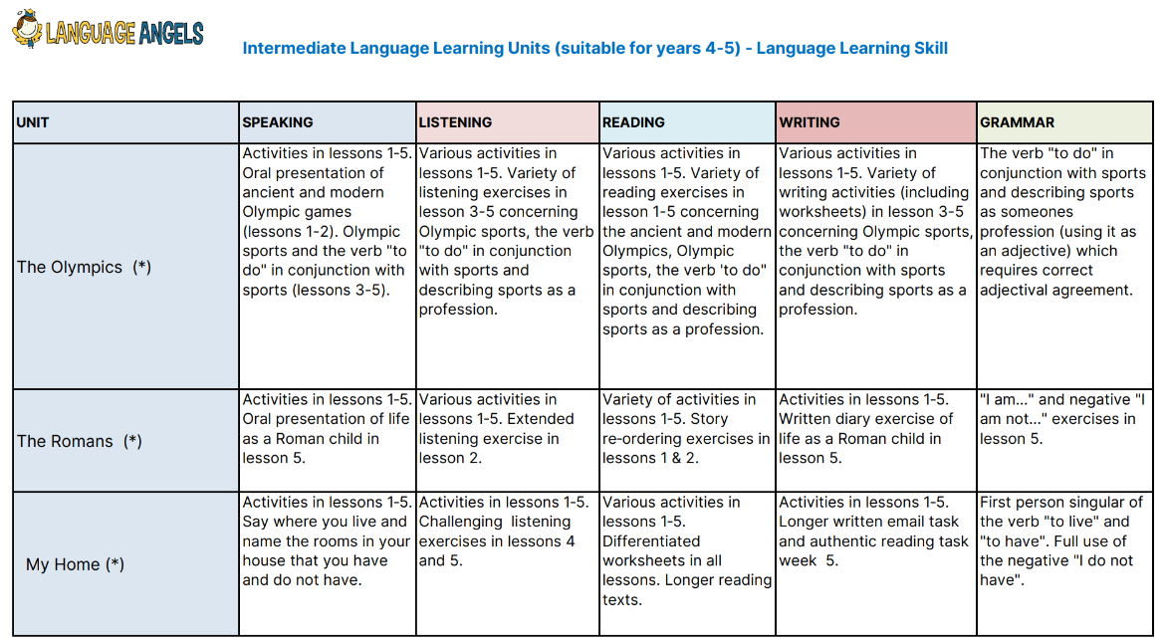
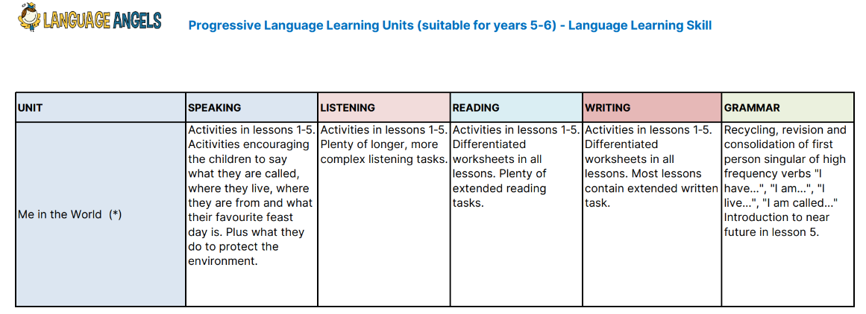
Language Progression

Slide 8
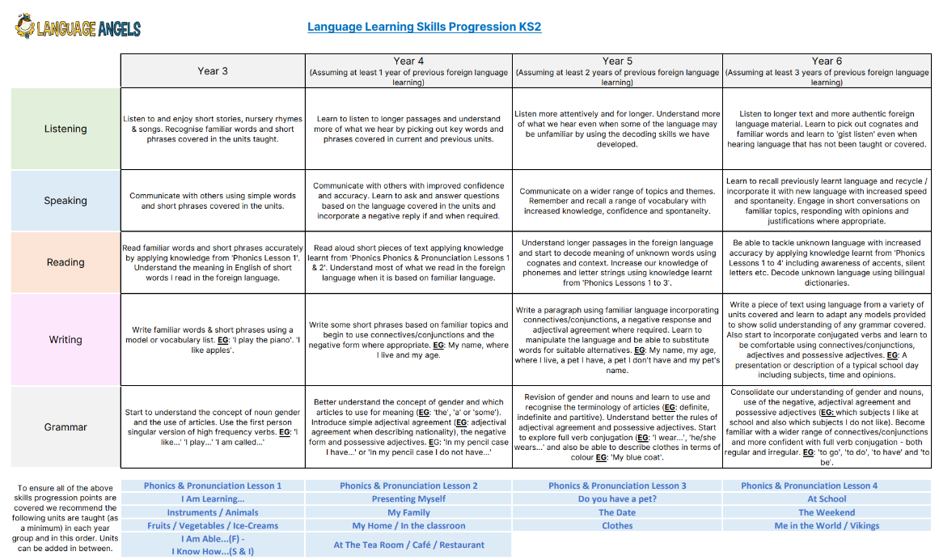
Language Learning Skills Progression

Slide 9
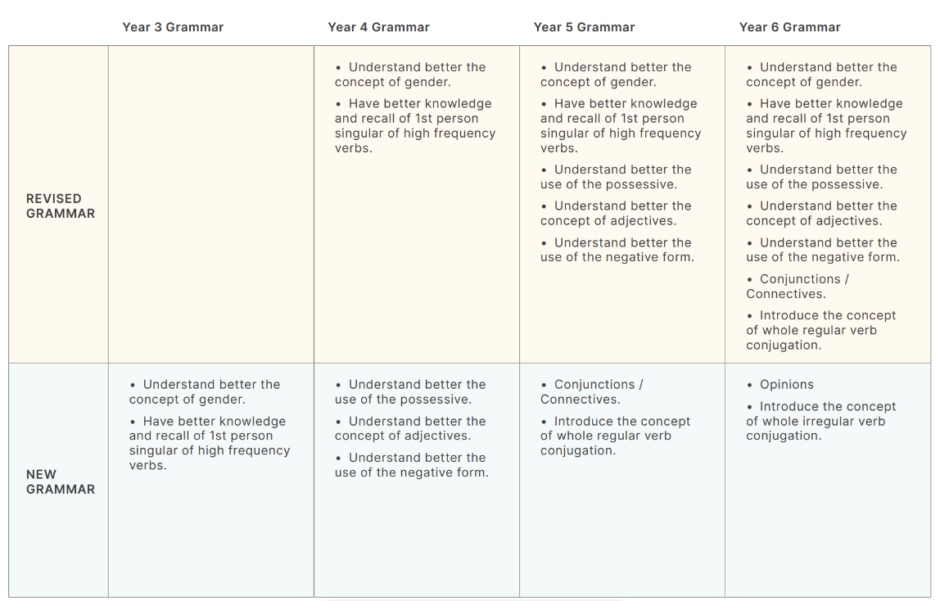
Curriculum Coverage
Grammar Grid

Slide 10


Assessment
Assessment of Pupil Learning & Progression
Two forms of assessment are available at the end of every Language Angels unit:
Peer and self-assessment ‘I can do…’ grids. A quick and easy way for all pupils in the class to record which units they have completed and the progress they are making.
More detailed skills-based assessments using bespoke skills assessment worksheets. This form of assessment enables us to determine the learning and progression of all pupils in the key language learning skills as well as monitoring their progress against the 12 attainment targets stipulated in the DfE Languages Programme of Study for Key Stage 2.
Monitoring and evaluation
The Subject Leader monitors the effectiveness of the language teaching provided throughout the school via regular termly observations with feedback given to teachers delivering foreign language lessons. The Subject Leader and class teacher will together monitor the learning and progression made by pupils across the key stage.
All data, ranging from evidence of classroom teaching to individual pupil skills reports, is securely stored on a password protected database. This can be accessed by class teachers, the Subject Leader and SLT so all key stakeholders can evaluate delivery, performance and progress.

Slide 11

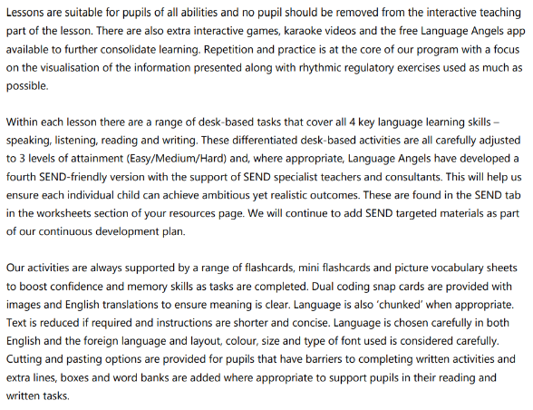
Inclusion
Explicit instruction - step-by-step modelling of what we want children to do, chunking the content and introducing new material in small steps
Cognitive and metacognitive strategies – opportunity to recall information to transfer it to our long-term memory
Scaffolding – pre-teaching, visual, verbal, written
Visual scaffolds may support a pupil to know what equipment they need, the steps they need to take, what their work should look like, an aid to access teaching and learning
Verbal scaffolds may involve re teaching a tricky concept to a group of pupils, or using questioning to identify and address any misconceptions
Written scaffolds will be provided for a pupil to support them with an independent written task. It could be notes made on a whiteboard during a discussion, a word bank, a sentence starter, a writing frame, it could even be the child’s own previous work used to support their recall.
Scaffolds provide temporary assistance to pupils so they can successfully complete tasks that they cannot yet do independently. We use scaffolds flexibly, evaluate their effectiveness and gradually remove them once they are no longer needed.
Flexible grouping - peer tutoring, Kagan grouping, flexible grouping
Assistive technology – to support delivery and recording of work
Rosenshine’s Principles of instruction:
Begin a lesson with a short review of previous learning
Present new material in small steps with pupil practice
Ask questions and check responses
Provide models
Guide pupil practice, provide scaffolding and support
Encourage independent practice and check pupil understanding
All children receive a high quality and ambitious education
All learners have access to the same academic opportunities by offering a stimulating and ambitious curriculum, adjusted to the needs of pupils with SEND, so that they are able to reach their full potential
It is vital that our children are equipped with the tools needed to become independent learners
Our curriculum will ensure that all pupils gain a greater understanding of how they learn and the skills of resilience, collaboration, participation, investigation, thinking, creativity, motivation and reflection
We provide an accessible learning environment which is tailored to the individual needs of all pupils
Pupils are supported by adults following a cycle of assess, plan, do, review, making necessary adjustments to the curriculum to meet the needs of all pupils
All learners are respected and acknowledged for their personal contribution

