Slide 1


Subject Handbook
PSHE

Slide 2

Our PSHE Curriculum
Intent
Our intention is that when children leave St John the Baptist, they will do so with the knowledge, understanding and emotions to be able to play an active, positive and successful role in today’s diverse society. The Ten Ten programme provides a curriculum in health and relationship education that is authentic to the Catholic Church’s teaching and acknowledges each pupil’s stage of physical and sexual development. The curriculum spirals throughout their school life, so the information is embedded and is differentiated for their appropriate stage of development.
Our children will develop an understanding of the importance of family life, stable and loving relationships, respect, love and care. We want our children to confidently discuss PSHE themes and feel supported and valued in lessons.
The Ten Ten programme promotes the spiritual, moral, cultural, mental and physical development of pupils, preparing them for the opportunities, responsibilities and experiences for later life. Our Relationships and Sex Education enables our children to learn how to be safe, and to understand and develop healthy relationships, both now and in their future lives.
We want our children to have high aspirations, a belief in themselves and realise that anything is possible if they put their mind to it. We are all aware of the important role the PSHE curriculum has in supporting school to implement the 9 protected characteristics of The Equality Act 2010.

Slide 3
Our PSHE Curriculum
Implementation
Each key stage focuses on the same three modules using a spiral approach where children build upon prior knowledge attained from their learning in the previous key stage.
As children progress through the school, they will revisit and further explore the concepts of each module. They learn through a range of scriptures, stories and video clips, drawing upon their personal experiences and reflecting on their choices and actions.
Whilst learning, teachers will use questioning to assess children’s understanding of what is being taught and present them with scenarios to offer them the opportunity to challenge their moral and spiritual thinking. An evaluative approach to assessment is adopted by teachers to inform them of individual progress.

Slide 4
Our PSHE Curriculum
Impact
At St John the Baptist, we strive to mould our children into kind, caring and thoughtful individuals who recognise difference and embrace individuality. By the end of Year 6, the children will have a well-developed, deeper understanding of the meaning of being healthy, how to stay safe and how to advocate for themselves.
They will be able to use skills taught to them such as: building self-esteem, resilience, and empathy to overcome potential problems in the future and support others in doing the same.
The children will have had experiences helping them to be independent and responsible members of a diverse society. This will all be underpinned with the teaching of God and how their faith provides the basis to their morals and the way they treat others within society.

Slide 5

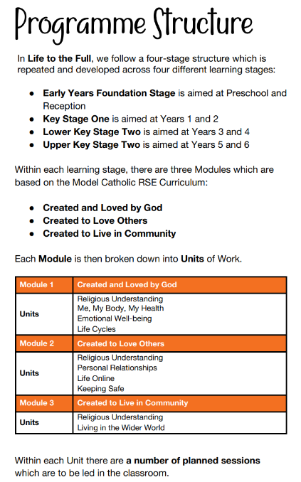
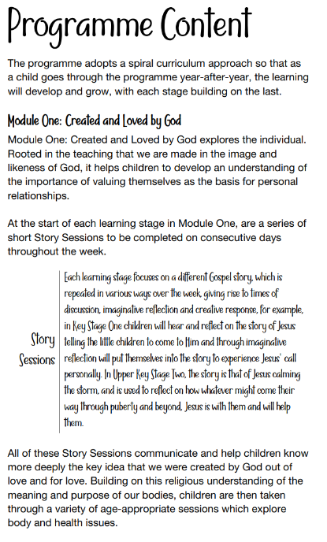
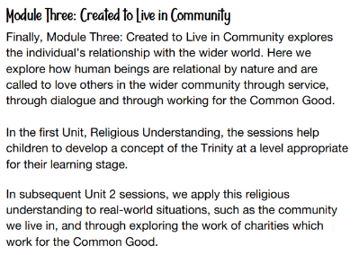
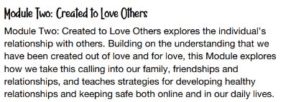
Curriculum Rationale

Slide 6


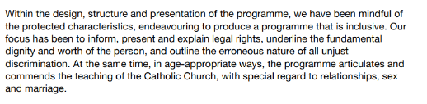
Protected Characteristics Coverage

Slide 7

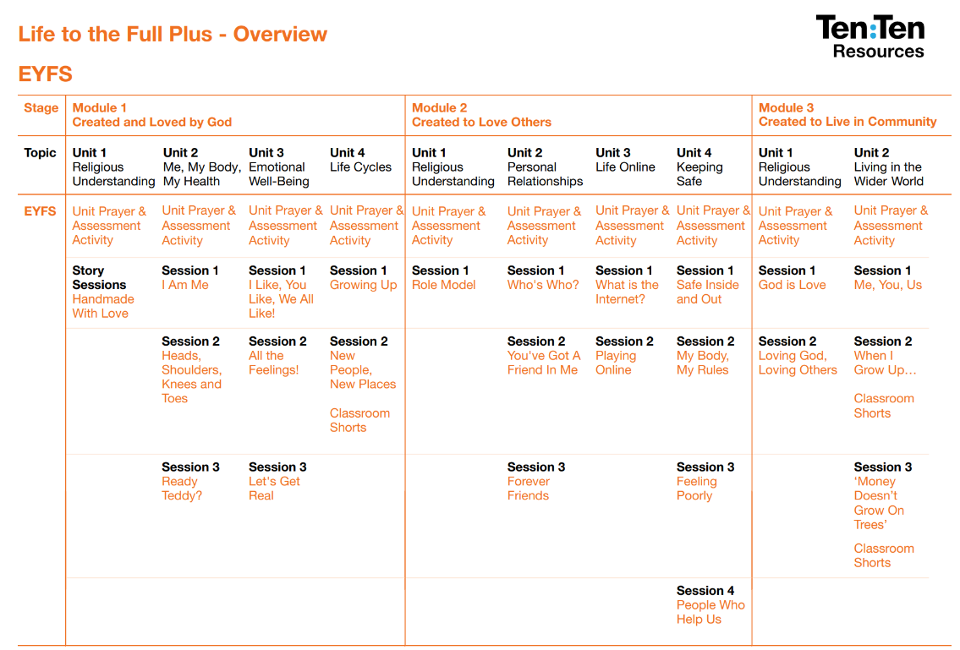
Curriculum Overview
EYFS

Slide 8
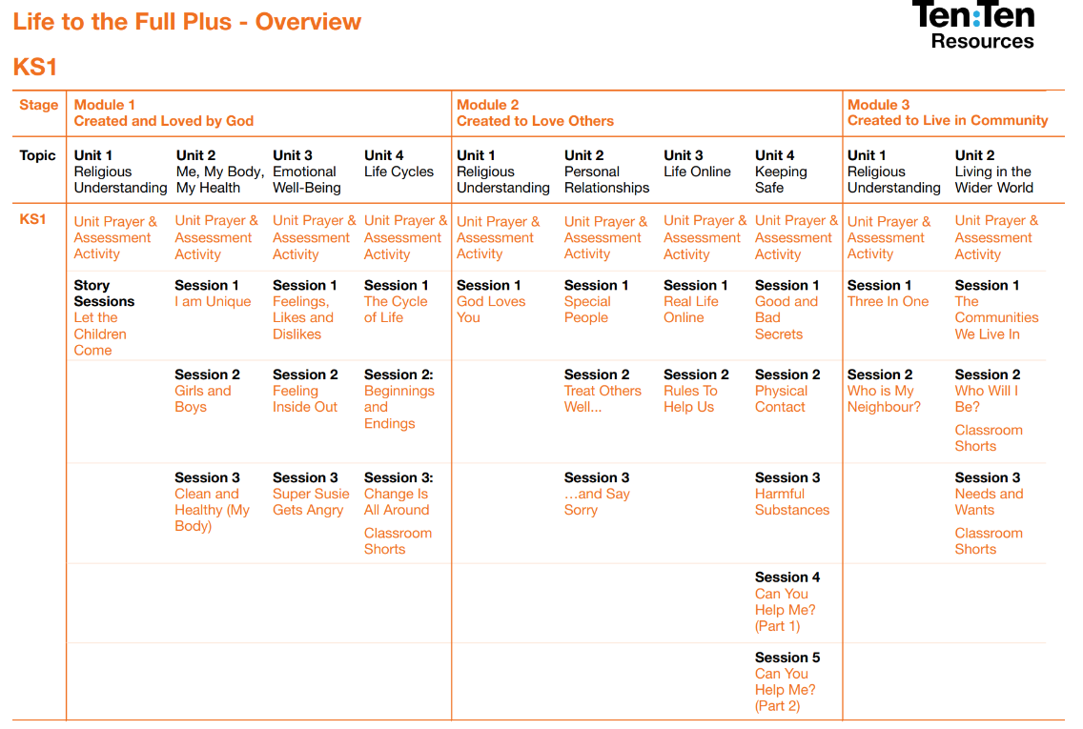
Curriculum Overview
KS1

Slide 9
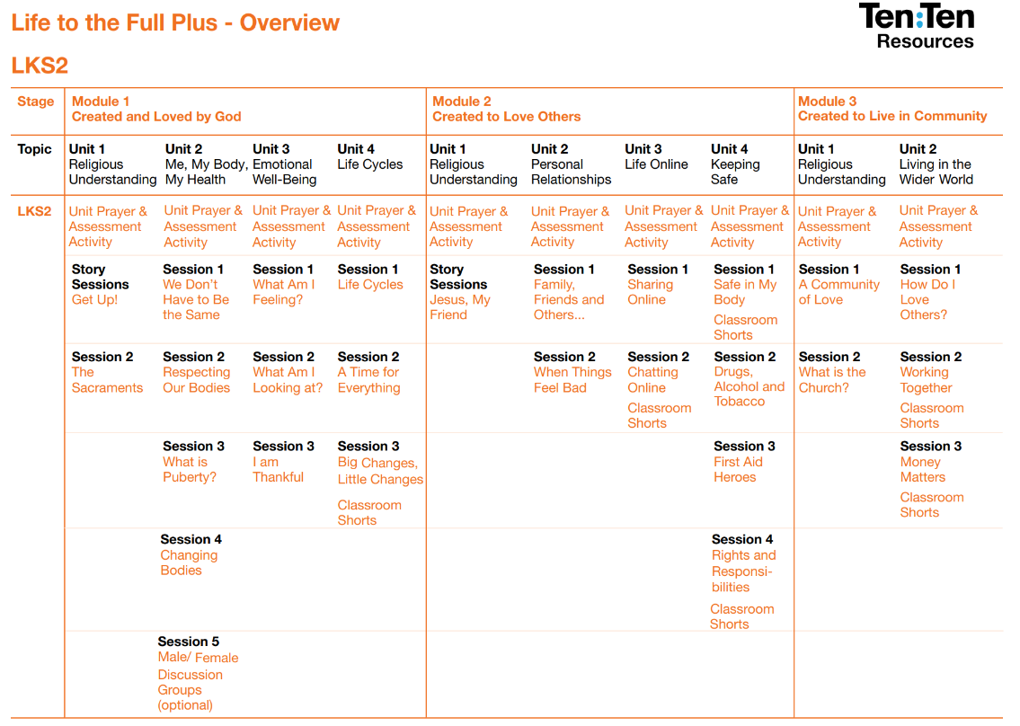
Curriculum Overview
LKS2

Slide 10
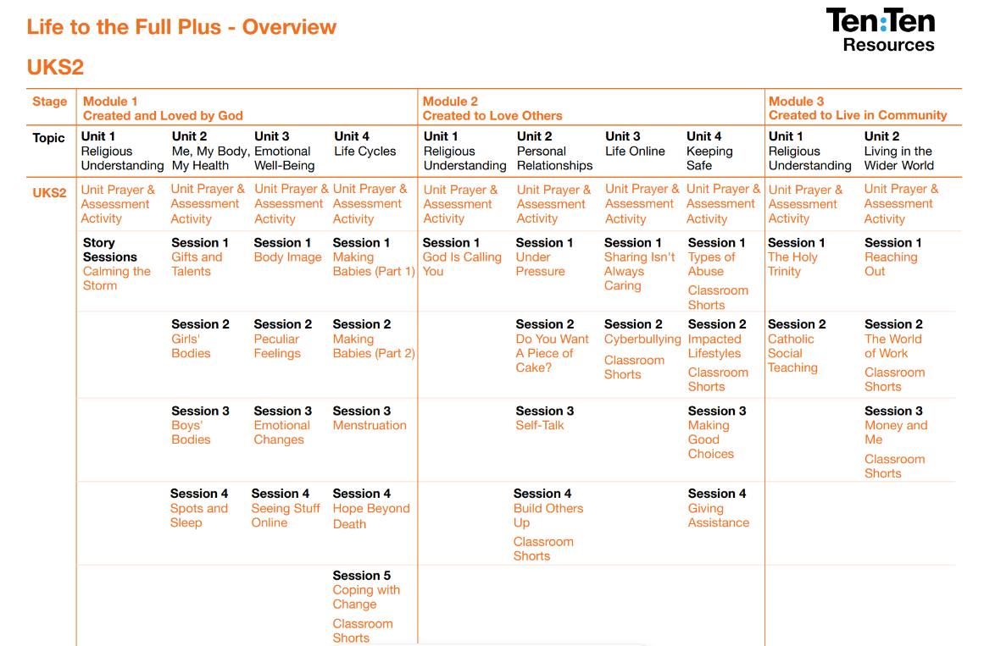
Curriculum Overview
UKS2

Slide 11

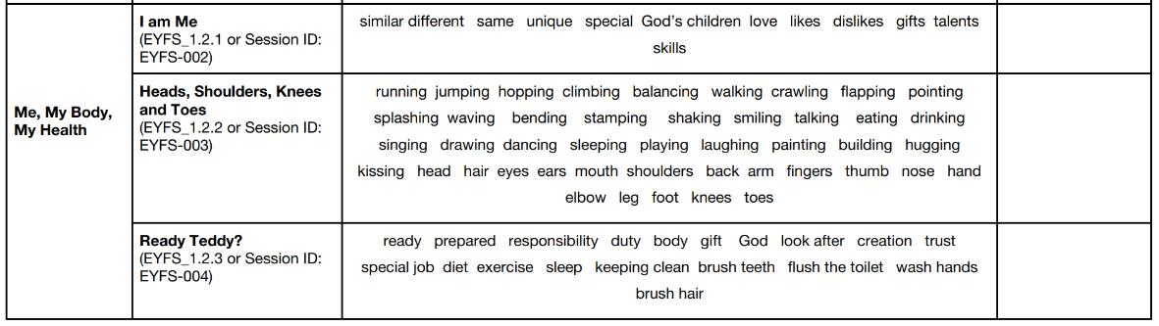
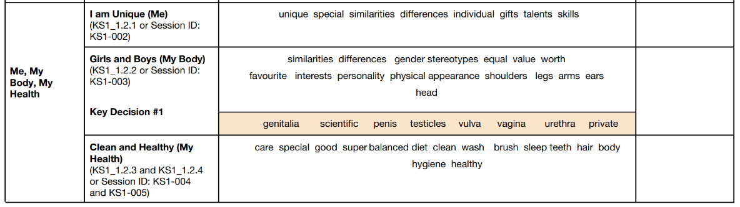
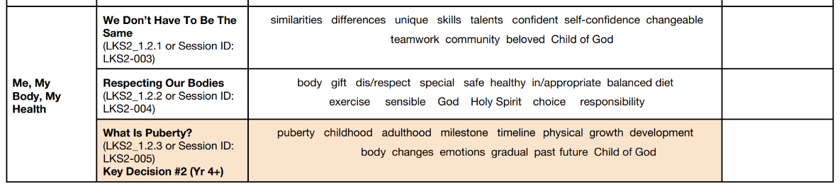
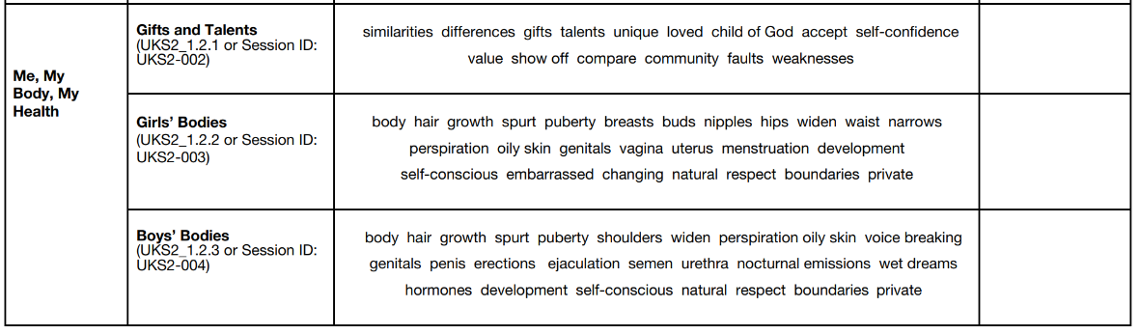
Progression of Vocabulary
EYFS
KS1
LKS2
UKS2

Slide 12
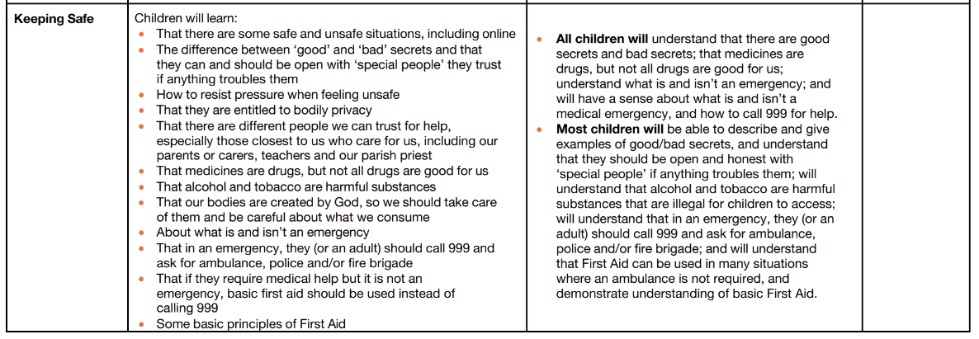
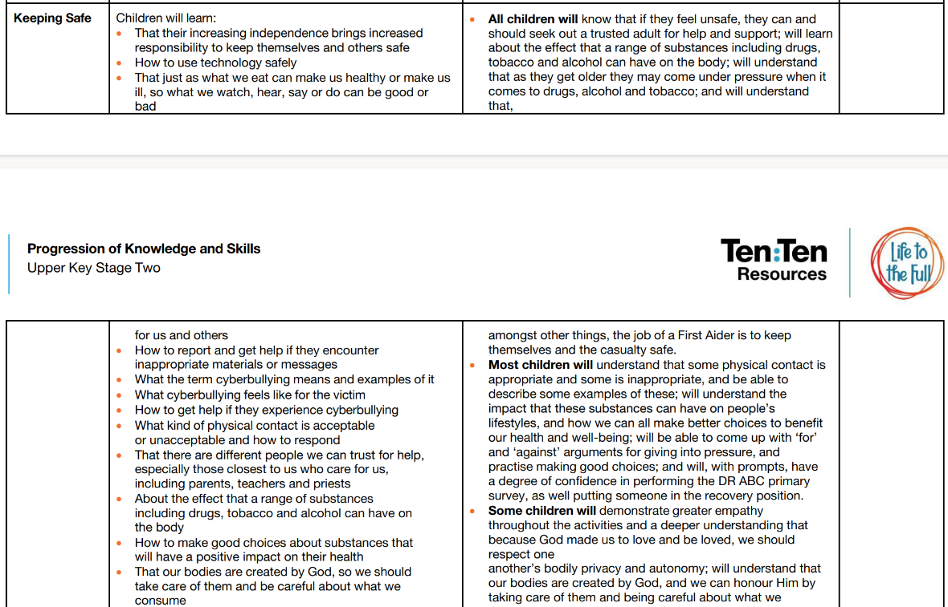
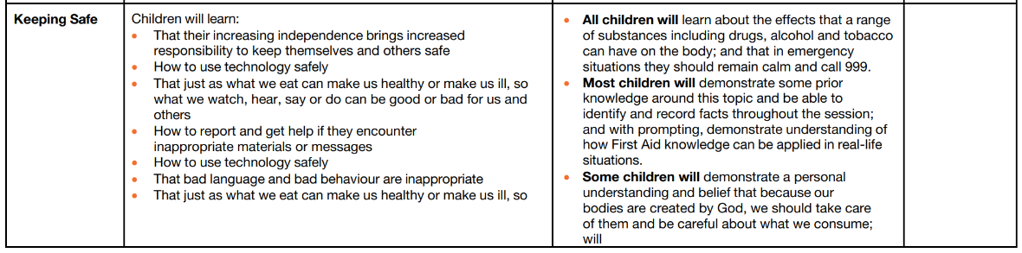
Progression of Skills
KS1
UKS2
LKS2

Slide 13

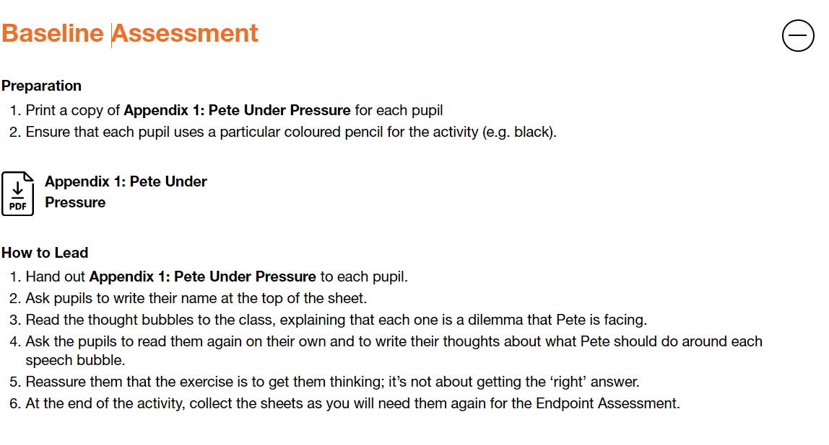
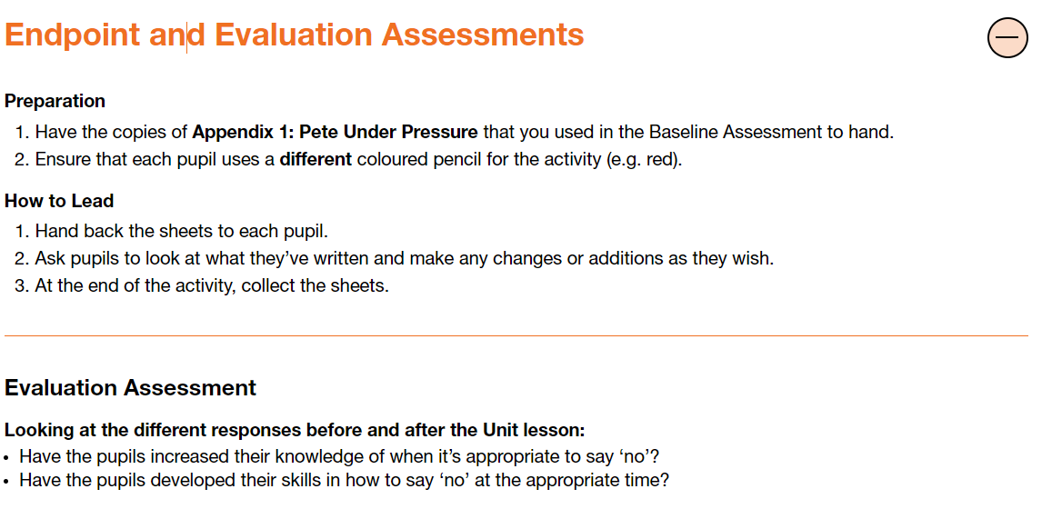
Assessment
Whilst learning, teachers will use questioning to assess children’s understanding of what is being taught and present them with scenarios to offer them the opportunity to challenge their moral and spiritual thinking.
An evaluative approach to assessment is adopted by teachers to inform them of individual progress.
Baseline assessments and endpoint assessments are also used to assess children’s progress at the end of each unit.

Slide 14

Inclusion
Explicit instruction - step-by-step modelling of what we want children to do, chunking the content and introducing new material in small steps
Cognitive and metacognitive strategies – opportunity to recall information to transfer it to our long-term memory
Scaffolding – pre-teaching, visual, verbal, written
Visual scaffolds may support a pupil to know what equipment they need, the steps they need to take, what their work should look like, an aid to access teaching and learning
Verbal scaffolds may involve re teaching a tricky concept to a group of pupils, or using questioning to identify and address any misconceptions
Written scaffolds will be provided for a pupil to support them with an independent written task. It could be notes made on a whiteboard during a discussion, a word bank, a sentence starter, a writing frame, it could even be the child’s own previous work used to support their recall.
Scaffolds provide temporary assistance to pupils so they can successfully complete tasks that they cannot yet do independently. We use scaffolds flexibly, evaluate their effectiveness and gradually remove them once they are no longer needed.
Flexible grouping - peer tutoring, Kagan grouping, flexible grouping
Assistive technology – to support delivery and recording of work
Rosenshine’s Principles of instruction:
Begin a lesson with a short review of previous learning
Present new material in small steps with pupil practice
Ask questions and check responses
Provide models
Guide pupil practice, provide scaffolding and support
Encourage independent practice and check pupil understanding
All children receive a high quality and ambitious education
All learners have access to the same academic opportunities by offering a stimulating and ambitious curriculum, adjusted to the needs of pupils with SEND, so that they are able to reach their full potential
It is vital that our children are equipped with the tools needed to become independent learners
Our curriculum will ensure that all pupils gain a greater understanding of how they learn and the skills of resilience, collaboration, participation, investigation, thinking, creativity, motivation and reflection
We provide an accessible learning environment which is tailored to the individual needs of all pupils
Pupils are supported by adults following a cycle of assess, plan, do, review, making necessary adjustments to the curriculum to meet the needs of all pupils
All learners are respected and acknowledged for their personal contribution

