Slide 1


Subject Handbook
Design
and Technology

Slide 2

Our DT Curriculum
Intent
At St. John the Baptist Catholic Primary School we believe that a high-quality Design and Technology should engage, inspire and challenge pupils, equipping them with the knowledge and skills to experiment, invent and create their own designs.
Design and technology prepares children to take part in the development of tomorrow’s rapidly changing world. Creative thinking encourages children to make positive changes to their quality of life. The subject encourages children to become autonomous and creative problem-solvers, both as individuals and as part of a team. It enables them to identify needs and opportunities and to respond by developing ideas and eventually making products and systems. Through the study of design and technology they combine practical skills with an understanding of aesthetic, social and environmental issues, as well as functions and industrial practices. This allows them to reflect on and evaluate present and past design and technology, its uses and its impacts. Design and technology helps all children to become discriminating and informed consumers and potential innovators.

Slide 3
Our DT Curriculum
Implementation
In our St. John the Baptist EYFS, D&T comes under the specific areas of learning “Understanding of the World” and ‘Expressive Art and Design’. Children are encouraged to make their own choices (e.g. choosing their own materials) through child initiated activities, and are led in the development of skills through adult directed tasks. We provide a range of experiences that encourage exploration, observation, problem solving, critical thinking and discussion. These activities, indoors and outdoors, attract the children’s interest and curiosity.
At Key Stages 1 & 2, the D&T curriculum is organised into themes that are taught in a termly block wherein children will be involved in investigative work and taught skills. Teaching methods to achieve the aims and objectives of this document will vary according to the classroom situation and the work planned by individual teachers. Each Year Group will have cohesive teaching sequences as the key start point for their class – teachers will adapt these annually (in line with the needs of their current class) to ensure that knowledge, skills, vocabulary and curricular links are appropriate for that cohort.

Slide 4
Our DT Curriculum
Impact
A wide range of strategies are used to measure the impact of our Design and Technology curriculum.
Our teaching sequence enables opportunities for formative assessments to be carried out by teachers during lessons, which will allow them to inform future planning. Additionally, summative assessments are carried out using evaluation. As a result of these assessment tools, pupils’ misconceptions or gaps in subject knowledge, skills, behaviours and attitudes are addressed and additional teaching and support is provided.
In EYFS, staff professional judgements are valued. Assessments are formative so that they quickly make a difference to children’s learning. They inform the provision of activities and experiences which develop children’s skills and knowledge as well as giving opportunity for further practice

Slide 5

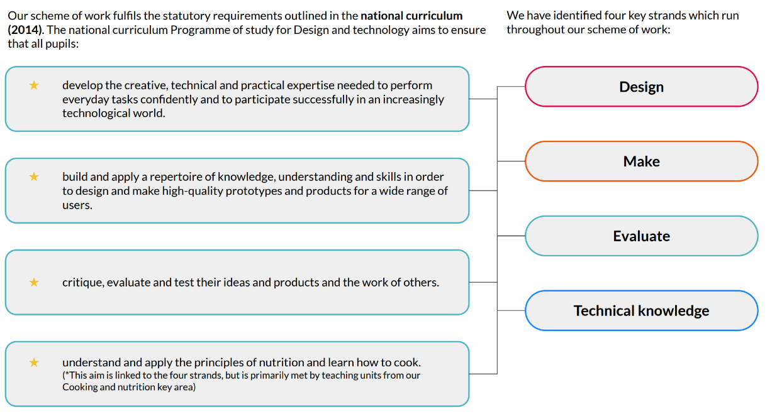
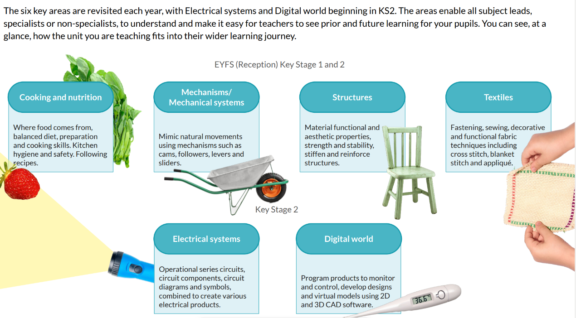
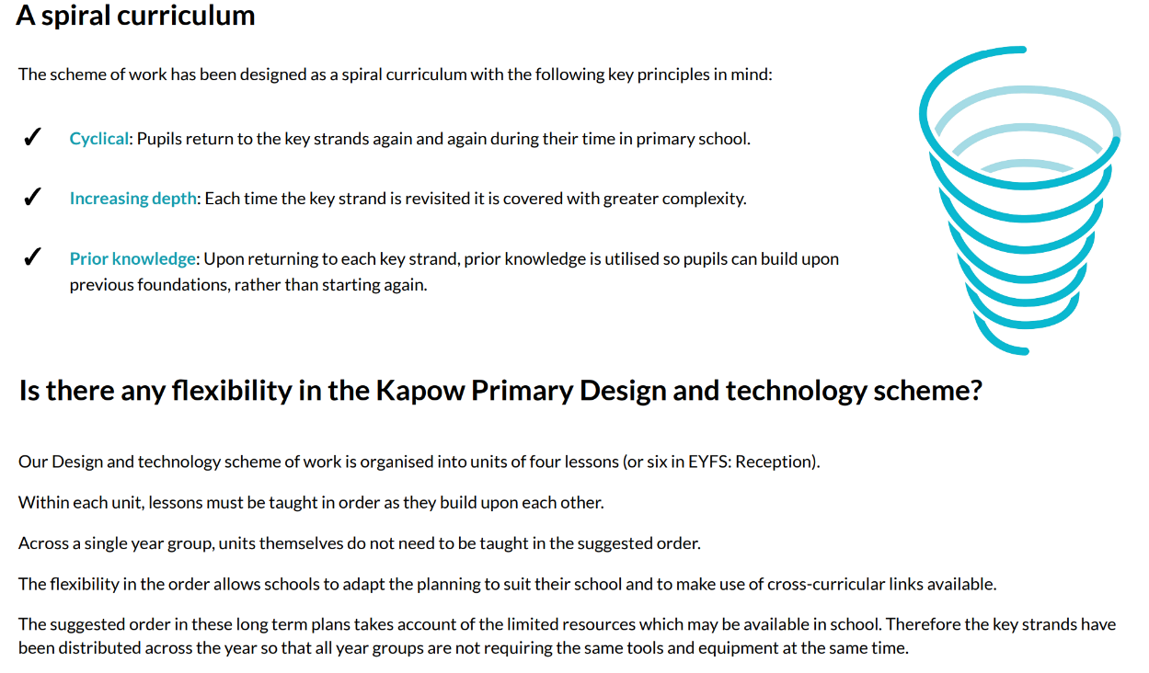

Curriculum Rationale

Slide 6
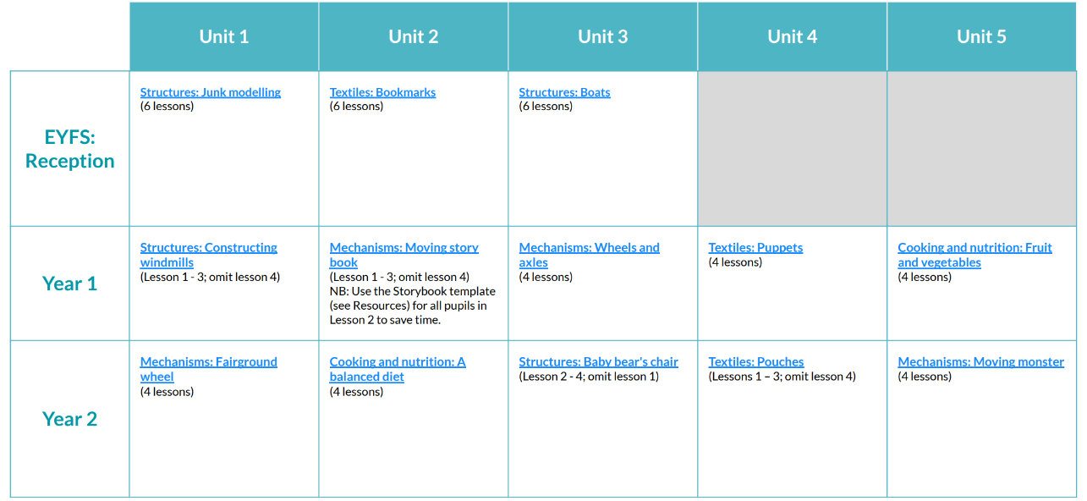
Curriculum Overview

Slide 7
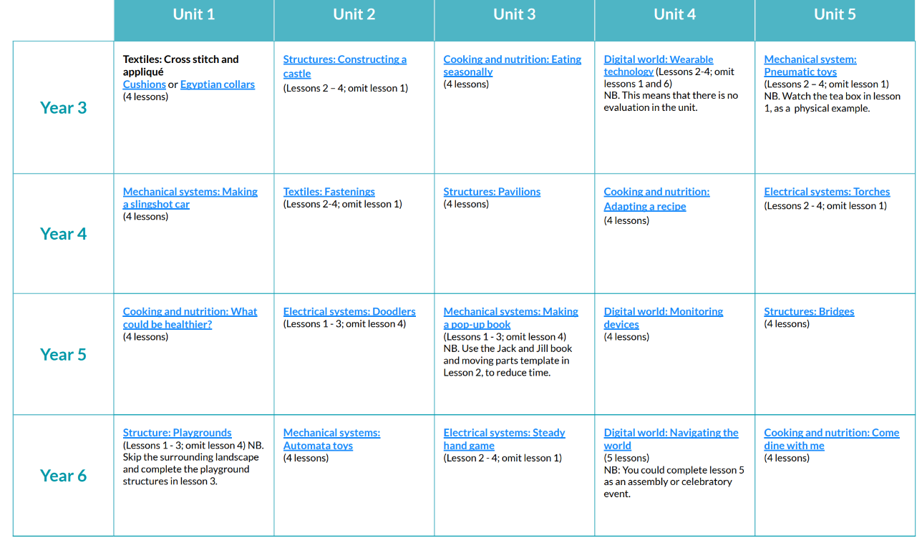
Curriculum Overview

Slide 8

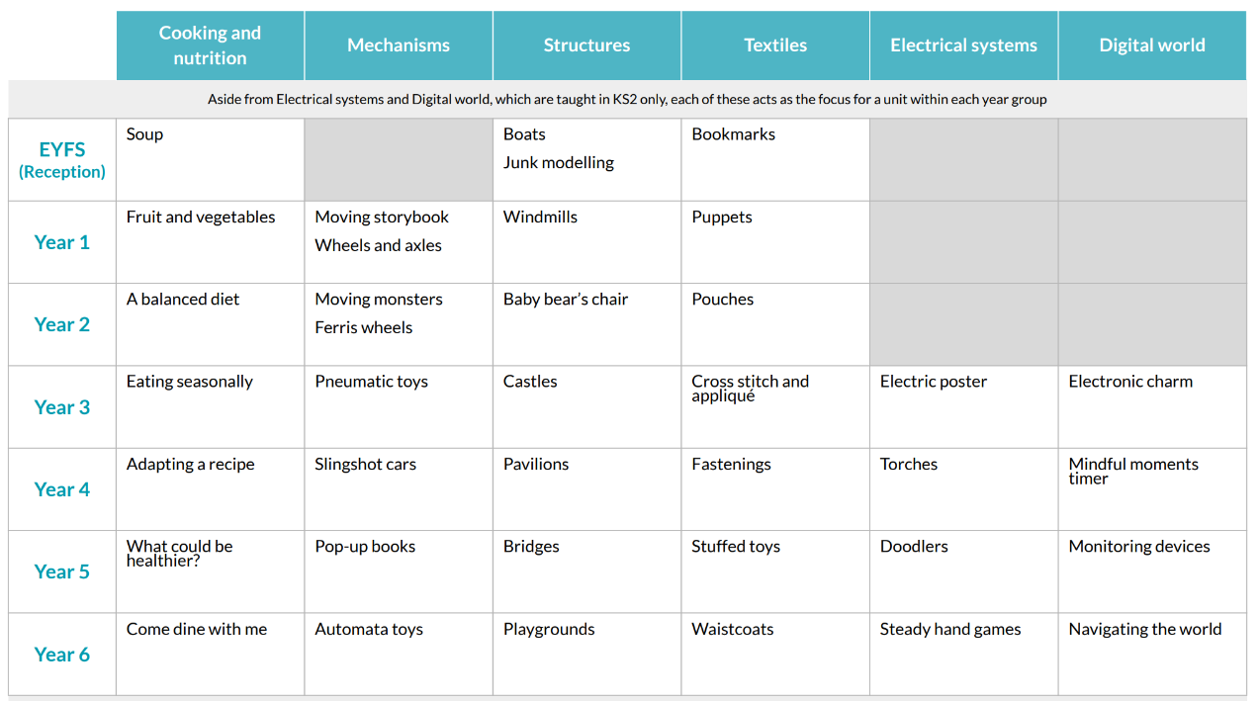
Coverage of Skills

Slide 9
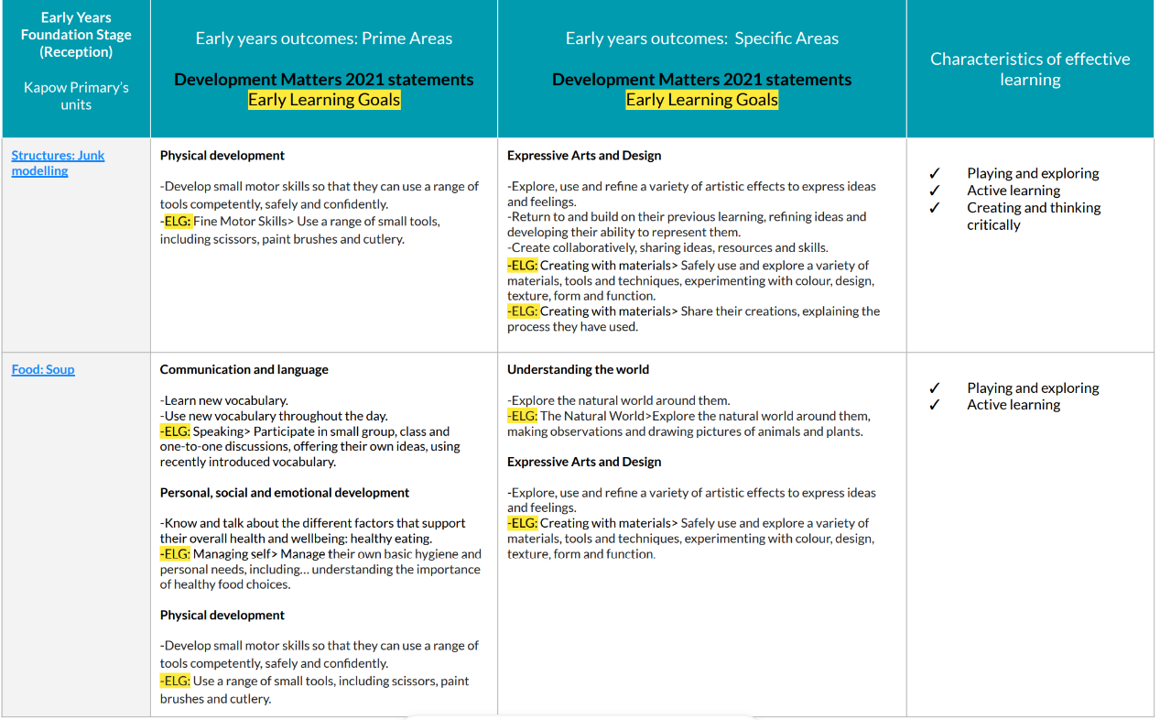
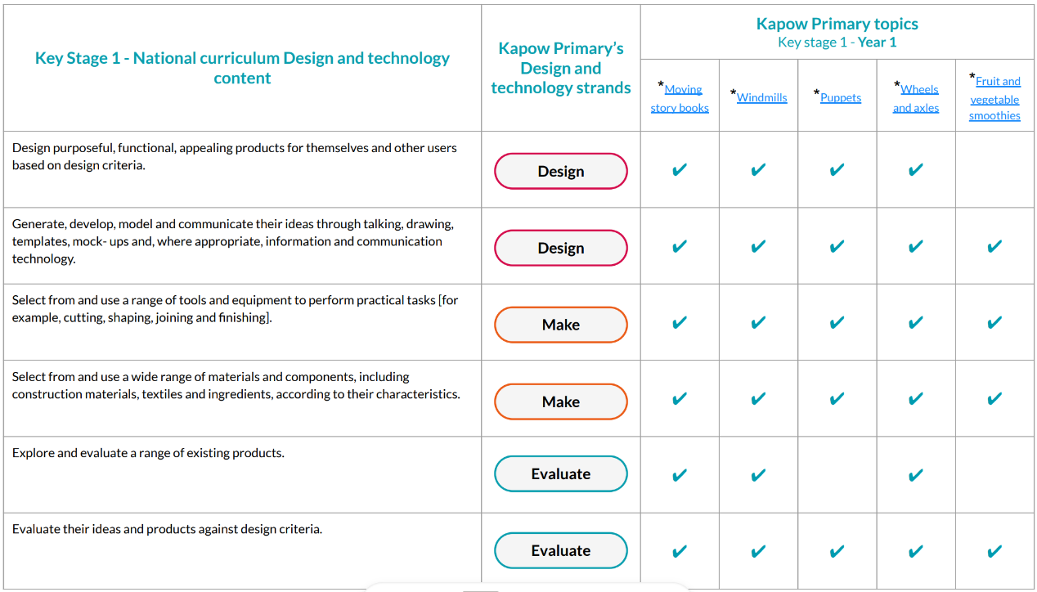
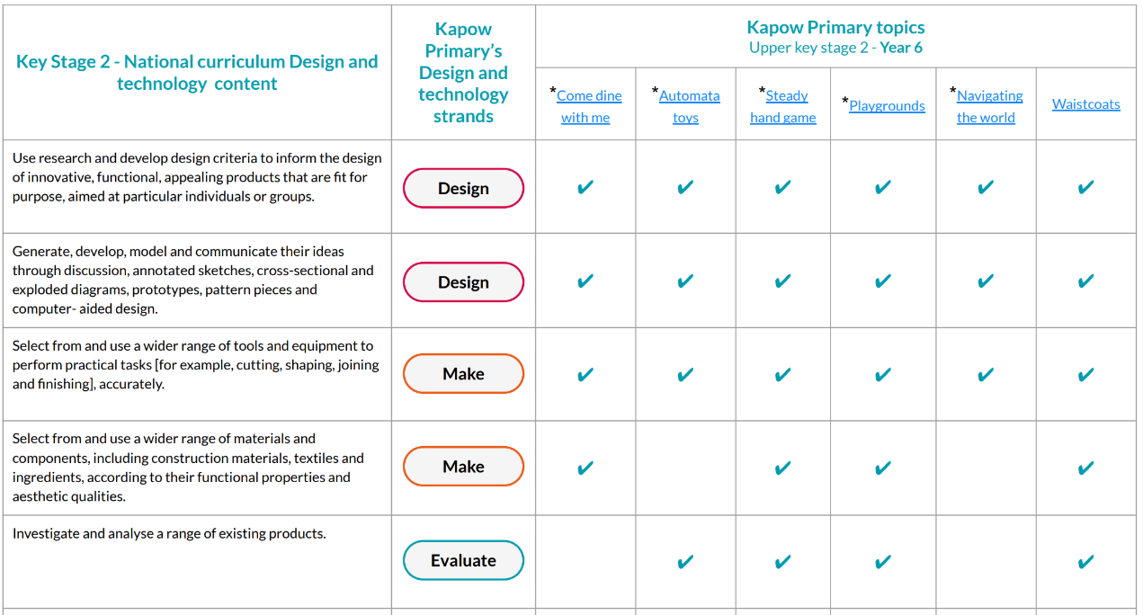
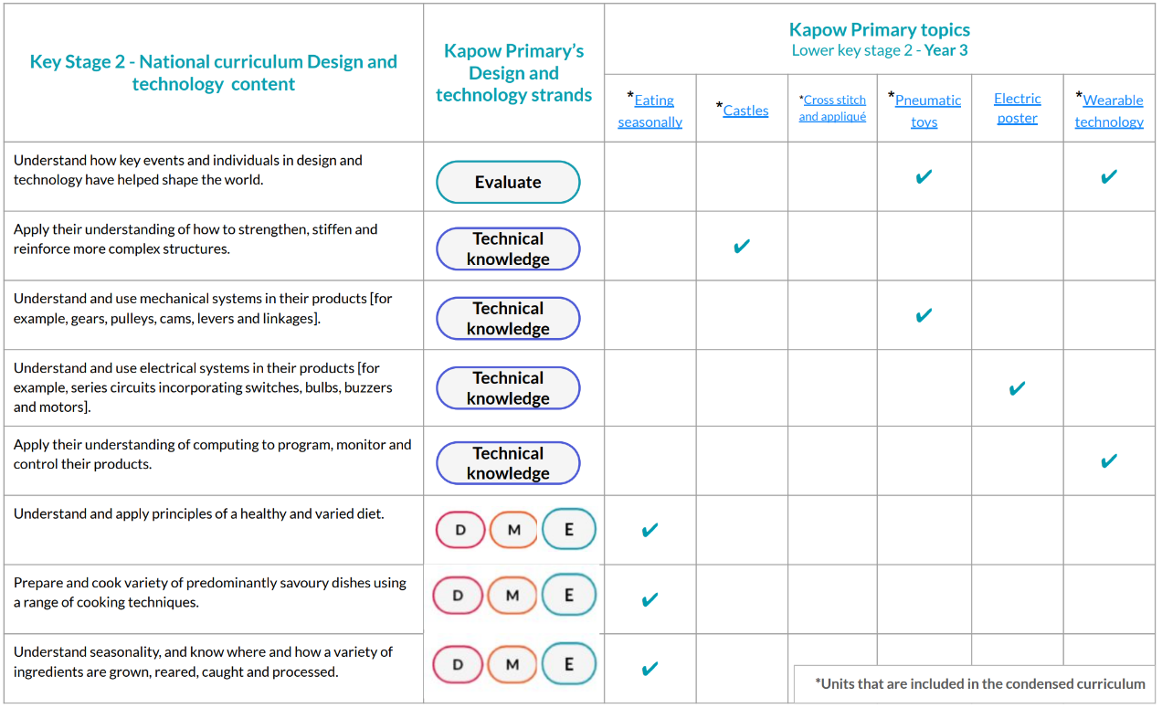
Coverage of Skills

Slide 10
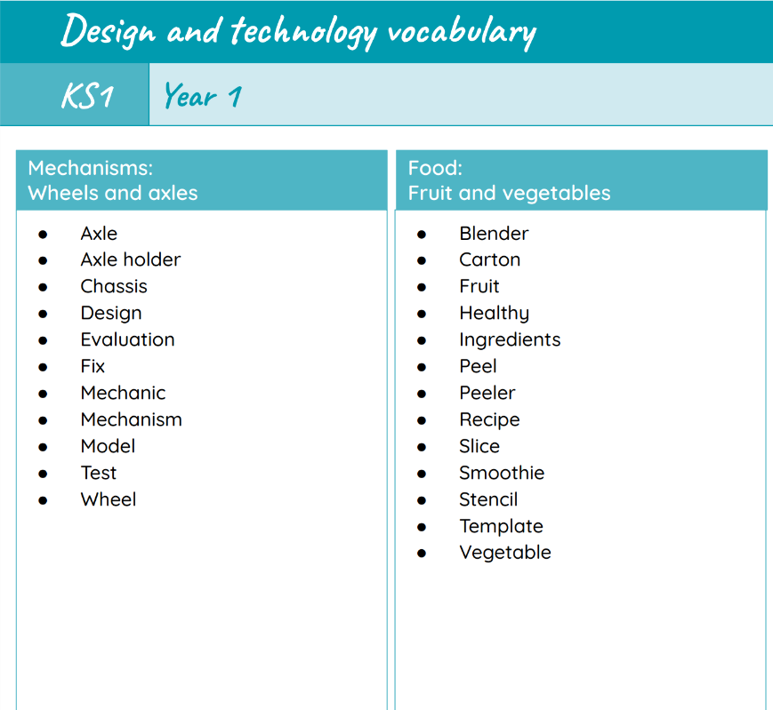
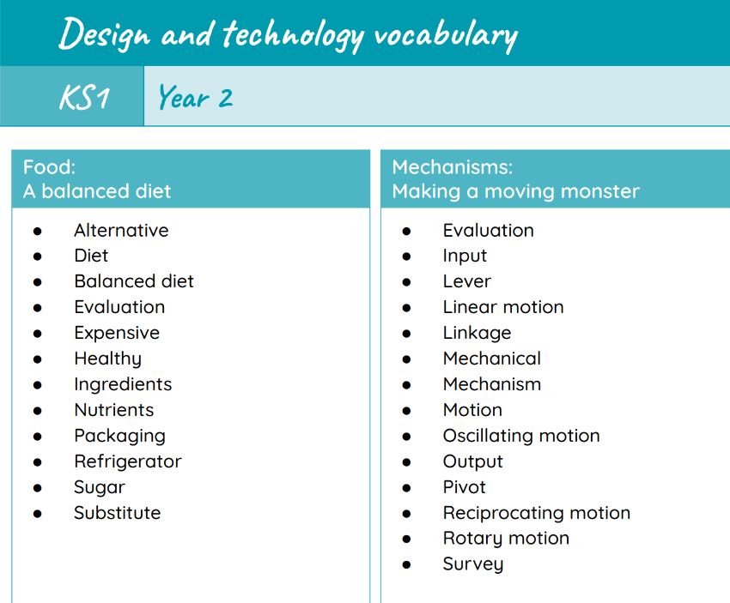
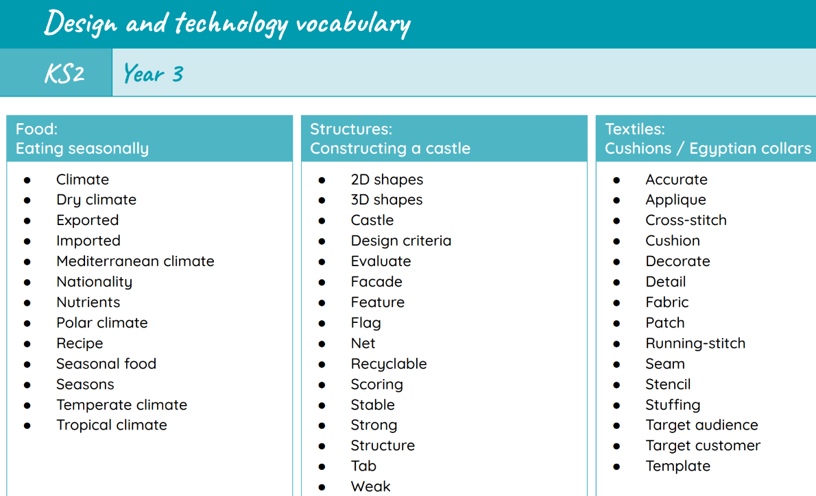
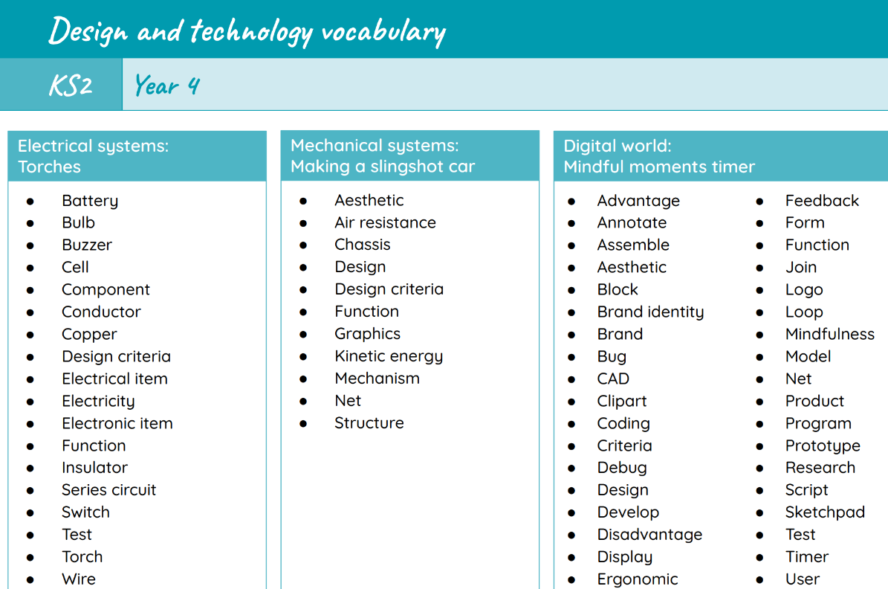
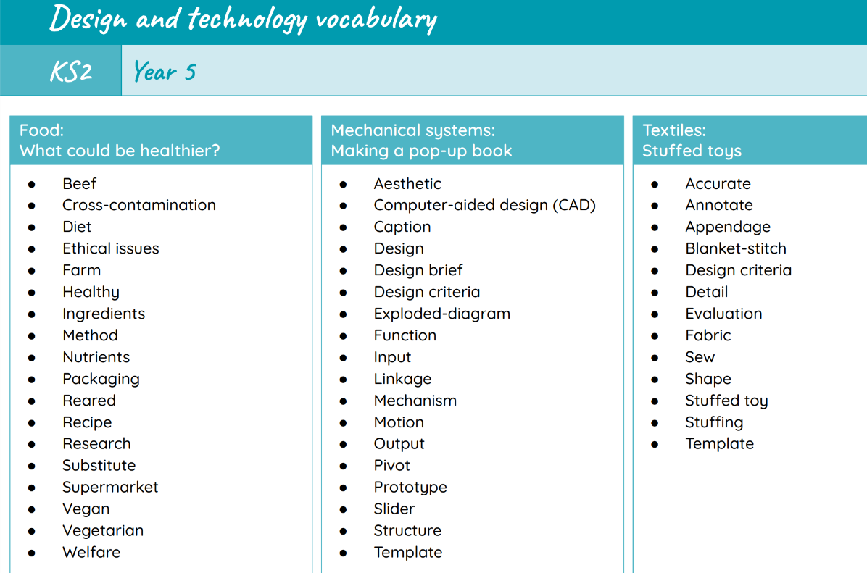
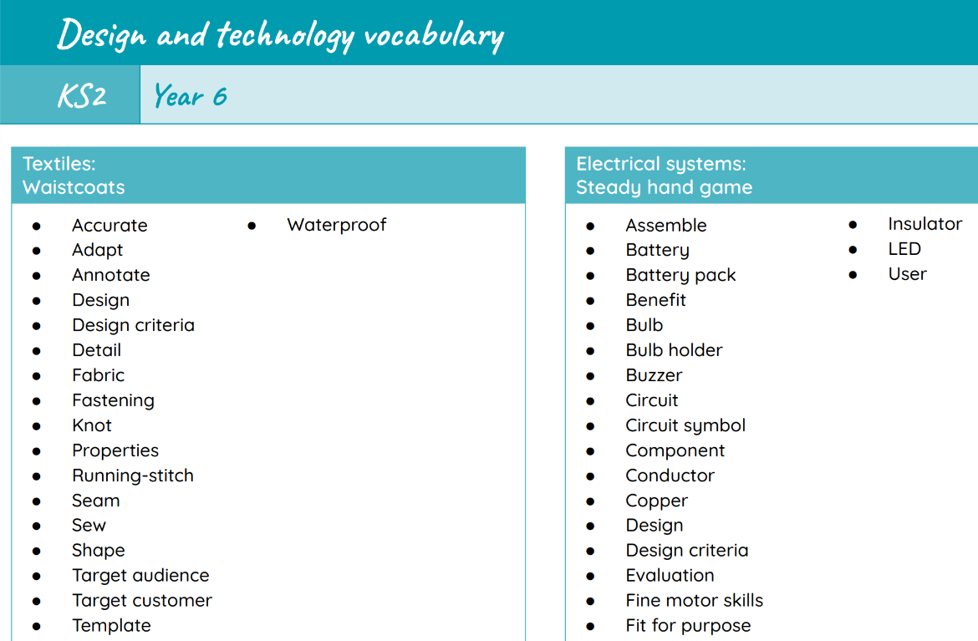
Progression of Vocabulary

Slide 11


Assessment
Kapow's assessment features offer teachers the ability to track and evaluate students' design process, creativity, and technical proficiency.
It allows staff to provide feedback, formally assess and generate comprehensive reports, helping them identify areas for improvement and celebrate students' achievements in D&T.

Slide 12

Inclusion
Explicit instruction - step-by-step modelling of what we want children to do, chunking the content and introducing new material in small steps
Cognitive and metacognitive strategies – opportunity to recall information to transfer it to our long-term memory
Scaffolding – pre-teaching, visual, verbal, written
Visual scaffolds may support a pupil to know what equipment they need, the steps they need to take, what their work should look like, an aid to access teaching and learning
Verbal scaffolds may involve re teaching a tricky concept to a group of pupils, or using questioning to identify and address any misconceptions
Written scaffolds will be provided for a pupil to support them with an independent written task. It could be notes made on a whiteboard during a discussion, a word bank, a sentence starter, a writing frame, it could even be the child’s own previous work used to support their recall.
Scaffolds provide temporary assistance to pupils so they can successfully complete tasks that they cannot yet do independently. We use scaffolds flexibly, evaluate their effectiveness and gradually remove them once they are no longer needed.
Flexible grouping - peer tutoring, Kagan grouping, flexible grouping
Assistive technology – to support delivery and recording of work
Rosenshine’s Principles of instruction:
Begin a lesson with a short review of previous learning
Present new material in small steps with pupil practice
Ask questions and check responses
Provide models
Guide pupil practice, provide scaffolding and support
Encourage independent practice and check pupil understanding
All children receive a high quality and ambitious education
All learners have access to the same academic opportunities by offering a stimulating and ambitious curriculum, adjusted to the needs of pupils with SEND, so that they are able to reach their full potential
It is vital that our children are equipped with the tools needed to become independent learners
Our curriculum will ensure that all pupils gain a greater understanding of how they learn and the skills of resilience, collaboration, participation, investigation, thinking, creativity, motivation and reflection
We provide an accessible learning environment which is tailored to the individual needs of all pupils
Pupils are supported by adults following a cycle of assess, plan, do, review, making necessary adjustments to the curriculum to meet the needs of all pupils
All learners are respected and acknowledged for their personal contribution

