Slide 1


Subject Handbook
Art

Slide 2

Our Art Curriculum
Intent
At St. John the Baptist Catholic Primary School we believe that a high-quality Art education should engage, inspire and challenge pupils, equipping them with the knowledge and skills to experiment, invent and create their own works of art, craft and design.
Our Art curriculum aims to inspire children to express themselves in a creative, imaginative manner. Children are introduced to a range of works by famous artists in order to develop their knowledge of styles and extend their vocabulary. Our Art curriculum also provides children with the opportunities to develop and extend their proficiency in drawing, painting, sculpture, collage, textiles, print and digital media.
Children will develop their skills to think critically about art, be reflective, and evaluate their own work. As pupils progress, they should be able to think critically and develop a more rigorous understanding of art.
They should also know how art and design both reflect and shape our history, and contribute to the culture, creativity and wealth of our nation.
Art provides the children with the opportunities to develop and extend skills and an opportunity to express their individual interests, thought and ideas.

Slide 3
Our Art Curriculum
Implementation
Our EYFS at St. John the Baptist Catholic Primary School, provides an engaging and safe environment for our children to feel confident to be creative and to express themselves freely. The Early Years Foundation Stage (EYFS) framework suggests that the development of children’s artistic and cultural awareness supports their imagination and creativity. We believe that each individual child has the power to create and make, to manipulate and contribute to the world, for the enjoyment of their own self and for others. There are three areas we focus on; Imagination and creativity, Self-expression and Communicating through arts. Our EYFS practitioners support our children to be creative. It is as much about encouraging attitudes of curiosity and questioning as about skills or techniques. They build on children’s interests which can lead to them creating amazing inventions or making marks on paper that represent for them an experience or something they have seen. Encouraging children to choose and use materials and resources in an open-ended way helps them to make choices and to have confidence in their own ideas.
We use the Primary Knowledge Curriculum to teach Art. This PKC art curriculum is a knowledge rich curriculum, and it supports planning of Art lessons across Key Stage 1 and 2. Knowledge, in the realm of art means knowledge not only of artists, designers, architects and their work, but of the artistic concepts that relate to their work shown in different types and styles of art, how these relate to each other in a historical context and how this affects the children’s own use of materials and development of skills. The curriculum is designed to enable children to learn by making connections between the work of artists, architects and designers (which they study critically) and their own work, which they evaluate and relate back to the works they have studied. This process is cyclical. For children following the curriculum, becoming informed about the subject discipline of art is a process that takes place alongside a growing love for the subject. Meaningful opportunities for self-expression and individual response are woven through the curriculum, giving children space to learn who they are as an artist.

Slide 4
Our Art Curriculum
Impact
Our curriculum provides a create a safe and inclusive environment where pupils are confident enough to express their ideas and not afraid to take risks with their work as emerging artists. We provide opportunities to engage and succeed in art. The purpose of art education is to give pupils the skills, concepts and knowledge necessary for them to express responses to ideas and experiences in a visual or tactile form. It fires their imagination and is a fundamental means of personal expression.
It is expected that evidence of the children’s art will be recorded in sketchbooks which can include the work, or photographs of the work they produce each lesson. Sketchbooks may include written reflections on the work of other artists/designers/architects, as well as the children’s written reflections on their own work.
Activities children are directed to undertake in lessons are designed with an eye to the importance of learning and practicing process. These activities include verbal and written observations and observational, analytical and imaginative drawing activities in key stage 1, leading to the process of independent investigation, observation, annotation, sketching, design and planning (allowing the children to experiment and invent) by the end of key stage 2. Independent and investigative study and the understanding of process is particularly provided for in the units which conclude the year for years 5 and 6.
The Art subject leader uses teachers’ assessment to ensure children are achieving expected standard at the end of each year group. This is done in the following ways:
· Looking at children’s work in their sketchbooks.
· Interviewing the pupils about their learning (pupil voice).
· Class art floor books are scrutinised and there is the opportunity for a dialogue between teachers to understand their class’s work.
· Annual reporting of standards across the curriculum.

Slide 5

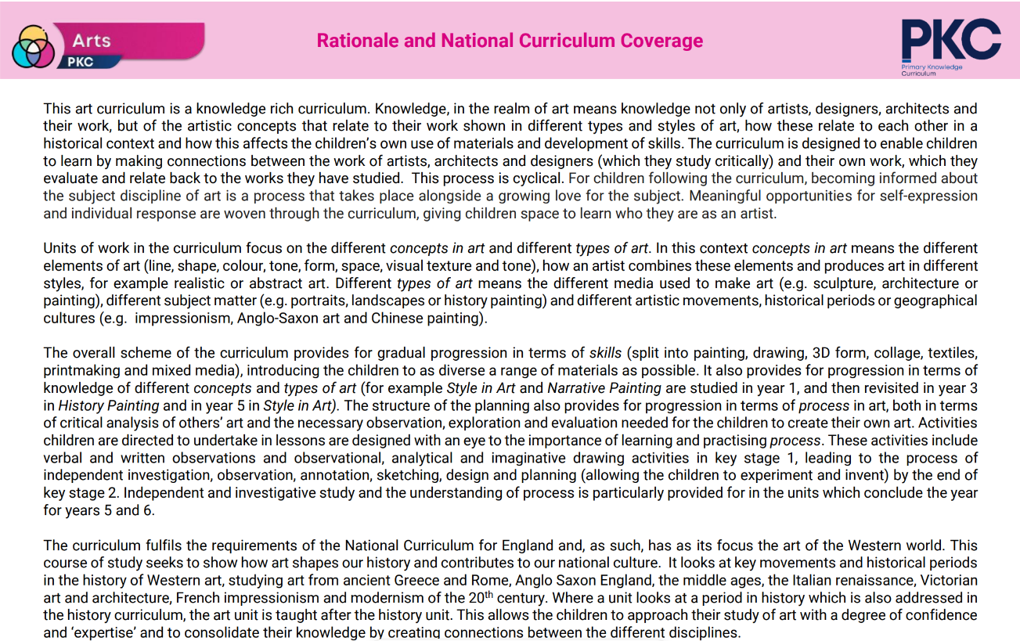
Curriculum Rationale

Slide 6
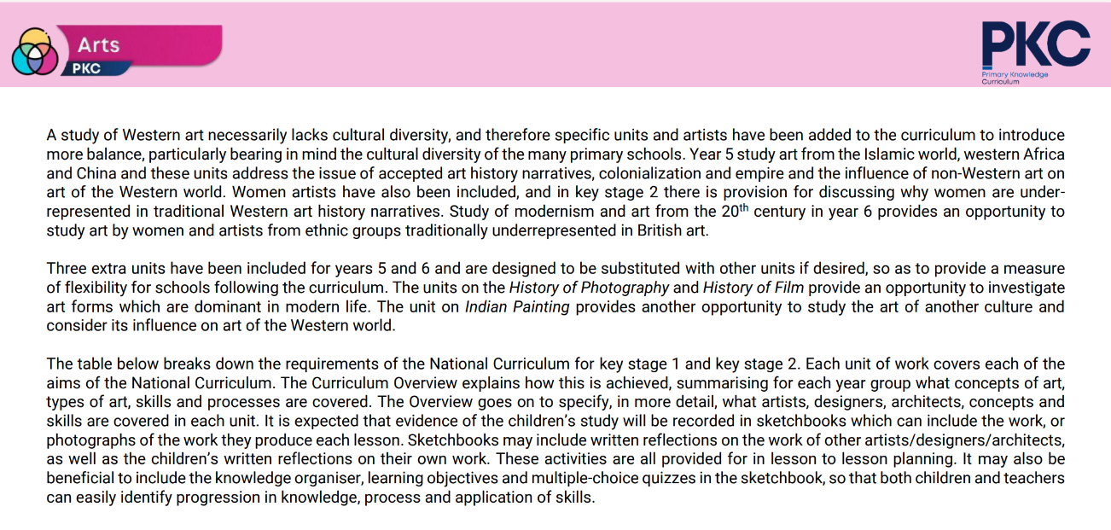
Curriculum Rationale

Slide 7
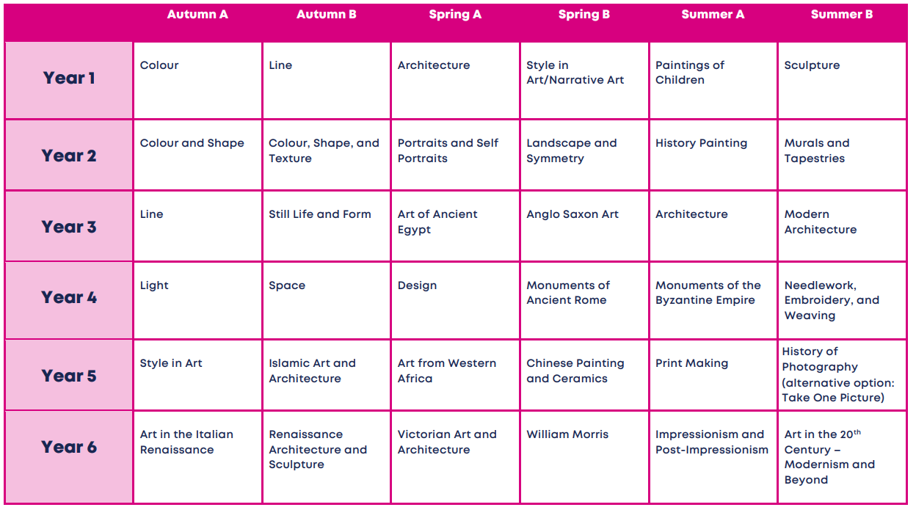
Curriculum Overview

Slide 8
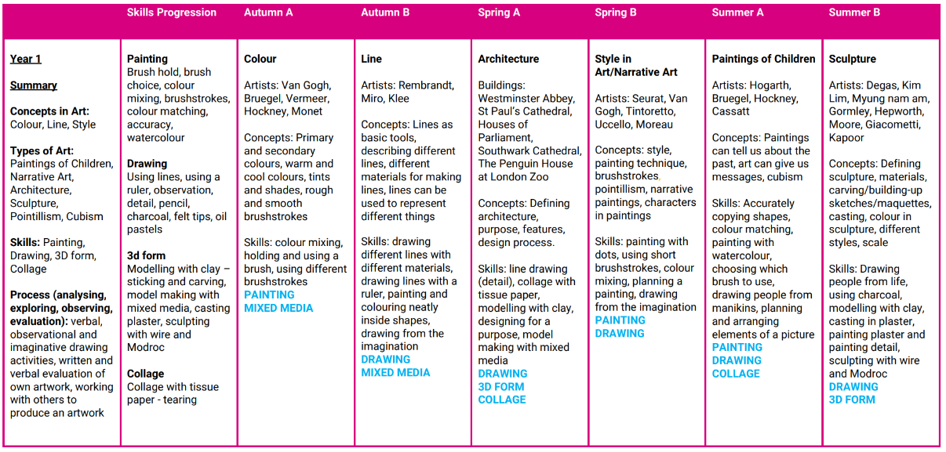
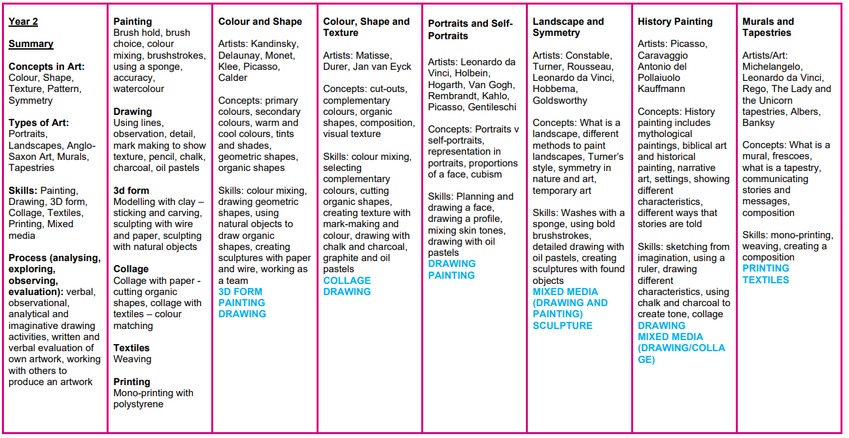
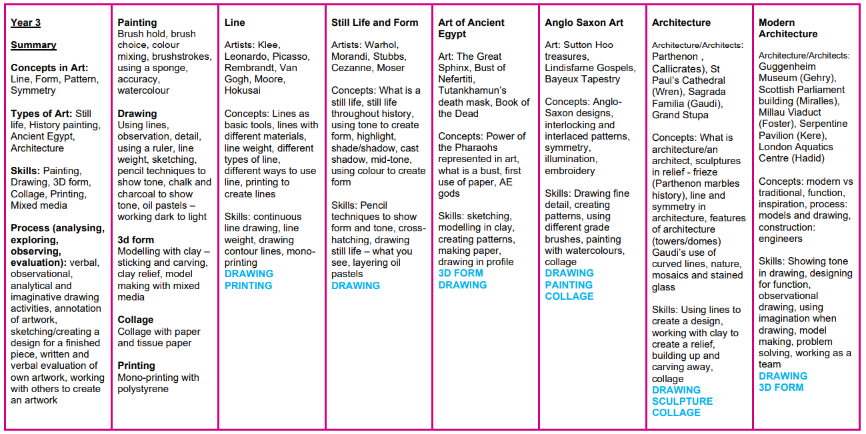
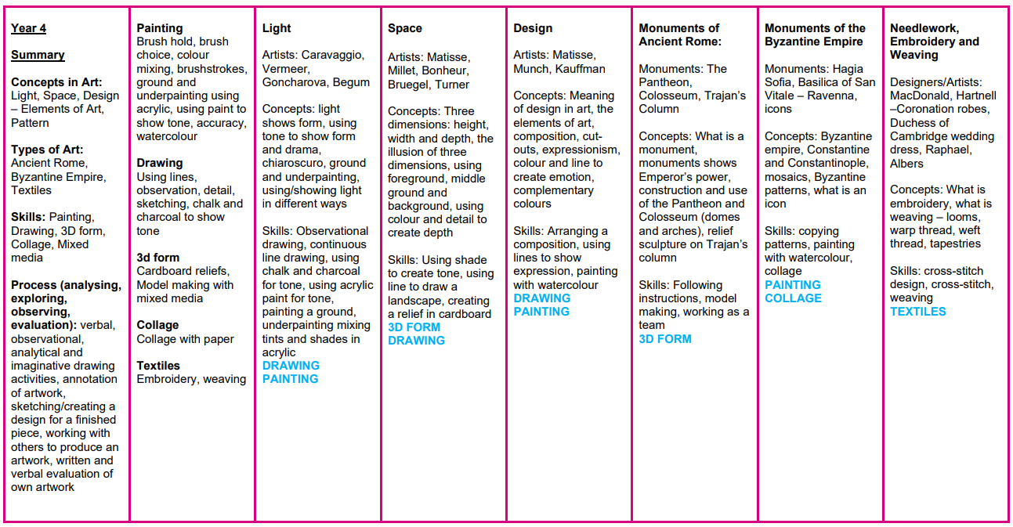
Curriculum Coverage

Slide 9
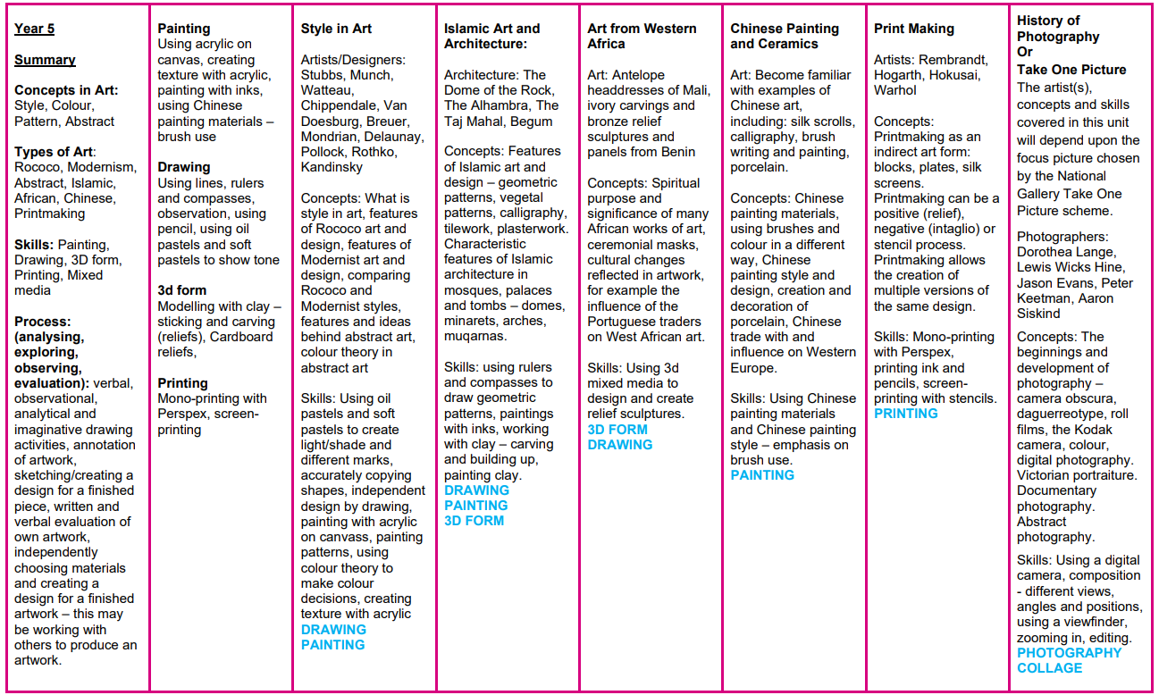
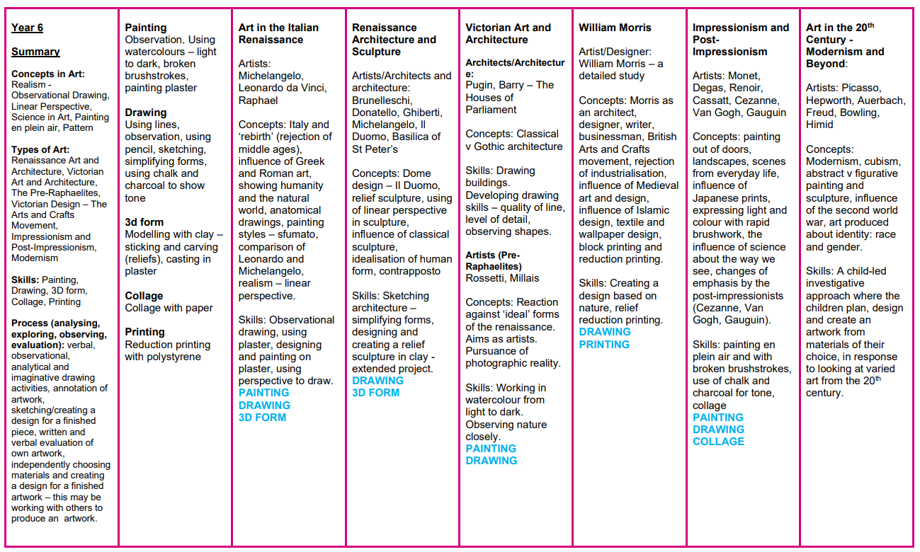
Curriculum Coverage

Slide 10
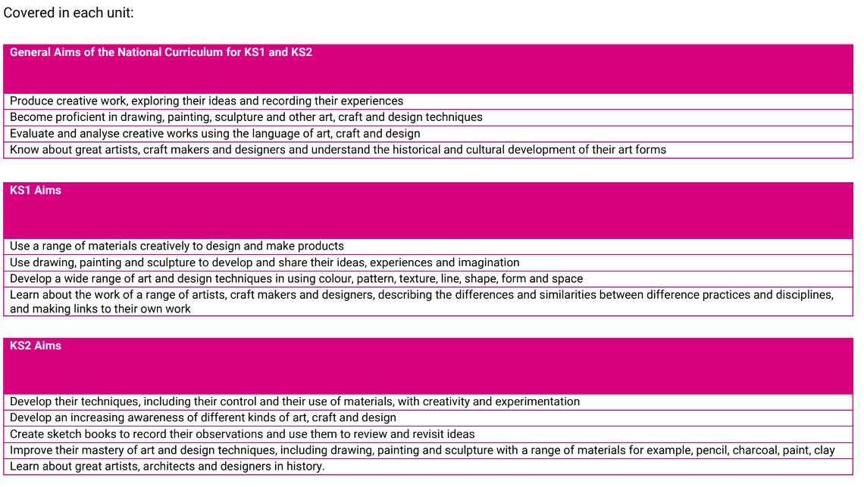
Curriculum Coverage

Slide 11

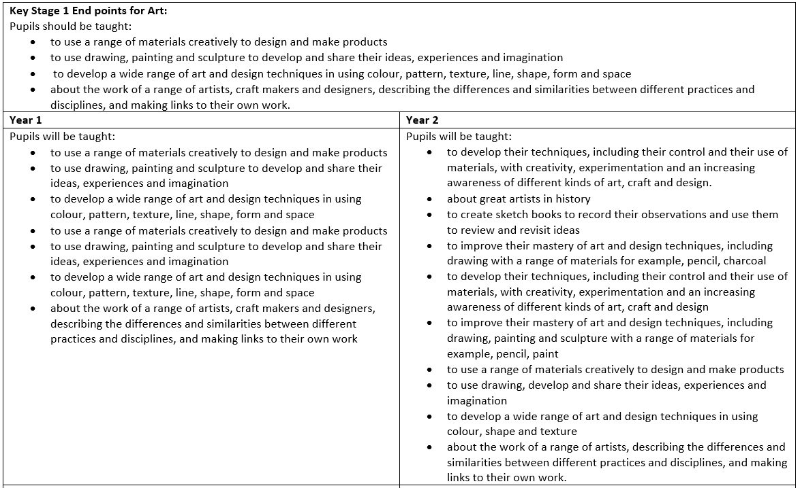
Progression of Knowledge
Year 1
Year 2

Slide 12
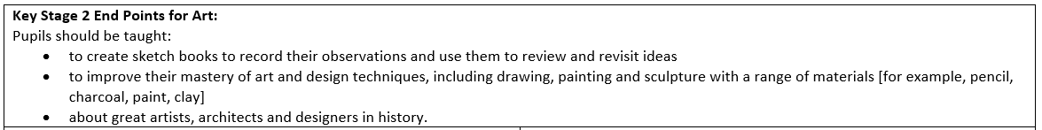
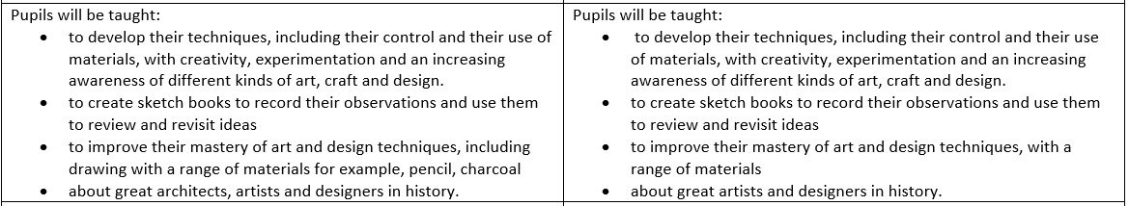
Progression of Knowledge
Year 3
Year 4

Slide 13
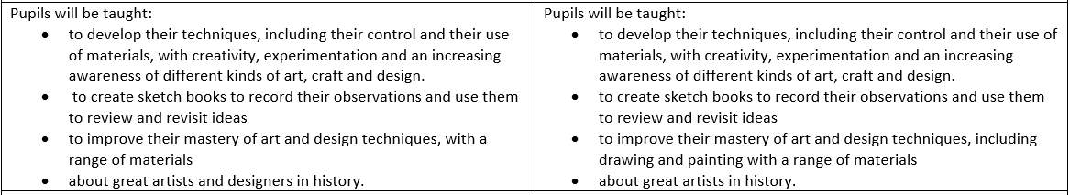
Progression of Knowledge
Year 5
Year 6

Slide 14
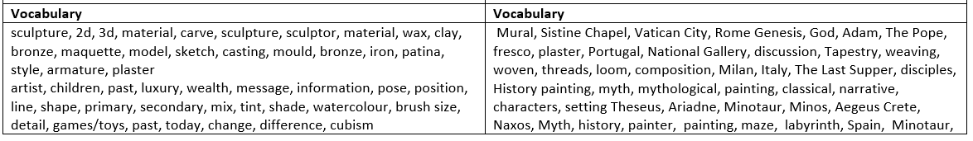
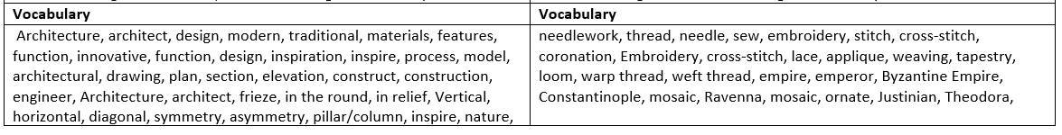
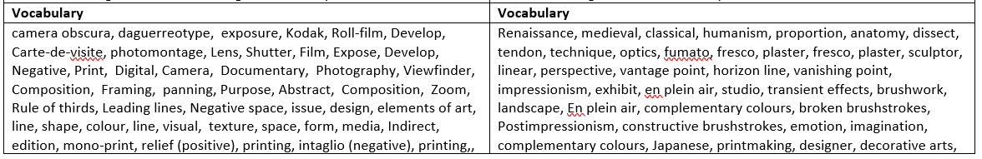
Progression of Vocabulary
Year 1
Year 2
Year 3
Year 4
Year 3
Year 4
Year 3
Year 4
Year 5
Year 6

Slide 15
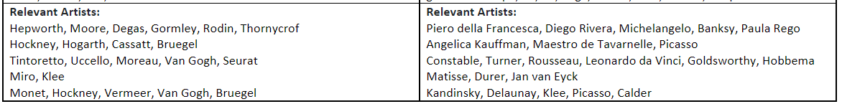
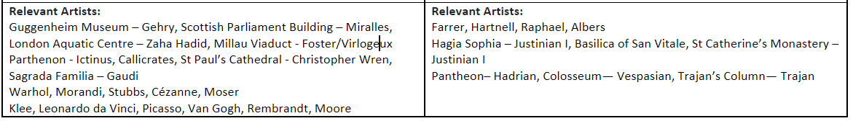
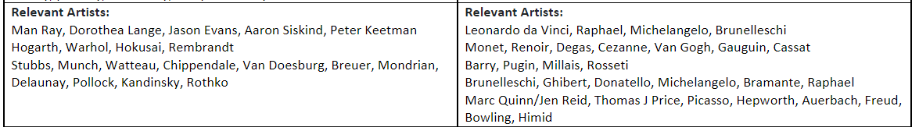
Progression of Artists
Year 1
Year 2
Year 3
Year 4
Year 5
Year 6

Slide 16

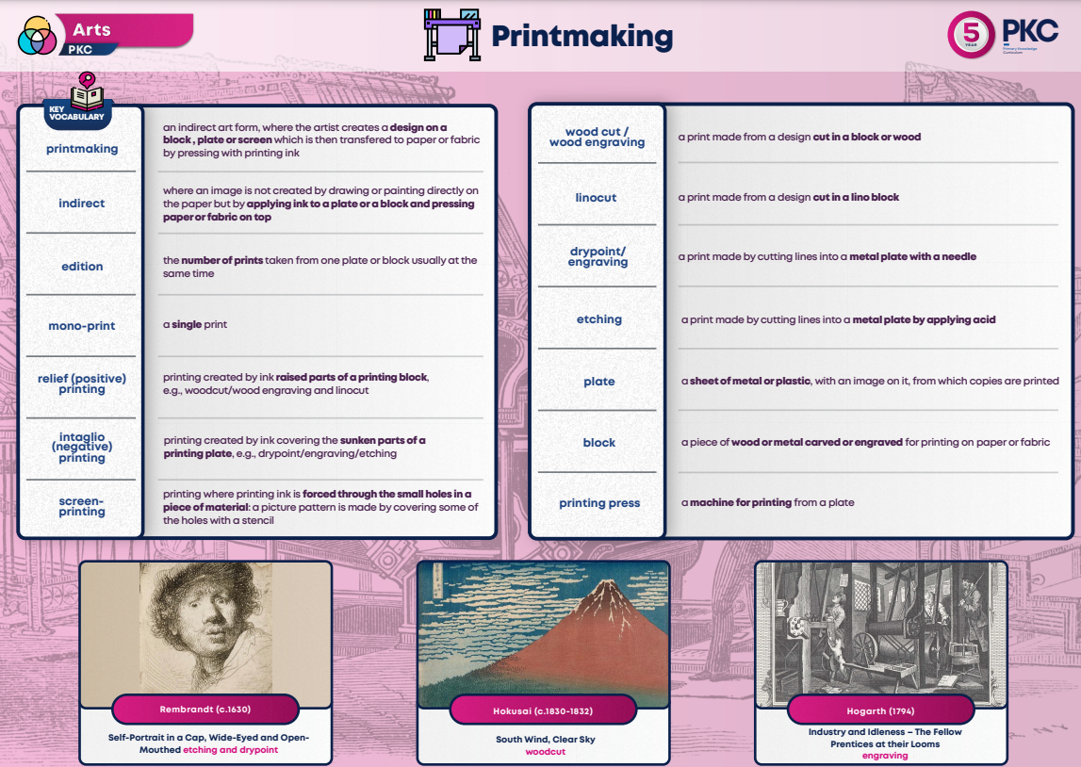
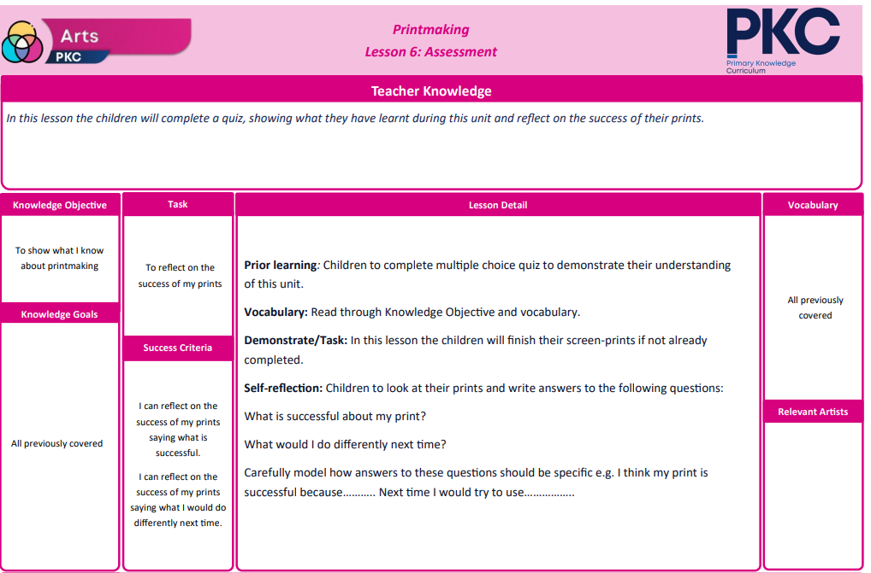
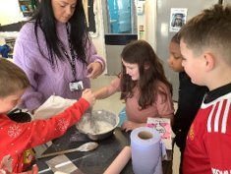
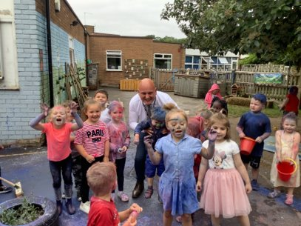
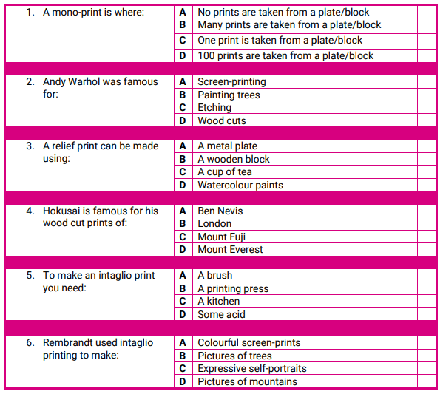
Assessment
Evidence and Assessment
It is expected that evidence of the children’s art will be recorded in sketchbooks which can include the work, or photographs of the work they produce each lesson. Sketchbooks may include written reflections on the work of other artists/designers/architects, as well as the children’s written reflections on their own work.
Activities children are directed to undertake in lessons are designed with an eye to the importance of learning and practicing process. These activities include verbal and written observations and observational, analytical and imaginative drawing activities in key stage 1, leading to the process of independent investigation, observation, annotation, sketching, design and planning (allowing the children to experiment and invent) by the end of key stage 2. Independent and investigative study and the understanding of process is particularly provided for in the units which conclude the year for years 5 and 6.
Multiple-choice Quizzes
Multiple-choice quizzes will be included in the children’s sketchbooks, so that both children and teachers can easily identify progression in knowledge, process and application of skills.

Slide 17

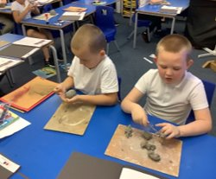
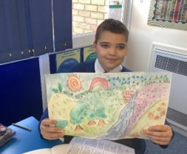
Inclusion
Explicit instruction - step-by-step modelling of what we want children to do, chunking the content and introducing new material in small steps
Cognitive and metacognitive strategies – opportunity to recall information to transfer it to our long-term memory
Scaffolding – pre-teaching, visual, verbal, written
Visual scaffolds may support a pupil to know what equipment they need, the steps they need to take, what their work should look like, an aid to access teaching and learning
Verbal scaffolds may involve re teaching a tricky concept to a group of pupils, or using questioning to identify and address any misconceptions
Written scaffolds will be provided for a pupil to support them with an independent written task. It could be notes made on a whiteboard during a discussion, a word bank, a sentence starter, a writing frame, it could even be the child’s own previous work used to support their recall.
Scaffolds provide temporary assistance to pupils so they can successfully complete tasks that they cannot yet do independently. We use scaffolds flexibly, evaluate their effectiveness and gradually remove them once they are no longer needed.
Flexible grouping - peer tutoring, Kagan grouping, flexible grouping
Assistive technology – to support delivery and recording of work
Rosenshine’s Principles of instruction:
Begin a lesson with a short review of previous learning
Present new material in small steps with pupil practice
Ask questions and check responses
Provide models
Guide pupil practice, provide scaffolding and support
Encourage independent practice and check pupil understanding
All children receive a high quality and ambitious education
All learners have access to the same academic opportunities by offering a stimulating and ambitious curriculum, adjusted to the needs of pupils with SEND, so that they are able to reach their full potential
It is vital that our children are equipped with the tools needed to become independent learners
Our curriculum will ensure that all pupils gain a greater understanding of how they learn and the skills of resilience, collaboration, participation, investigation, thinking, creativity, motivation and reflection
We provide an accessible learning environment which is tailored to the individual needs of all pupils
Pupils are supported by adults following a cycle of assess, plan, do, review, making necessary adjustments to the curriculum to meet the needs of all pupils
All learners are respected and acknowledged for their personal contribution

