Slide 1


Subject Handbook
Geography

Slide 2


Our Geography Curriculum
Intent
Our Geography curriculum is designed to develop children’s curiosity and fascination about the world and its people. Children investigate a range of places, both in Britain and abroad, to help develop their knowledge and understanding of the Earth’s physical and human processes. We are committed to providing children with opportunities to investigate and make enquiries about their local area so that they can develop of real sense of who they are; their heritage and what makes our local area unique and special. We are also developing the children’s ability to apply geographical skills and to enable them to confidently communicate their findings and geographical understanding.
Through high quality teaching, we develop the following essential characteristics of geographers:
An excellent knowledge of where places are and what they are like, both in Britain and the wider world;
A comprehensive understanding of the ways in which places are interdependent and interconnected;
An extensive base of geographical knowledge and vocabulary;
Fluency in complex, geographical enquiry and the ability to apply questioning skills, as well as effective presentation techniques;
The ability to reach clear conclusions and explain their findings;
Excellent fieldwork skills as well as other geographical aptitudes and techniques;
The ability to express well-balanced opinions, rooted in very good knowledge and understanding about current issues in society and the environment;
A genuine interest in the subject and a real sense of curiosity about the world and its people.

Slide 3
Our Geography Curriculum
Implementation
We use the Primary Knowledge Curriculum to teach Geography. The PKC has been designed to be both knowledge-rich and coherently sequenced. As children work through the geography curriculum they will know and understand more about their local area, the UK, Europe and the World. Children will develop their geographical knowledge and understanding by building on prior knowledge, allowing them to make meaningful
connections and gain an understanding of how our world is connected.
Children will:
Learn about key geographical concepts such as place, space, the environment and interconnection;
Become more skilled at answering questions such as; What is it like to live in this place? What are the challenges of this environment?
Gain an understanding of what geographers do, what they look for and what they may say about a place;
Discover explorers such as Ibn Battuta, Roald Amundsen and Captain James Cook;
Look at the migration of both animals and people, studying the impact migration and colonialism had on places such as Australia and New Zealand.
Each year our geography curriculum begins with a ‘Spatial Sense’ unit that explicitly teaches geographical skills such as locating places on a map, positioning items on a map, using symbols in a key, interpreting scale, reading climate graphs, identifying locations using co-ordinates, interpreting population data, identifying elevation on relief maps and more. The spatial sense units for each year group are positioned at the beginning of the year to explicitly teach skills which will then be used in context throughout the rest of the year as children apply those skills to learn more about people, places and the environment. The spatial sense units build on prior knowledge before moving children on as the level of challenges increases from year to year.

Slide 4
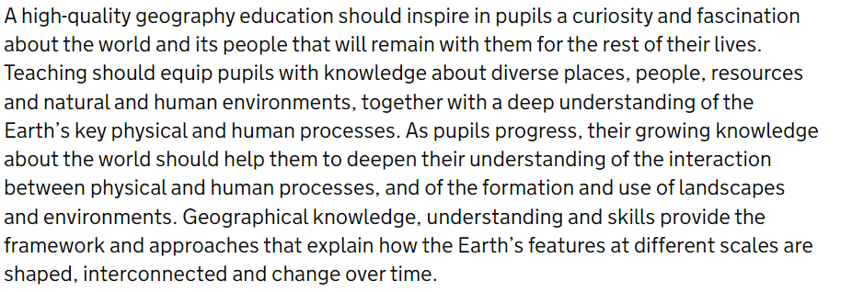
Our Geography Curriculum
Impact
Our geography curriculum equips pupils with knowledge about diverse places, people and environments.
We have seen that arming children with powerful knowledge about the world around them helps them to develop a love for the subject of geography and recognise their own role in becoming a responsible global citizen.

Slide 5

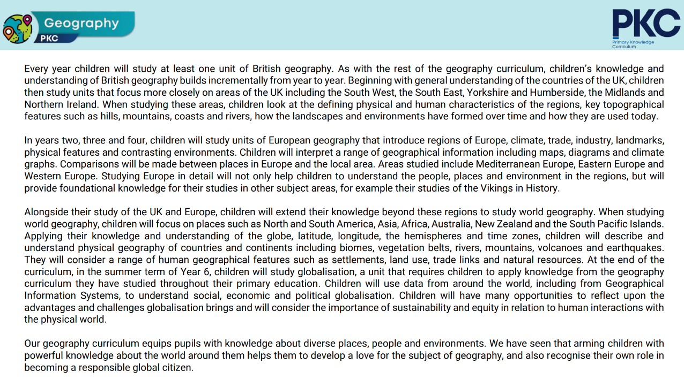
Curriculum Rationale

Slide 6
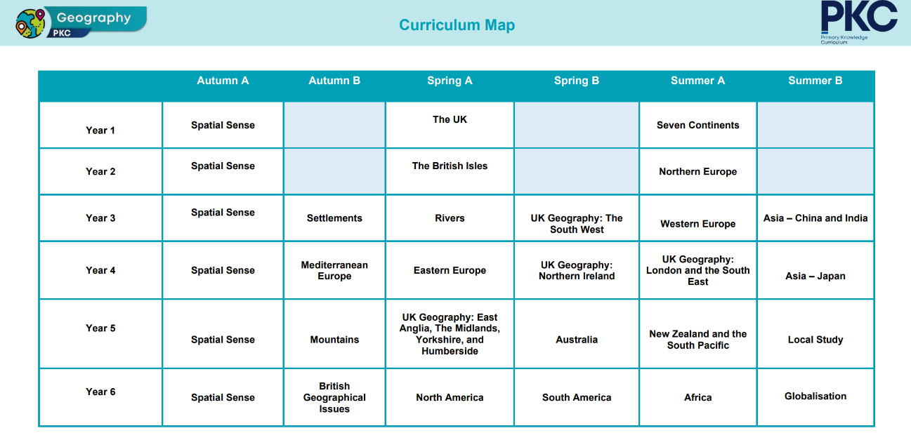
Curriculum Overview

Slide 7
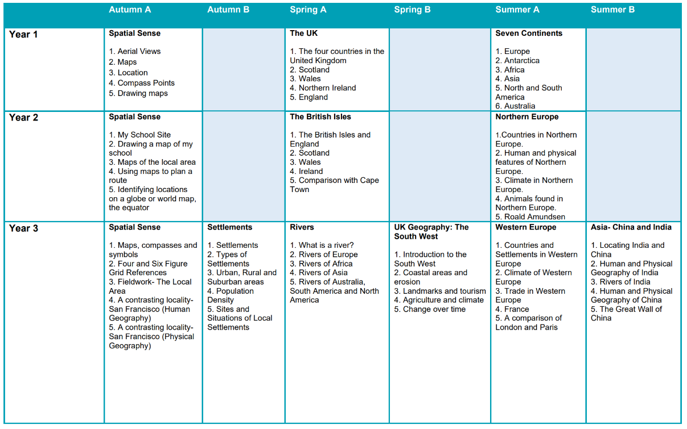
Curriculum Coverage

Slide 8
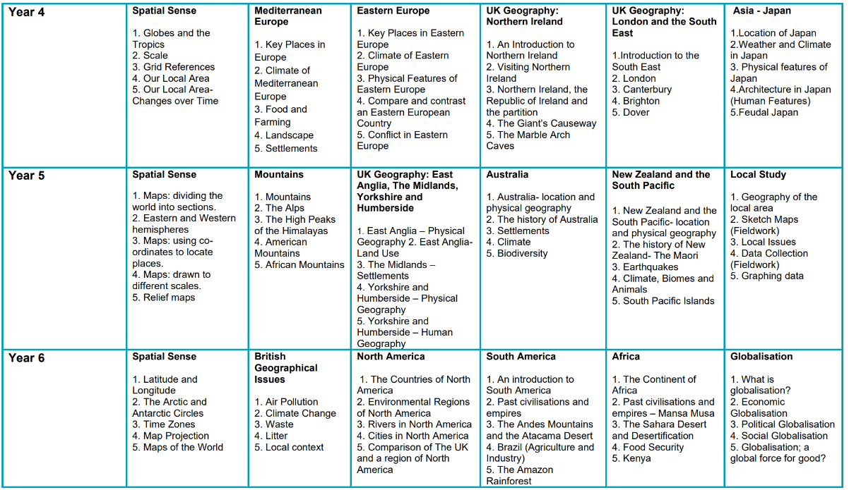
Curriculum Coverage

Slide 9
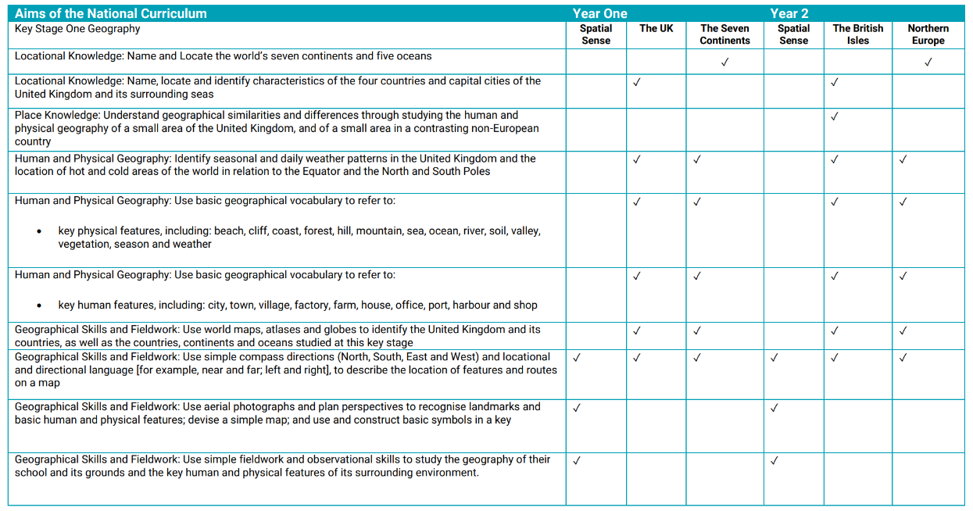
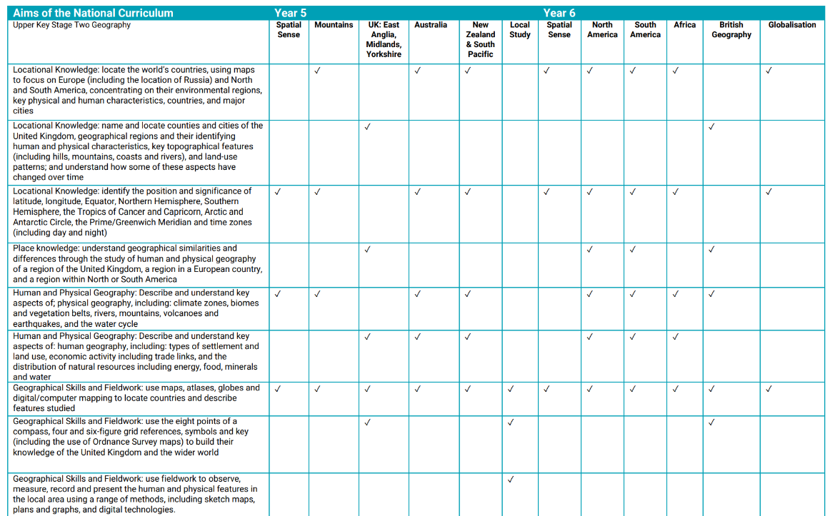
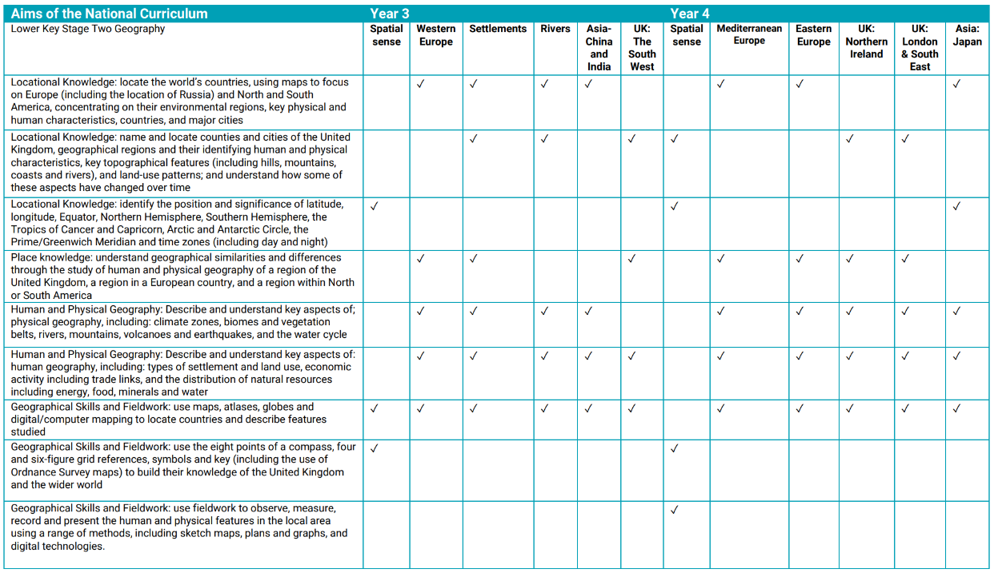
Curriculum Coverage

Slide 10

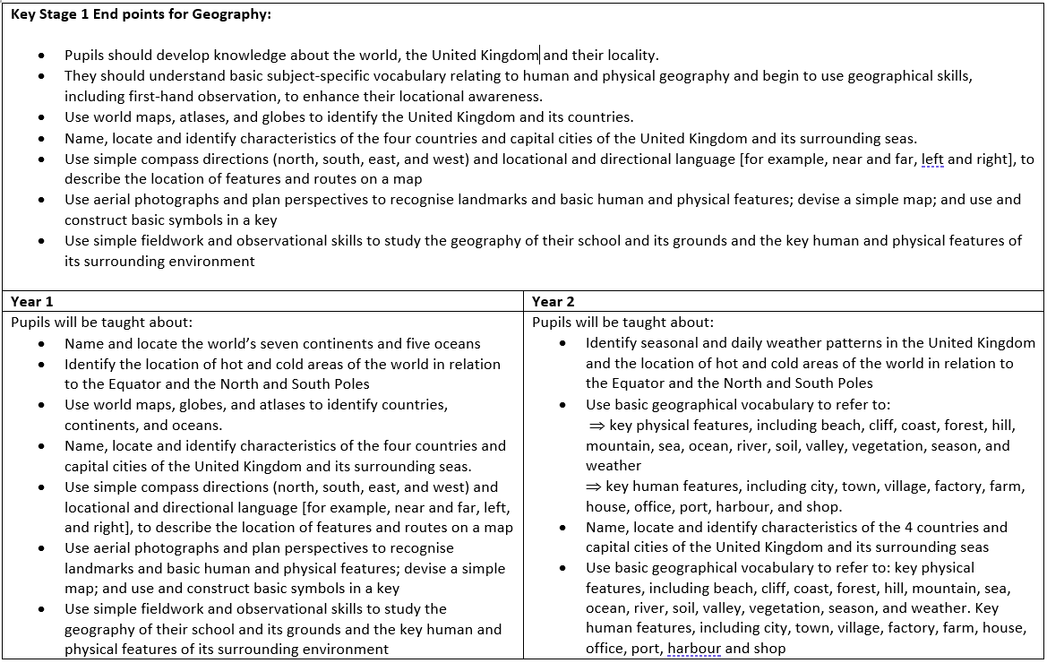
Progression of Knowledge

Slide 11
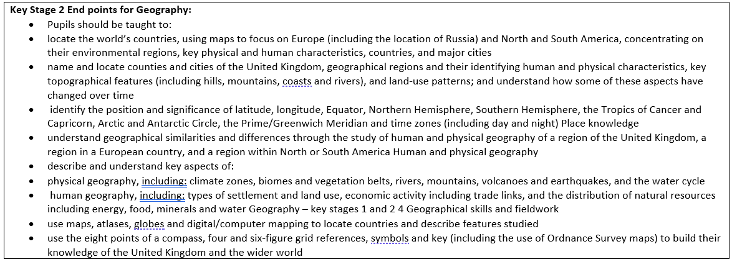
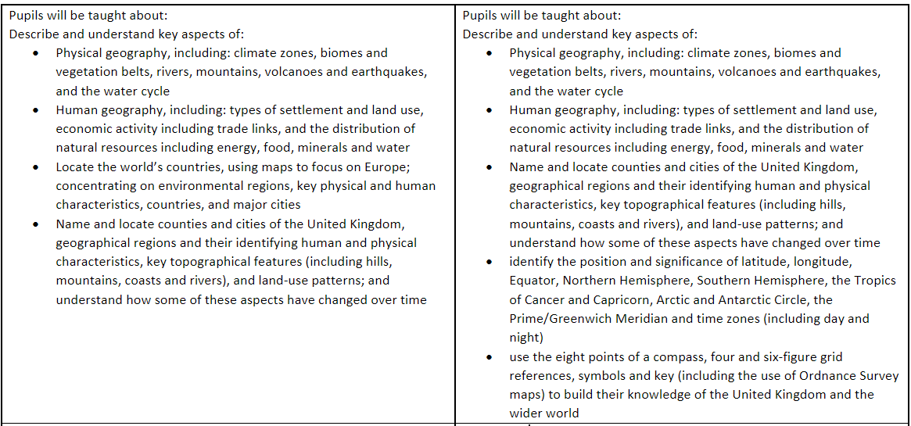
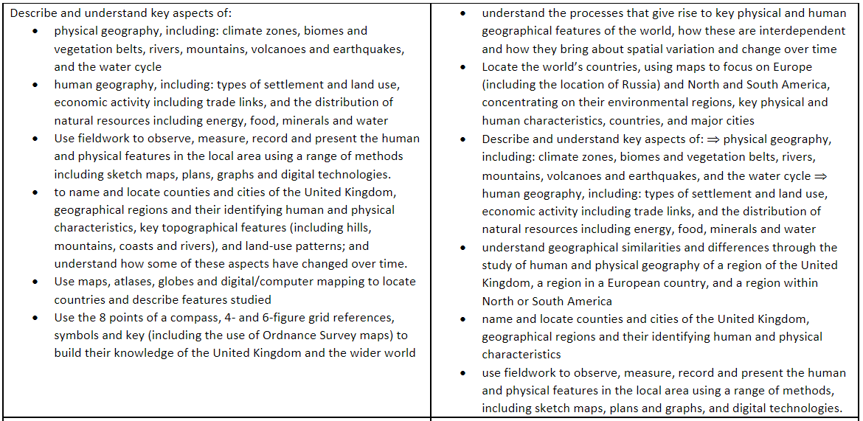
Progression of Knowledge
Year 3
Year 4
Year 5
Year 6

Slide 12
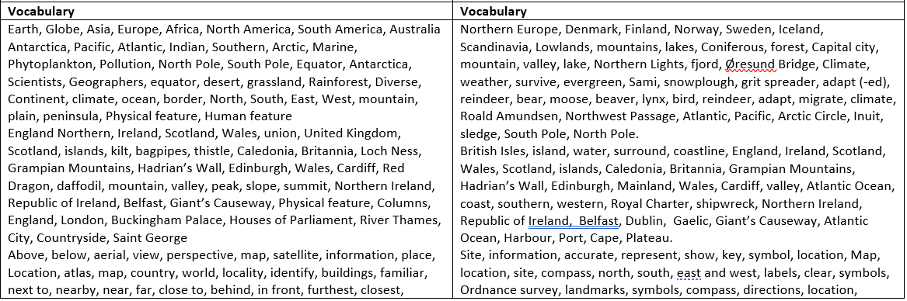
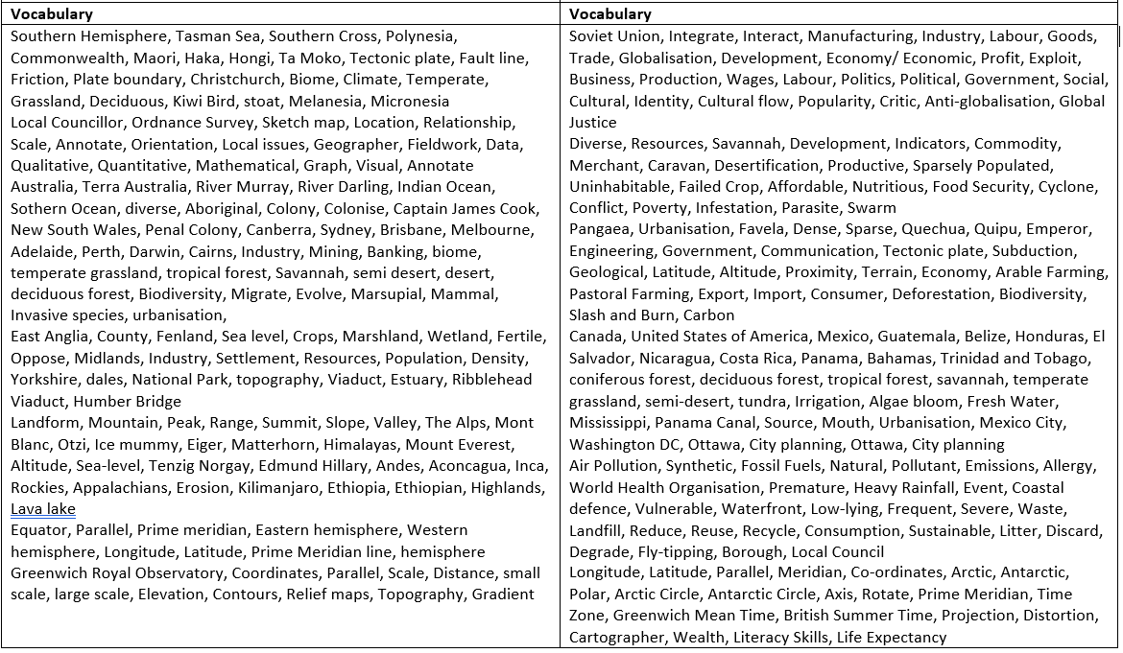
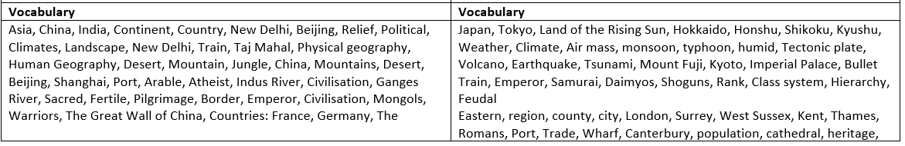
Progression of Vocabulary
Year 1
Year 2
Year 5
Year 6
Year 3
Year 4

Slide 13
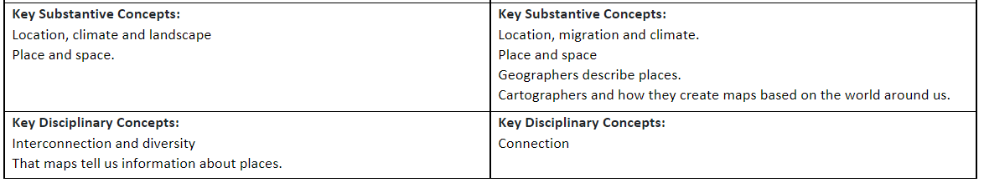
Progression of Knowledge
Year 1
Year 2

Slide 14
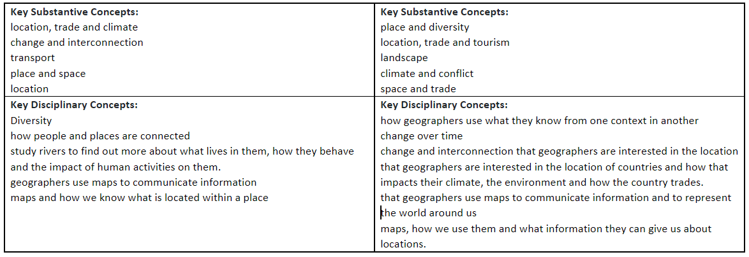
Progression of Knowledge
Year 3
Year 4

Slide 15
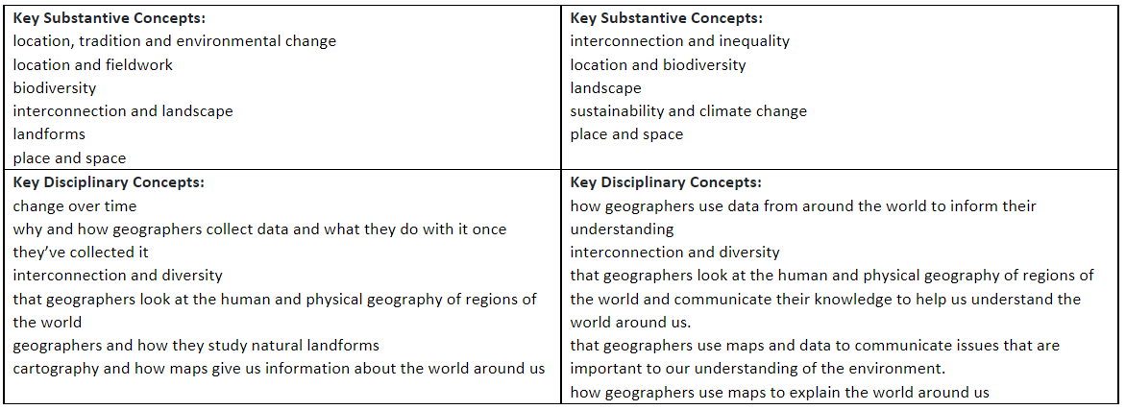
Progression of Knowledge
Year 5
Year 6

Slide 16

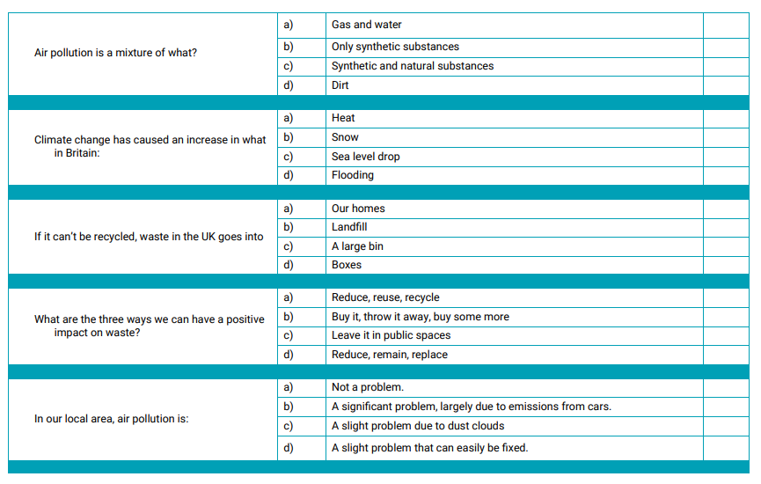
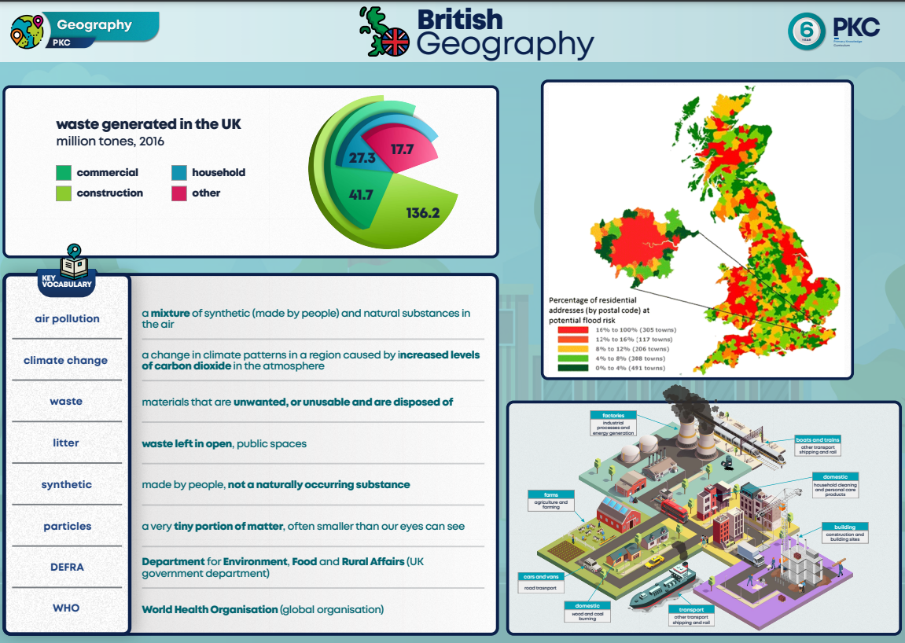
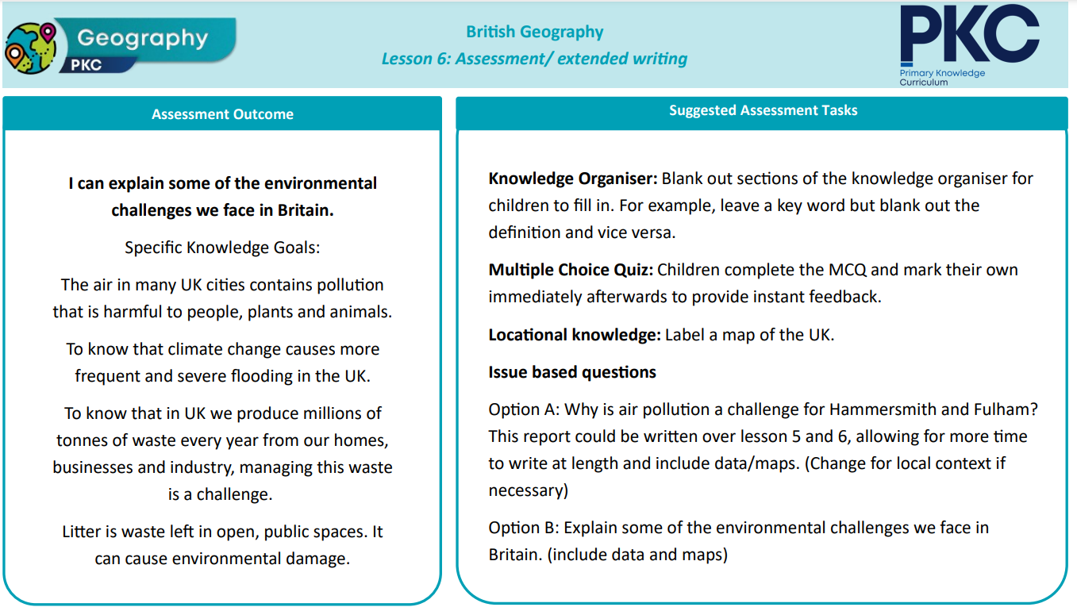
Assessment
Written Assessment
Children are assessed at the end of each Geography unit, where they complete a multiple-choice quiz as well as an essay-style task. The task is designed to consolidate learning as well as giving the class teacher a clear understanding of knowledge retention.
Summative Assessment
Children are formally assessed using Family Fisher Trust.

Slide 17


Inclusion
Explicit instruction - step-by-step modelling of what we want children to do, chunking the content and introducing new material in small steps
Cognitive and metacognitive strategies – opportunity to recall information to transfer it to our long-term memory
Scaffolding – pre-teaching, visual, verbal, written
Visual scaffolds may support a pupil to know what equipment they need, the steps they need to take, what their work should look like, an aid to access teaching and learning
Verbal scaffolds may involve re teaching a tricky concept to a group of pupils, or using questioning to identify and address any misconceptions
Written scaffolds will be provided for a pupil to support them with an independent written task. It could be notes made on a whiteboard during a discussion, a word bank, a sentence starter, a writing frame, it could even be the child’s own previous work used to support their recall.
Scaffolds provide temporary assistance to pupils so they can successfully complete tasks that they cannot yet do independently. We use scaffolds flexibly, evaluate their effectiveness and gradually remove them once they are no longer needed.
Flexible grouping - peer tutoring, Kagan grouping, flexible grouping
Assistive technology – to support delivery and recording of work
Rosenshine’s Principles of instruction:
Begin a lesson with a short review of previous learning
Present new material in small steps with pupil practice
Ask questions and check responses
Provide models
Guide pupil practice, provide scaffolding and support
Encourage independent practice and check pupil understanding
All children receive a high quality and ambitious education
All learners have access to the same academic opportunities by offering a stimulating and ambitious curriculum, adjusted to the needs of pupils with SEND, so that they are able to reach their full potential
It is vital that our children are equipped with the tools needed to become independent learners
Our curriculum will ensure that all pupils gain a greater understanding of how they learn and the skills of resilience, collaboration, participation, investigation, thinking, creativity, motivation and reflection
We provide an accessible learning environment which is tailored to the individual needs of all pupils
Pupils are supported by adults following a cycle of assess, plan, do, review, making necessary adjustments to the curriculum to meet the needs of all pupils
All learners are respected and acknowledged for their personal contribution

