Slide 1


Subject Handbook
History

Slide 2

Our History Curriculum
Intent
At St John’s, we believe that high-quality history lessons inspire children to want to know more about the past and to think and act as historians. By linking learning to a range of topics, children have opportunities to investigate and interpret the past, understand chronology, build an overview of Britain’s past as well as that of the wider world, and to be able to communicate historically.
To develop the essential characteristics that will help our children become historians, we enable them to:
Learn about what a historian does, looking at basic sources and simplified perspectives to develop an appreciation and understanding of what it means to be a historian;
Explore the connection between significant events and people and how they have influenced the modern world;
Have a secure overview of a period, before studying aspects in more depth;
Have more time to study the period in more detail;
Develop a solid understanding of the political context of each period as well as studying a wide range of contexts in more depth, including the cultural, social and religious context of the time;
Understand how the past is constructed and contested;
Ask perceptive questions, analyse more complex sources and begin to use their knowledge to develop perspective;
Explore continuity and change, cause and consequence and similarity, difference and significance

Slide 3
Our History Curriculum
Implementation
We use the Primary Knowledge Curriculum to teach History. The PKC has been designed to be both knowledge-rich and coherently sequenced. It allows our children to develop a chronologically secure knowledge and understanding of local, British and world history. The knowledge taught in the curriculum has been carefully chosen and sequenced using a largely chronological approach. Each unit of work is not viewed as a stand-alone topic, but as a chapter in the story of the history of Britain and the wider world.
From year to year, unit to unit, lesson to lesson, the curriculum supports children in making connections and building upon prior knowledge. For example, the children develop a secure understanding of ‘monarchy’ in Britain. They begin to learn about British monarchs in Year 1, and build upon their knowledge of monarchy in British society throughout the curriculum, looking
at the reigns of significant monarchs. Each British history unit allows children to add to their understanding of ‘monarchy’ in Britain, the impact it had on the lives of the British people, and analyse the significance and legacy of each monarch.

Slide 4
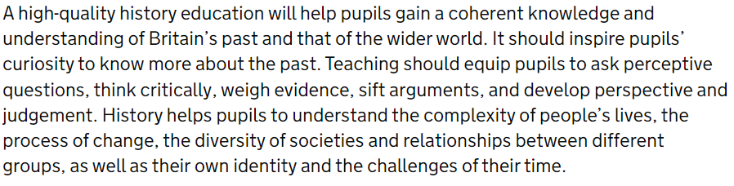
Our History Curriculum
Impact
The Primary Knowledge Curriculum aspires to create curious and knowledgeable young people, who hold a deep understanding and appreciation of the discipline of history and are able to sift and weigh evidence to begin to formulate their own viewpoints and perspectives of the world.
Ultimately, the impact and measure of this is to ensure that children at St John’s are equipped with historical skills and knowledge that will enable them to be ready for the curriculum at Key Stage 3 and for life as an adult in the wider world. We want the children to have thoroughly enjoyed learning about history, therefore encouraging them to undertake new life experiences now and in the future

Slide 5

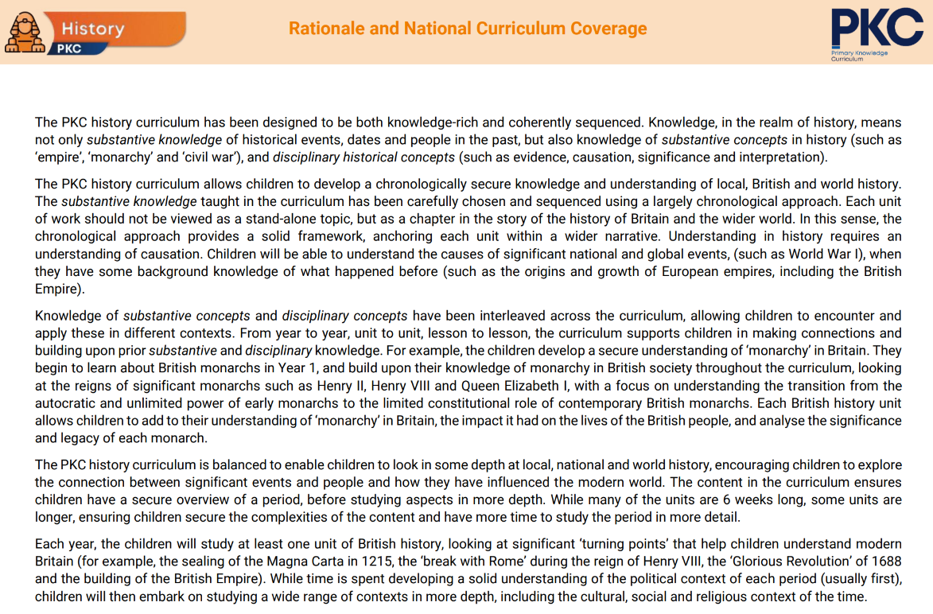
Curriculum Rationale

Slide 6
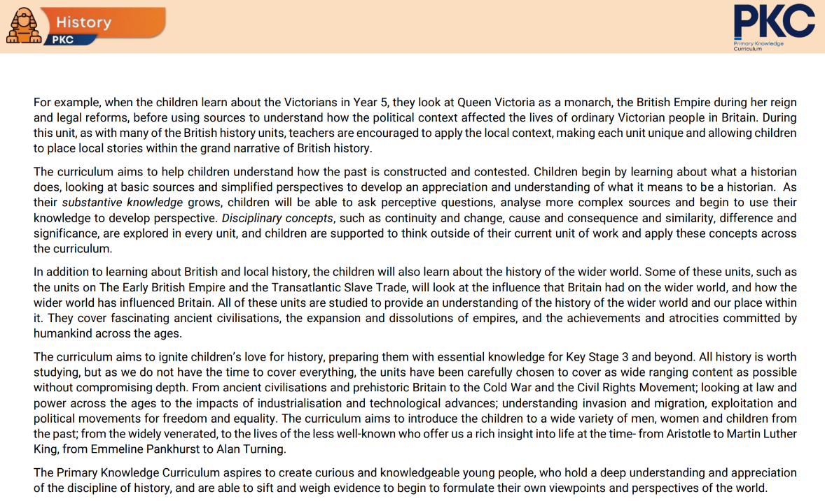
Curriculum Rationale

Slide 7
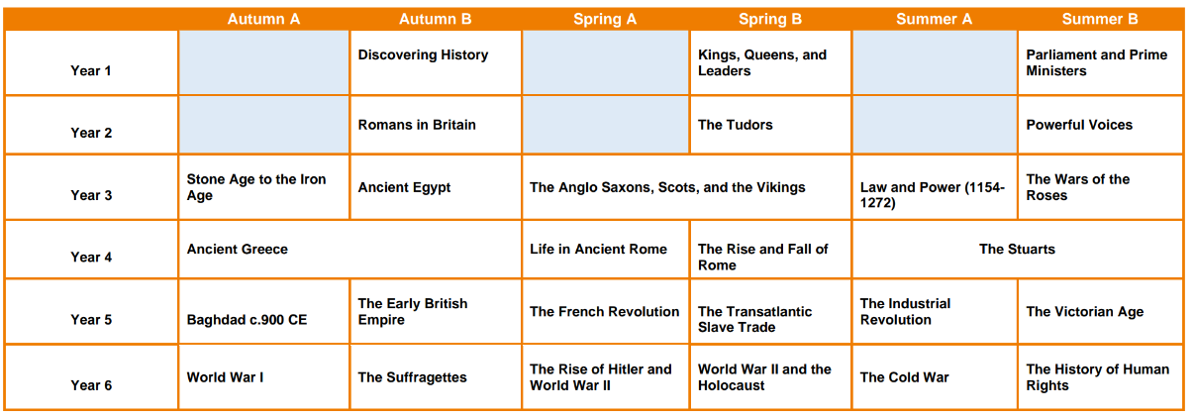
Curriculum Overview

Slide 8
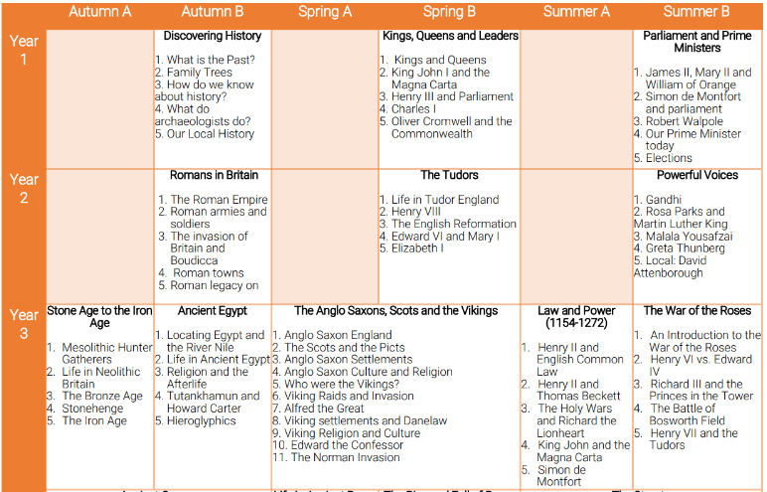
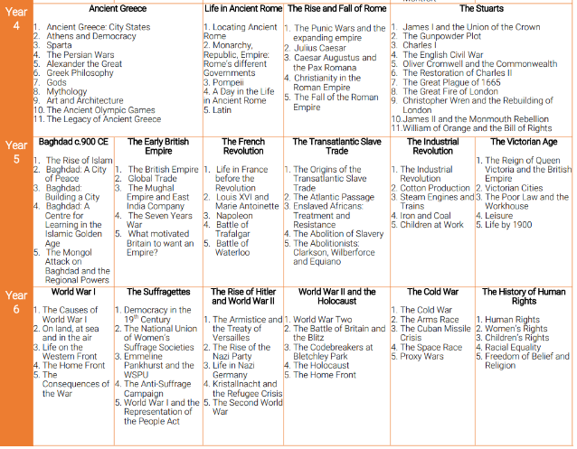
Curriculum Coverage

Slide 9
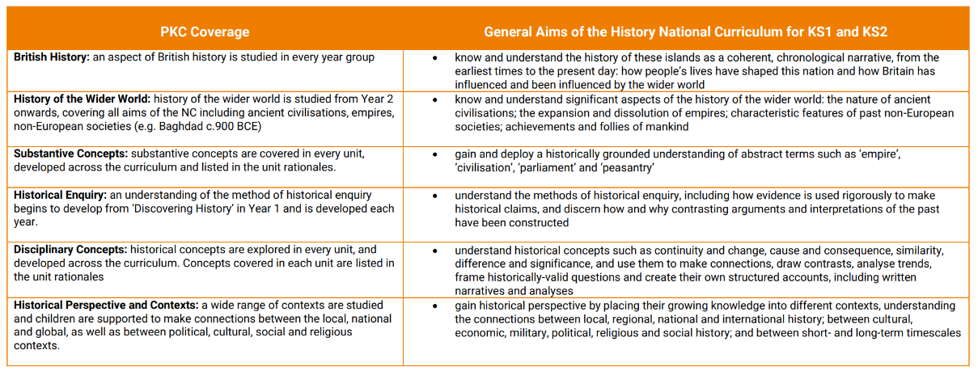
Curriculum Coverage

Slide 10
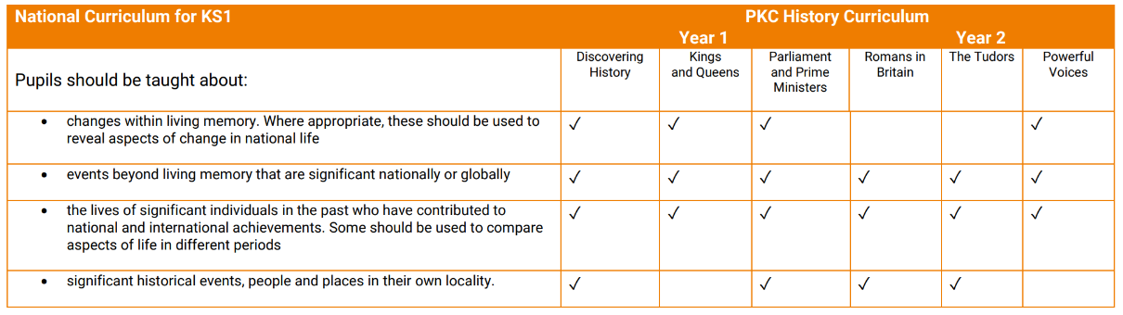
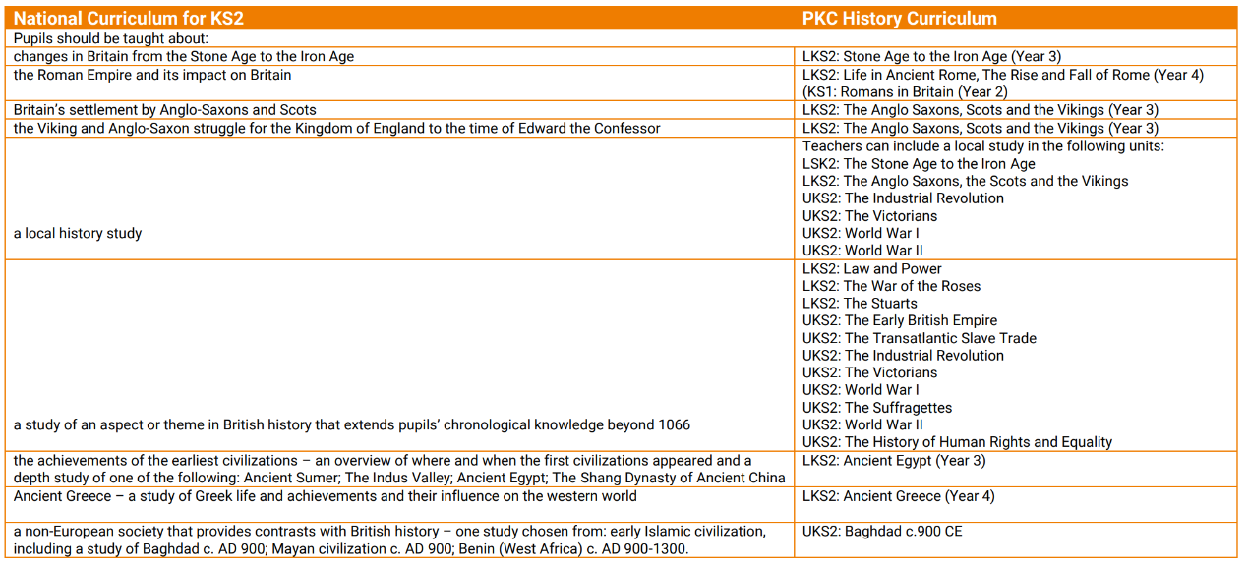
Curriculum Coverage

Slide 11

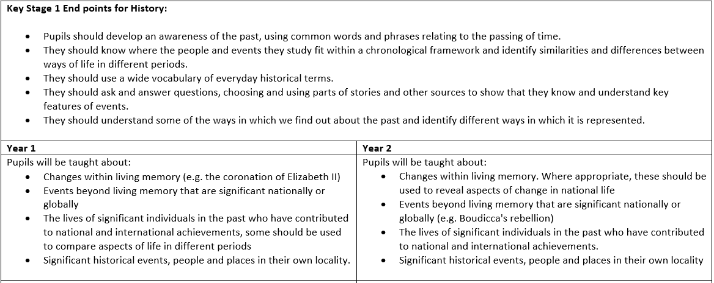
Progression of Knowledge

Slide 12
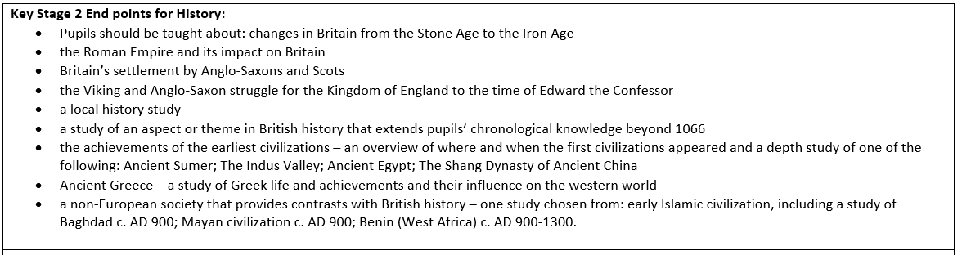
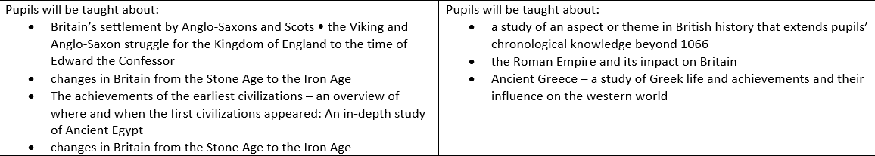
Progression of Knowledge
Year 3
Year 4

Slide 13
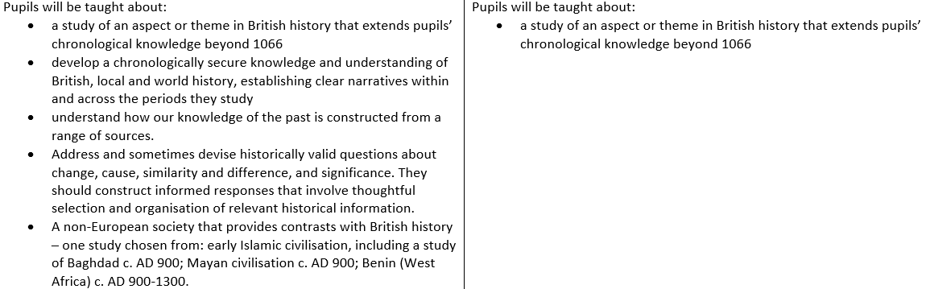
Progression of Knowledge
Year 5
Year 6

Slide 14
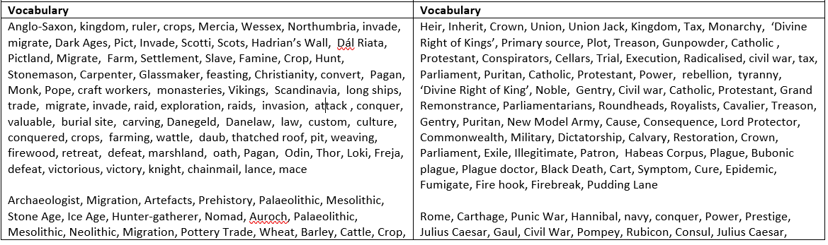
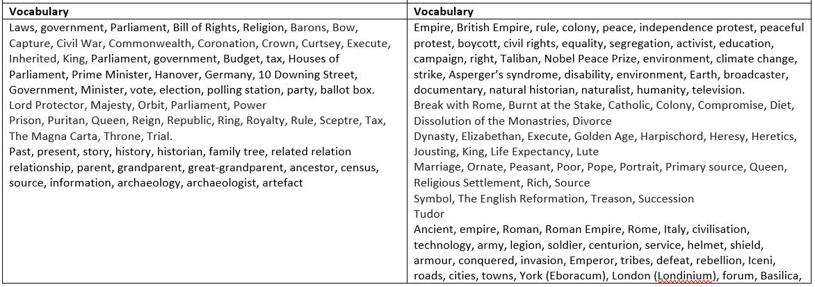
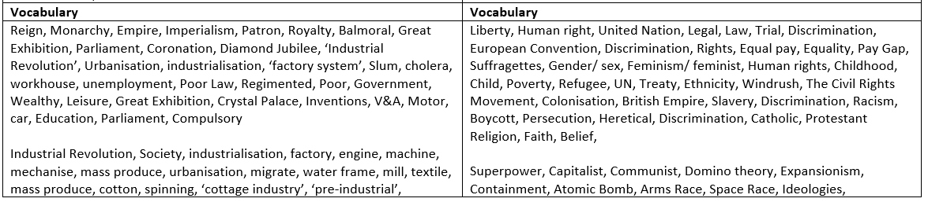
Progression of Vocabulary
Year 1
Year 2
Year 3
Year 4
Year 3
Year 4
Year 5
Year 6

Slide 15
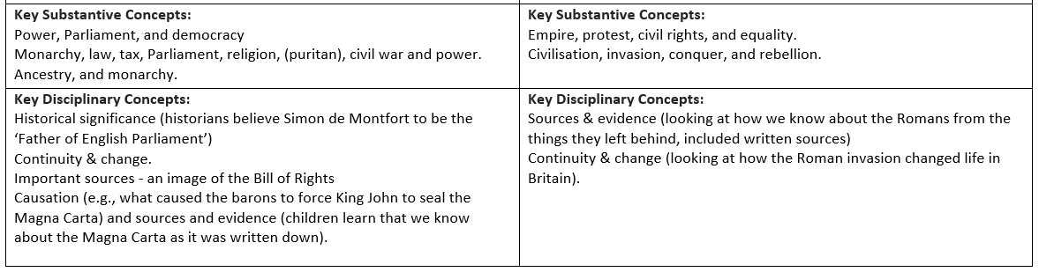
Progression of Knowledge
Year 1
Year 2

Slide 16
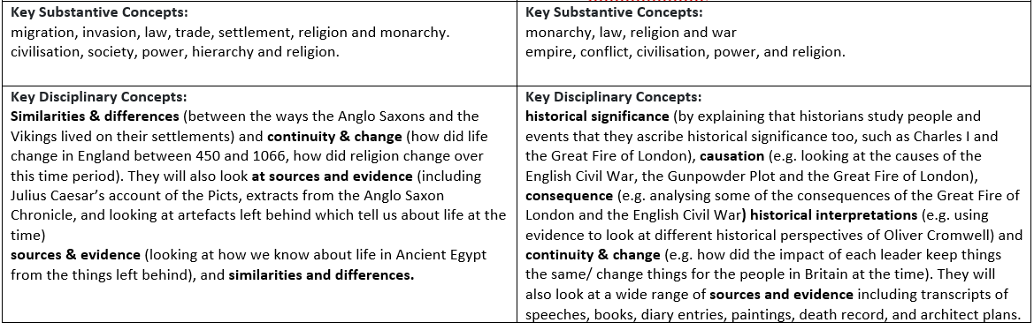
Progression of Knowledge
Year 3
Year 4

Slide 17
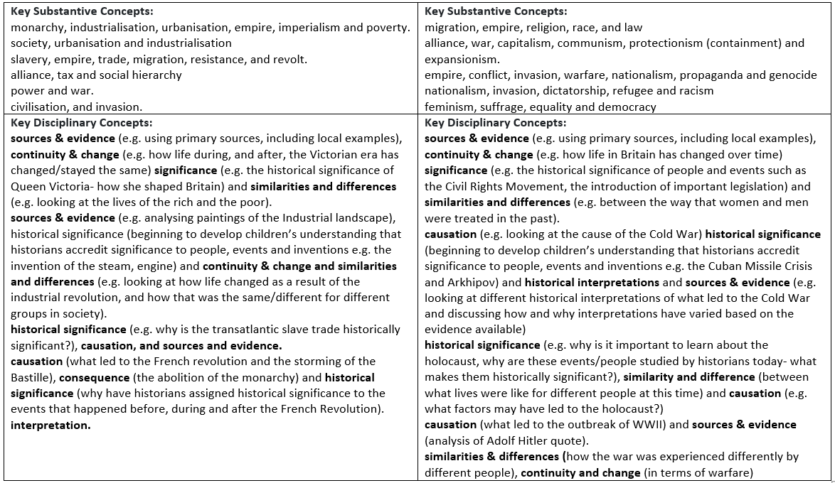
Progression of Knowledge
Year 5
Year 6
Year 5
Year 6

Slide 18

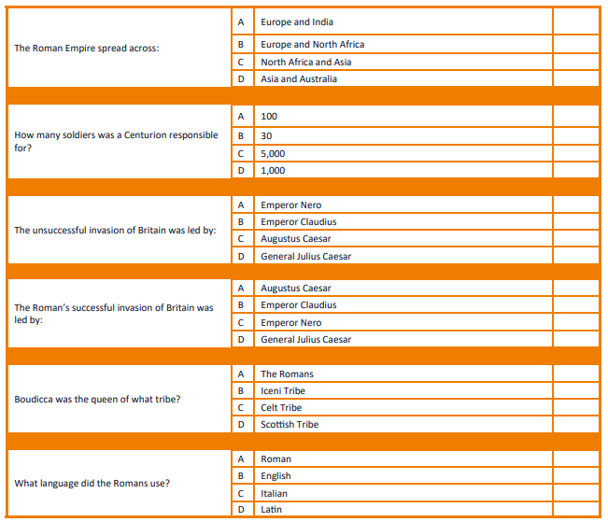
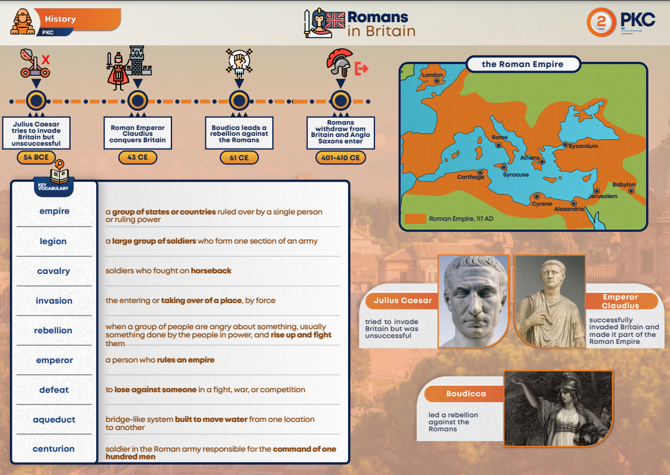
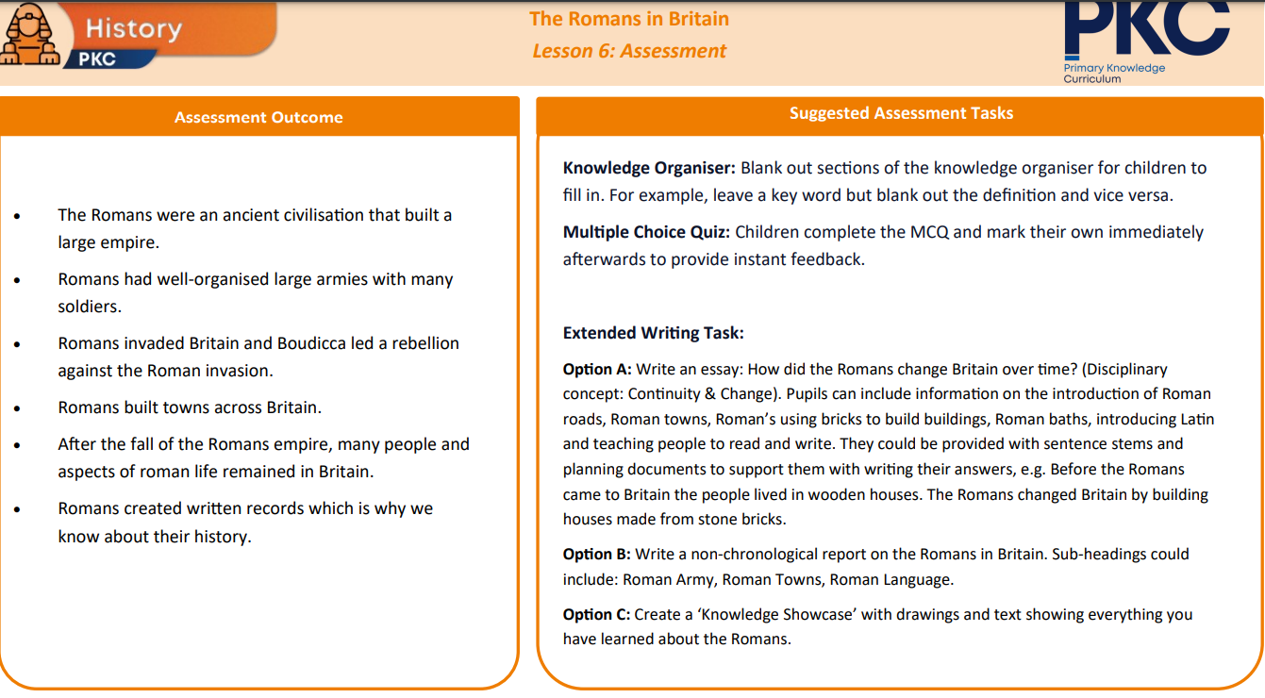
Assessment
Written Assessment
Children are assessed at the end of each History unit, where they complete a multiple-choice quiz as well as an essay-style task. The task is designed to consolidate learning as well as giving the class teacher a clear understanding of knowledge retention.
Summative Assessment
Children are formally assessed using Family Fisher Trust.

Slide 19


Inclusion
Explicit instruction - step-by-step modelling of what we want children to do, chunking the content and introducing new material in small steps
Cognitive and metacognitive strategies – opportunity to recall information to transfer it to our long-term memory
Scaffolding – pre-teaching, visual, verbal, written
Visual scaffolds may support a pupil to know what equipment they need, the steps they need to take, what their work should look like, an aid to access teaching and learning
Verbal scaffolds may involve re teaching a tricky concept to a group of pupils, or using questioning to identify and address any misconceptions
Written scaffolds will be provided for a pupil to support them with an independent written task. It could be notes made on a whiteboard during a discussion, a word bank, a sentence starter, a writing frame, it could even be the child’s own previous work used to support their recall.
Scaffolds provide temporary assistance to pupils so they can successfully complete tasks that they cannot yet do independently. We use scaffolds flexibly, evaluate their effectiveness and gradually remove them once they are no longer needed.
Flexible grouping - peer tutoring, Kagan grouping, flexible grouping
Assistive technology – to support delivery and recording of work
Rosenshine’s Principles of instruction:
Begin a lesson with a short review of previous learning
Present new material in small steps with pupil practice
Ask questions and check responses
Provide models
Guide pupil practice, provide scaffolding and support
Encourage independent practice and check pupil understanding
All children receive a high quality and ambitious education
All learners have access to the same academic opportunities by offering a stimulating and ambitious curriculum, adjusted to the needs of pupils with SEND, so that they are able to reach their full potential
It is vital that our children are equipped with the tools needed to become independent learners
Our curriculum will ensure that all pupils gain a greater understanding of how they learn and the skills of resilience, collaboration, participation, investigation, thinking, creativity, motivation and reflection
We provide an accessible learning environment which is tailored to the individual needs of all pupils
Pupils are supported by adults following a cycle of assess, plan, do, review, making necessary adjustments to the curriculum to meet the needs of all pupils
All learners are respected and acknowledged for their personal contribution

