Slide 1


Subject Handbook
Science

Slide 2


Our Science Curriculum
Intent
Ensuring ‘quality first teaching’ is achieved throughout the school through consistent delivery approaches and adherence to the sequential learning provided by the Primary Knowledge Curriculum.
Ensuring that colleagues are aware of expectations
Create positive and enthusiastic attitudes towards science
Ensure all children make good progress over the course of the year.
Action planning for future development
Creating a stronger relationship with school governors to support science.

Slide 3
Our Science Curriculum
Implementation
Ensuring that teaching within the subject is strong and promotes the acquisition of key knowledge, building on prior learning
Leading professional development, providing guidance and support to colleagues
Promoting the subject and championing the subject with colleagues and pupils
Oversee assessment
Meeting with ‘science governor’ and collaborating to strengthen the subject of science

Slide 4
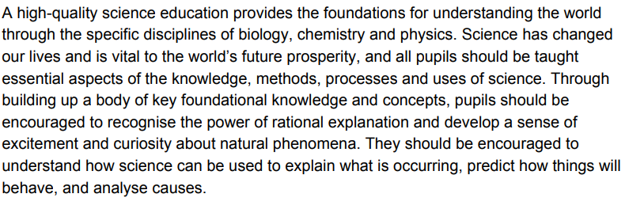
Our Science Curriculum
Impact
Monitoring the effectiveness of teaching and the impact on learning and standards
Evaluating and summarizing all aspects of the subject to define next steps for improvement.

Slide 5


Curriculum Rationale

Slide 6
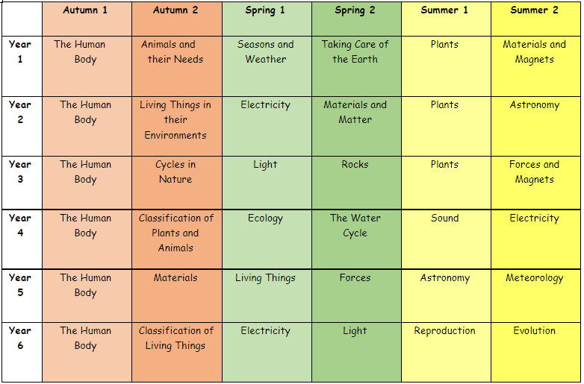
Curriculum Overview

Slide 7
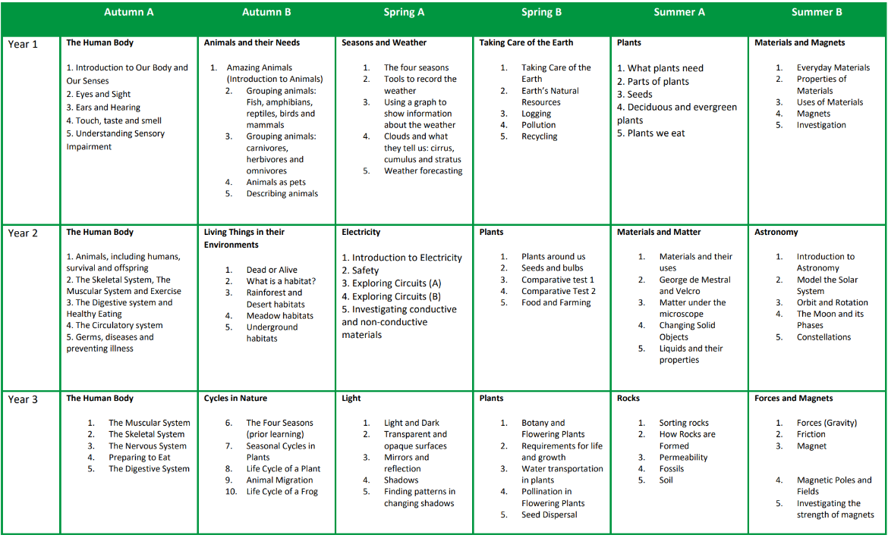
Curriculum Coverage

Slide 8
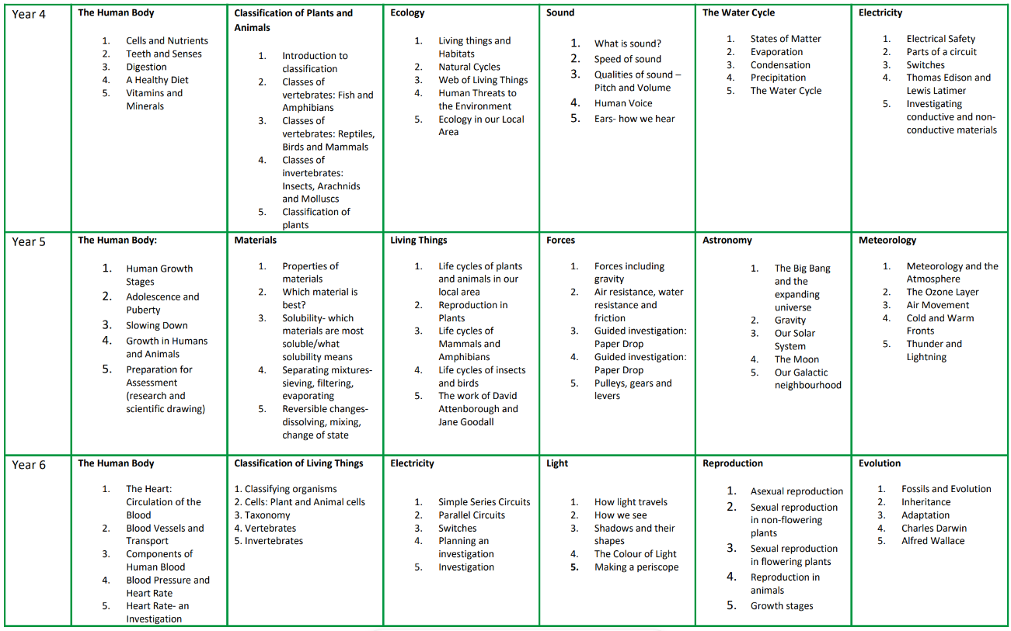
Curriculum Coverage

Slide 9
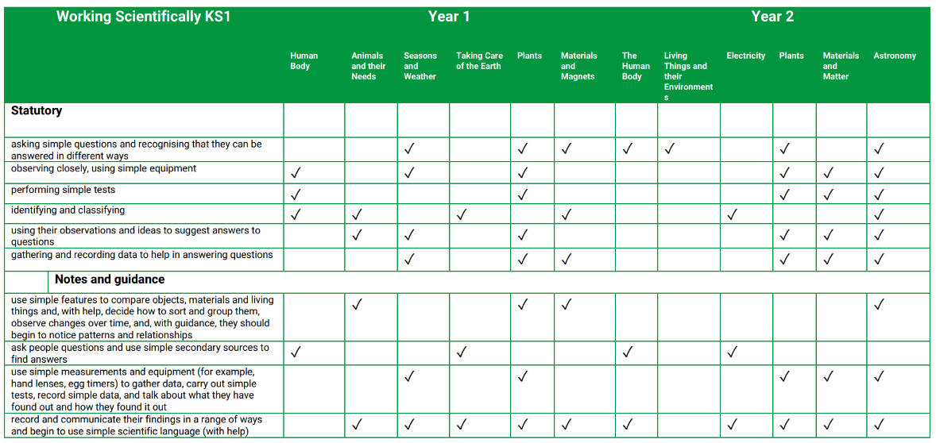
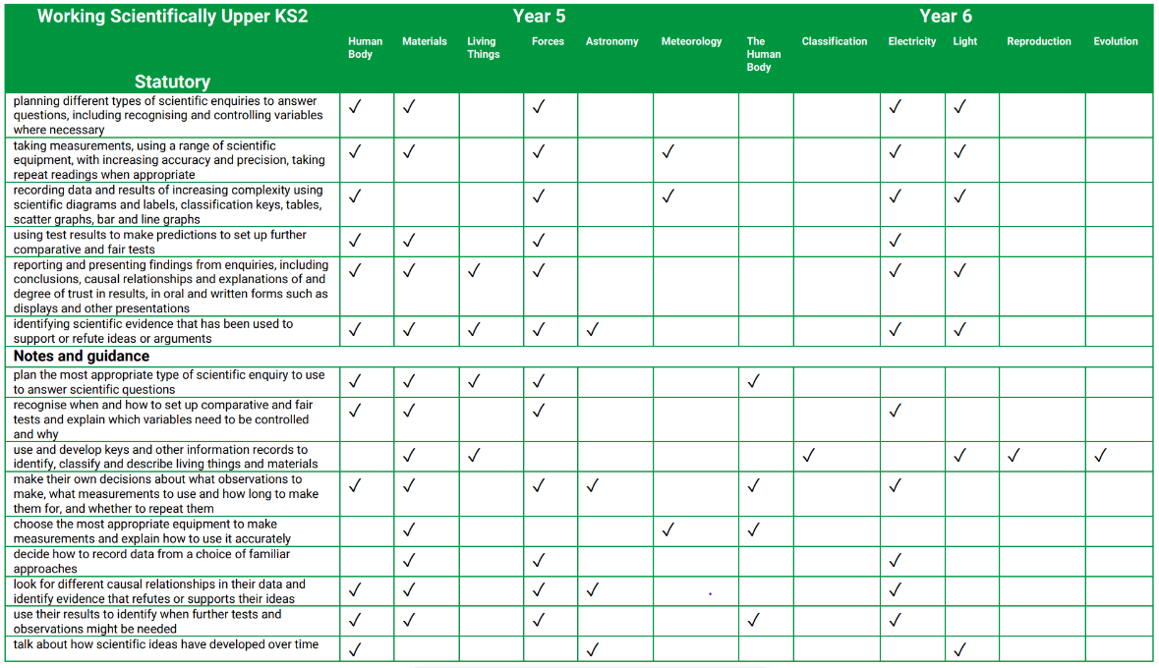
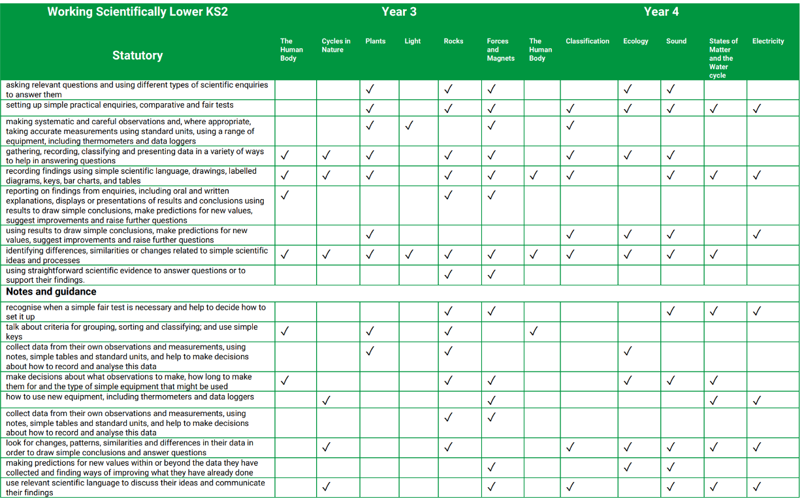
Curriculum Coverage

Slide 10

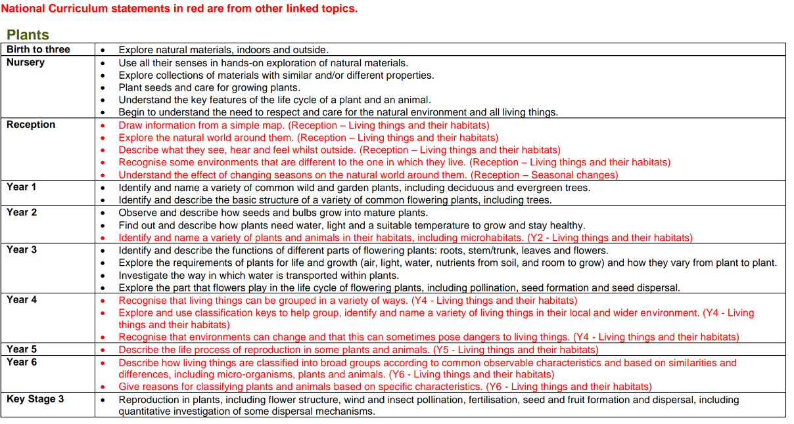
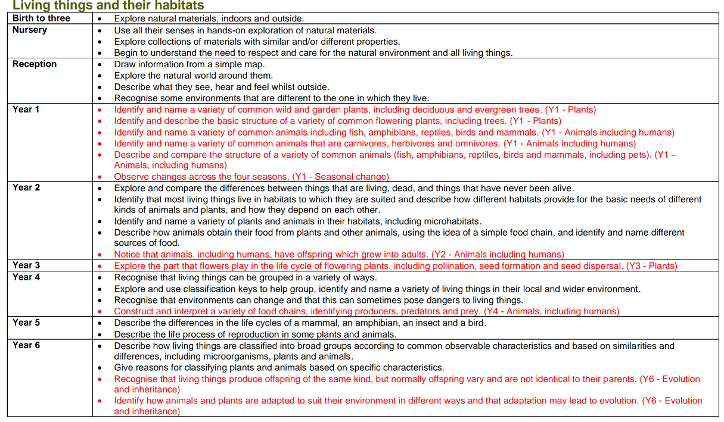
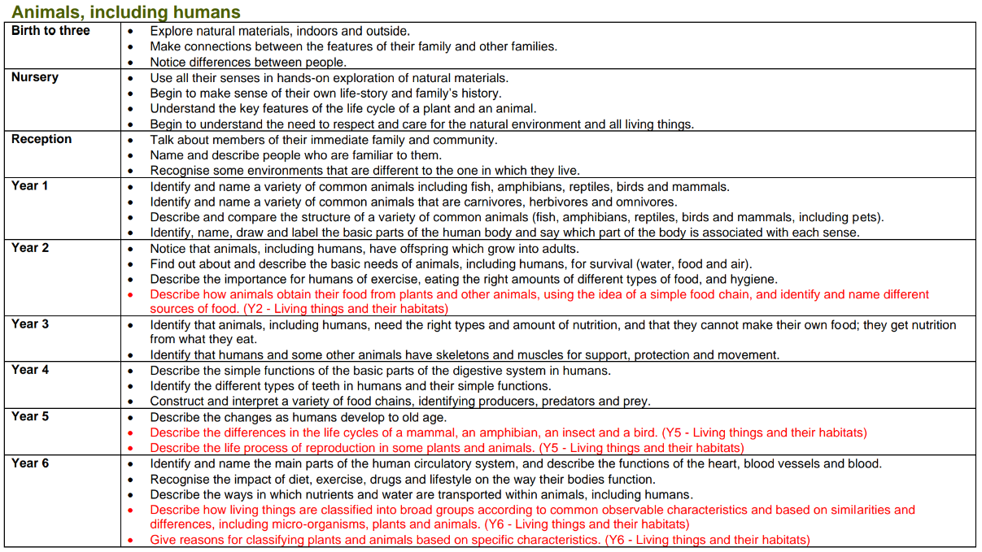
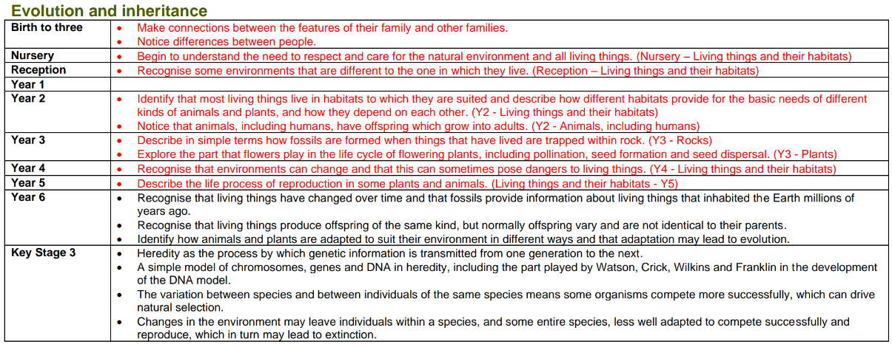
Progression of Knowledge

Slide 11
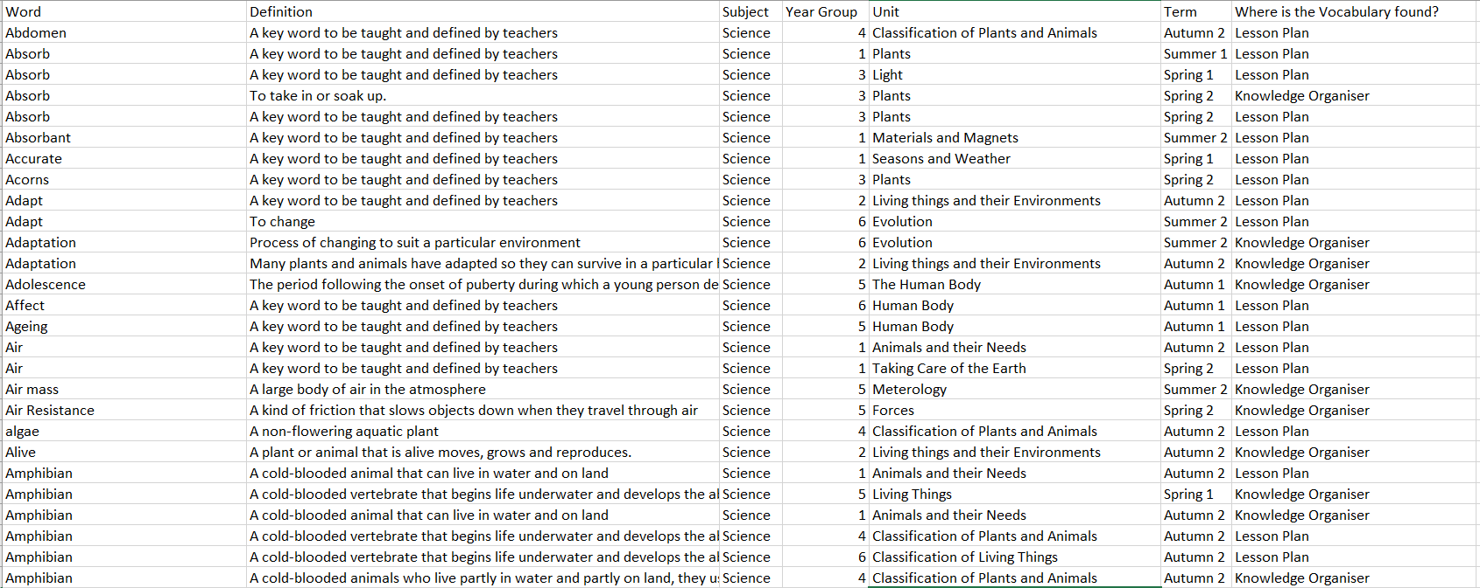
Progression of Vocabulary

Slide 12
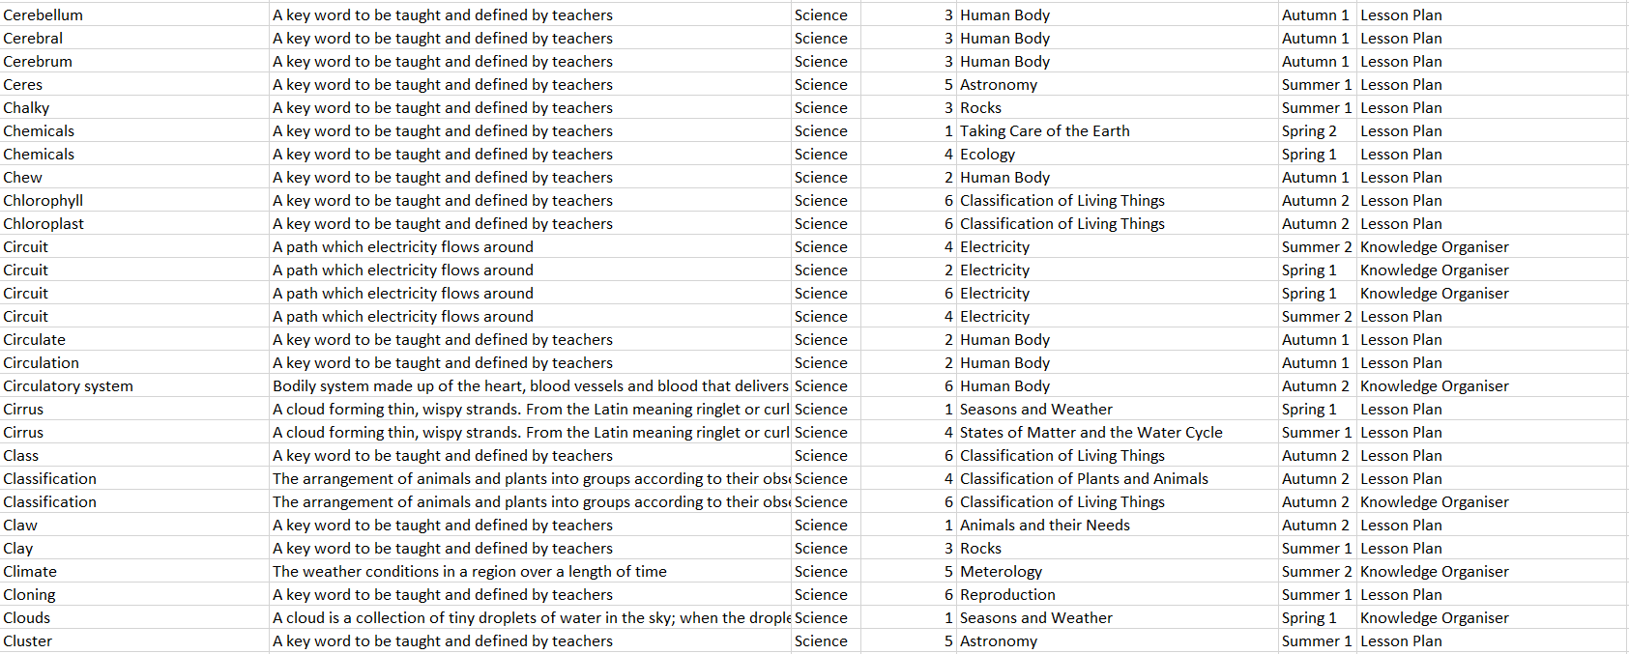
Progression of Vocabulary

Slide 13
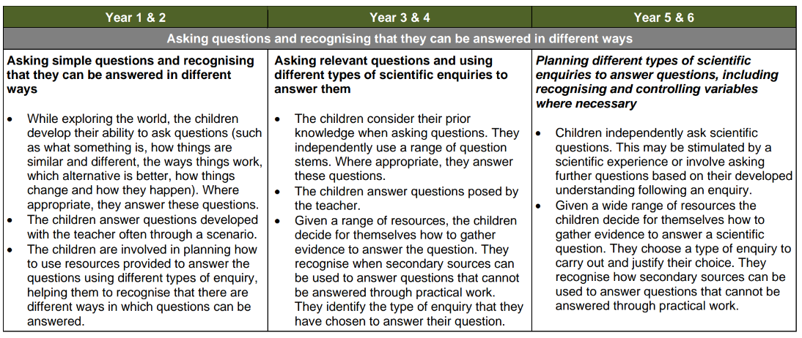
Progression of Skills
Working Scientifically

Slide 14
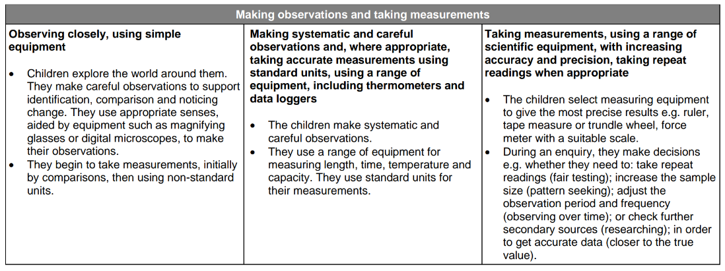
Progression of Skills
Working Scientifically

Slide 15
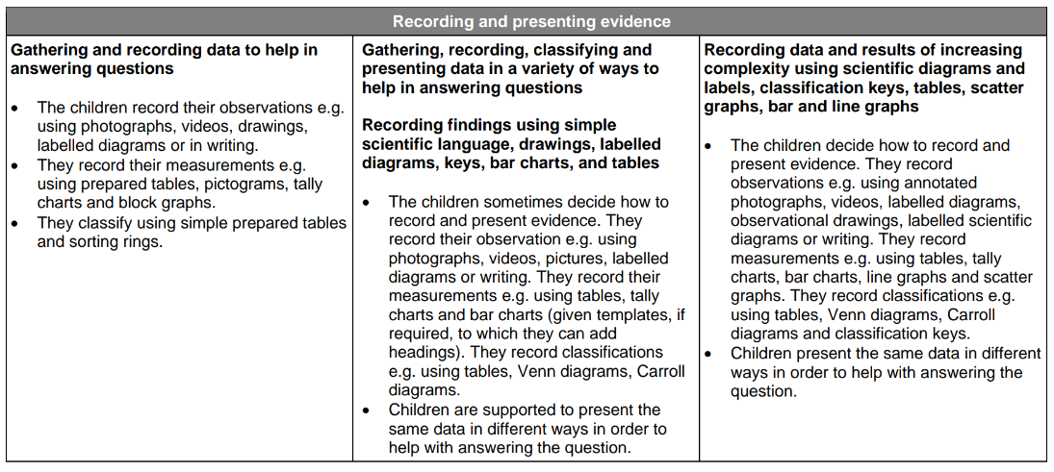
Progression of Skills
Working Scientifically

Slide 16
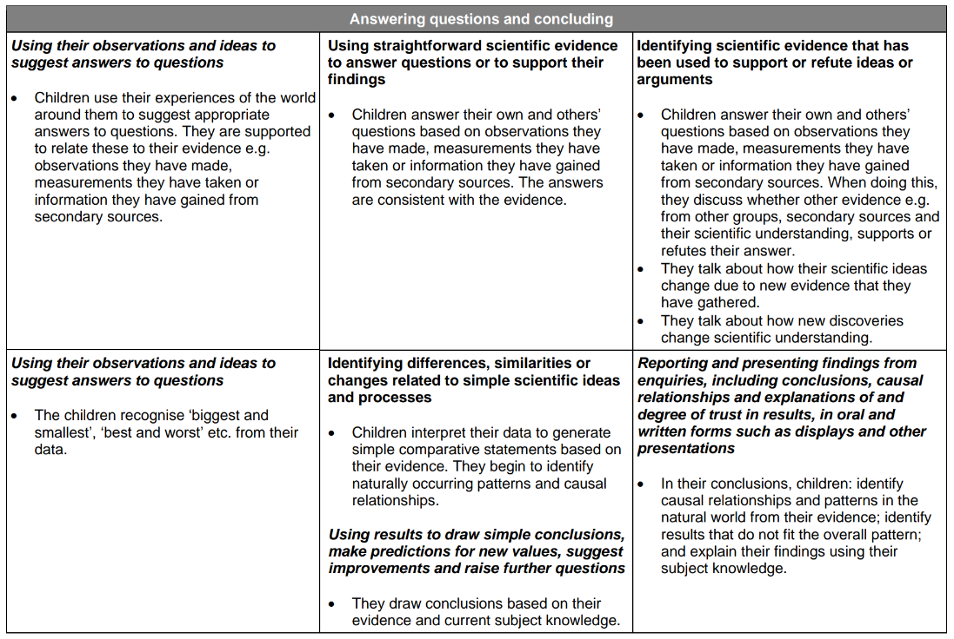
Progression of Skills
Working Scientifically

Slide 17
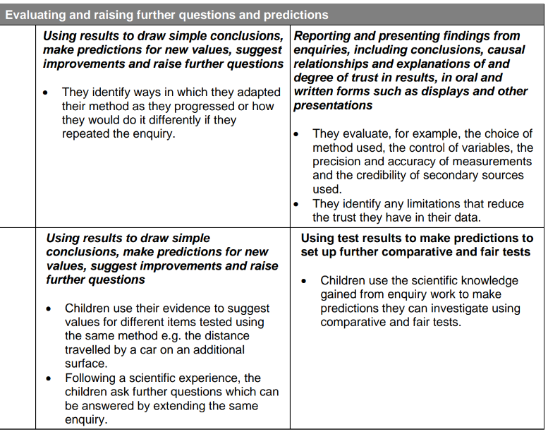
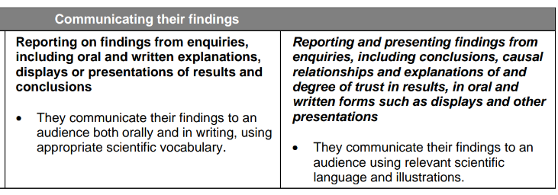
Progression of Skills
Working Scientifically

Slide 18

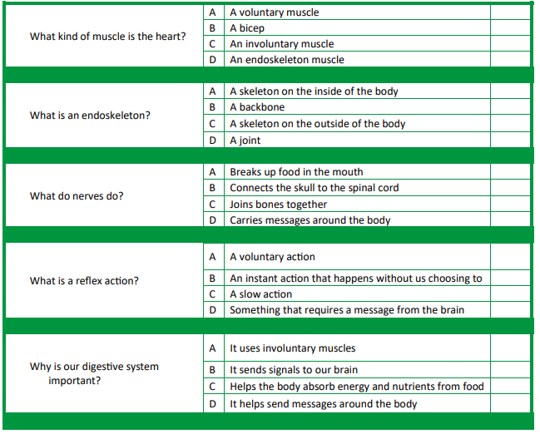
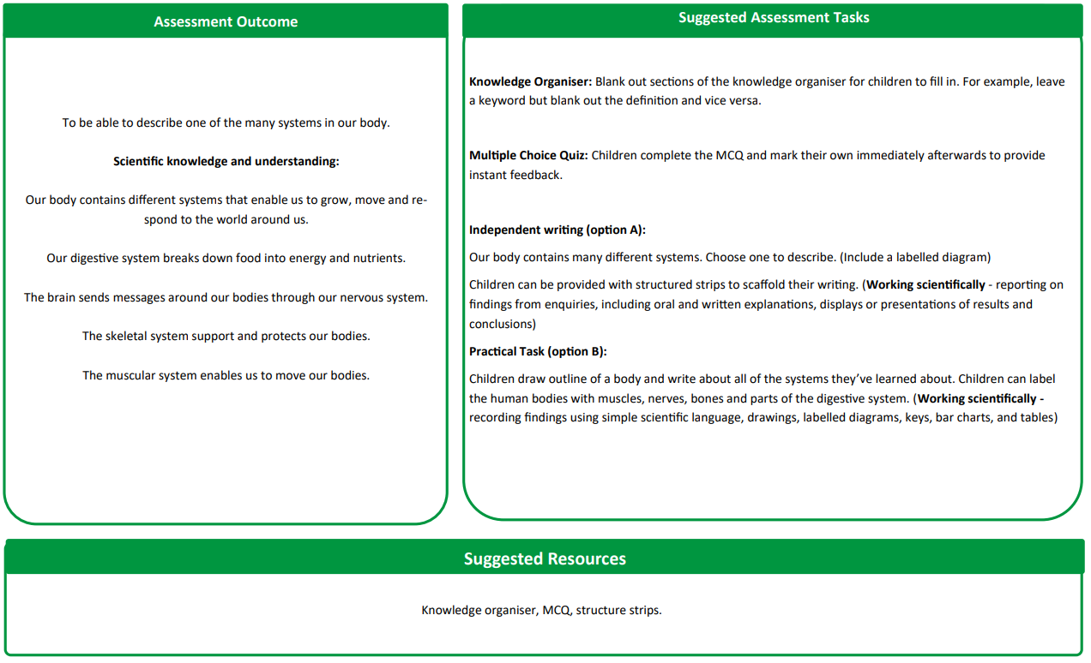
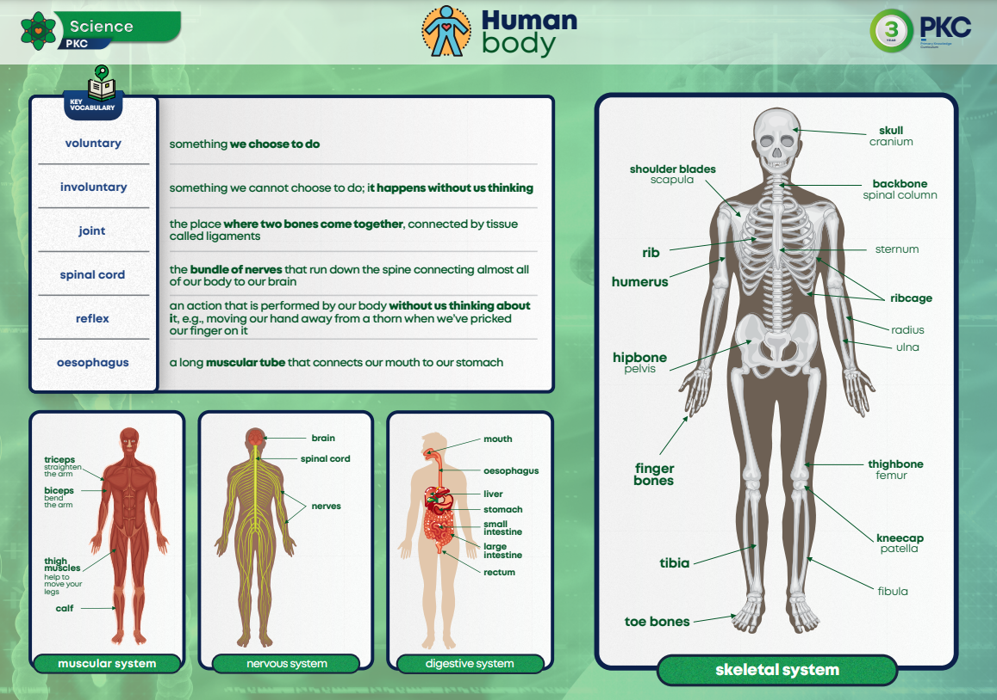
Assessment
Written Assessment
Children are assessed at the end of each Science unit, where they complete a multiple-choice quiz as well as an essay-style task. The task is designed to consolidate learning as well as giving the class teacher a clear understanding of knowledge retention.
Summative Assessment
Children are formally assessed using Family Fisher Trust.

Slide 19

Inclusion
Explicit instruction - step-by-step modelling of what we want children to do, chunking the content and introducing new material in small steps
Cognitive and metacognitive strategies – opportunity to recall information to transfer it to our long-term memory
Scaffolding – pre-teaching, visual, verbal, written
Visual scaffolds may support a pupil to know what equipment they need, the steps they need to take, what their work should look like, an aid to access teaching and learning
Verbal scaffolds may involve re teaching a tricky concept to a group of pupils, or using questioning to identify and address any misconceptions
Written scaffolds will be provided for a pupil to support them with an independent written task. It could be notes made on a whiteboard during a discussion, a word bank, a sentence starter, a writing frame, it could even be the child’s own previous work used to support their recall.
Scaffolds provide temporary assistance to pupils so they can successfully complete tasks that they cannot yet do independently. We use scaffolds flexibly, evaluate their effectiveness and gradually remove them once they are no longer needed.
Flexible grouping - peer tutoring, Kagan grouping, flexible grouping
Assistive technology – to support delivery and recording of work
Rosenshine’s Principles of instruction:
Begin a lesson with a short review of previous learning
Present new material in small steps with pupil practice
Ask questions and check responses
Provide models
Guide pupil practice, provide scaffolding and support
Encourage independent practice and check pupil understanding
All children receive a high quality and ambitious education
All learners have access to the same academic opportunities by offering a stimulating and ambitious curriculum, adjusted to the needs of pupils with SEND, so that they are able to reach their full potential
It is vital that our children are equipped with the tools needed to become independent learners
Our curriculum will ensure that all pupils gain a greater understanding of how they learn and the skills of resilience, collaboration, participation, investigation, thinking, creativity, motivation and reflection
We provide an accessible learning environment which is tailored to the individual needs of all pupils
Pupils are supported by adults following a cycle of assess, plan, do, review, making necessary adjustments to the curriculum to meet the needs of all pupils
All learners are respected and acknowledged for their personal contribution

