Slide 1


Subject Handbook
Physical Education

Slide 2

Our PE Curriculum
Intent
PESSPA (Physical Education, School Sport and Physical Activity) at St John the Baptist Catholic Primary School aims to offer an inclusive, fun, vigorous and high-quality curriculum which inspires all children to succeed in physically demanding activities. From EYFS all the way to Year 6, we aim to provide opportunities for all our children to develop their physical, cognitive and emotional skills through high-quality physical education, school sport and physical activity structure.
We aim to provide a clear and progressive learning journey for our children, ensuring a holistic teaching, learning and assessment approach is applied, to reflect our school values, aims and ethos.
Our children will have opportunities to compete in sport and other activities that build character and help to embed both the British and School Games Values. PESSPA at St John the Baptist Catholic Primary School is an imperative element of the curriculum, which develops an understanding and application for being physically literature, leading a healthy lifestyle, consuming a balanced diet, developing a growth mind-set and owning the resilience to persevere with activities that may have once felt too challenging.
We are passionate about the need to teach children how to cooperate and collaborate with others as part of a team, understanding fairness, the rule of law and sporting etiquette.

Slide 3
Our PE Curriculum
Implementation
Children at St John the Baptist Catholic Primary School participate in a minimum of 2 hours per week high-quality PESSPA and sporting activities led by teachers and specialist sports coaches.
Children at St John the Baptist Catholic Primary school will be taught and assessed using Get Set 4 PE: a progressive and well-structured resource which runs in line with the AfPE ‘Head, Heart, Hands’ concept, allowing us to ensure we are developing well-balanced children for the 21st century.
Our PESSPA curriculum incorporates a variety of sports to ensure all children develop the confidence, awareness and appreciation of their own and others’ strengths and weaknesses. It gives children the opportunity to assess, evaluate, improve theirs and their peers’ performances.
Our PESSPA curriculum allows children to positively transfer previously learnt skills across a range of sports.
We provide opportunities for all children to engage in extra-curricular activities before, during and after school, in addition to competitive sporting events. This allows us to extend and enrich our PESSPA curriculum. (Yognastics, Dancenastics, Mobility Class, Multi-Skills, Football Club)
Targeted interventions are implemented to ensure no child is left behind.
SEND interventions are implemented to ensure our SEND offer goes above and beyond.
We use Family Fisher Trust (FFT) effectively to ensure children are assessed against the National Curriculum.

Slide 4
Our PE Curriculum
Impact
Our PESSPA curriculum will ensure children leave St John the Baptist Catholic Primary with the cognitive, physical and emotional skills to continue to progress into the KS3 curriculum and beyond.
Our PESSPA curriculum will produce a well-balanced, physically literate and healthy child ready for the 21st century.
Our PESSPA curriculum will produce a resilient, determined and positive child who has the cognitive behaviours to approach challenge with open-mindedness.
Our PESSPA curriculum will give children the competitive opportunities, experiences and encounters, to embed core values for society.
Our PESSPA curriculum will produce a child who can make links, connections and associations with themselves and sport throughout the world.

Slide 5

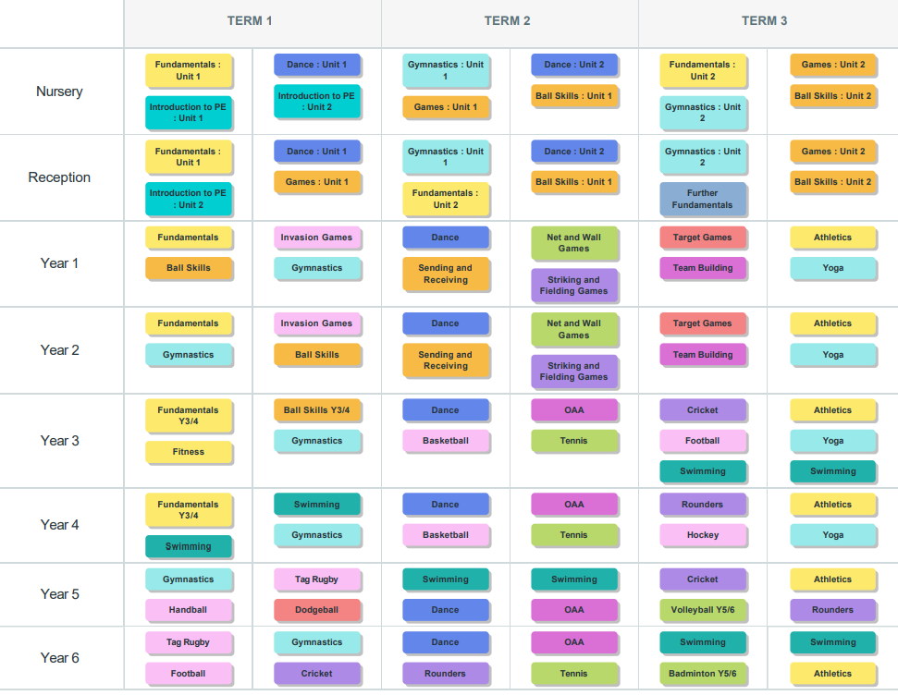
Curriculum Overview

Slide 6

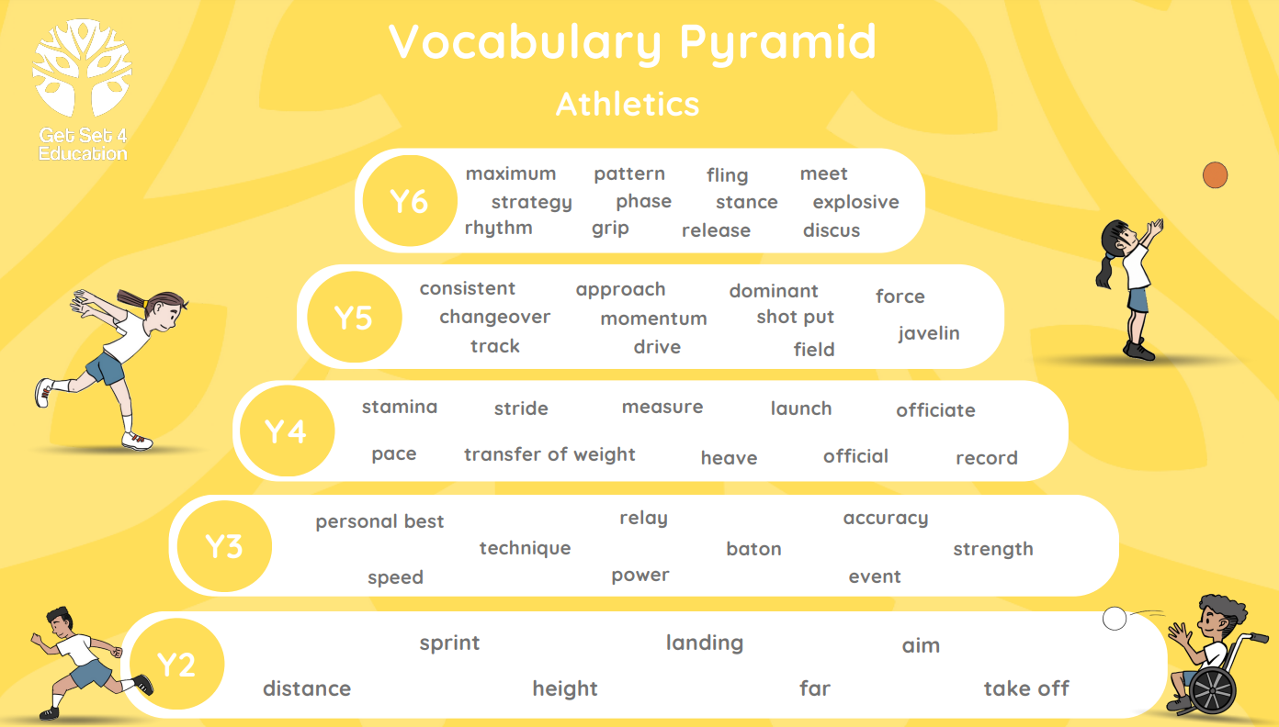
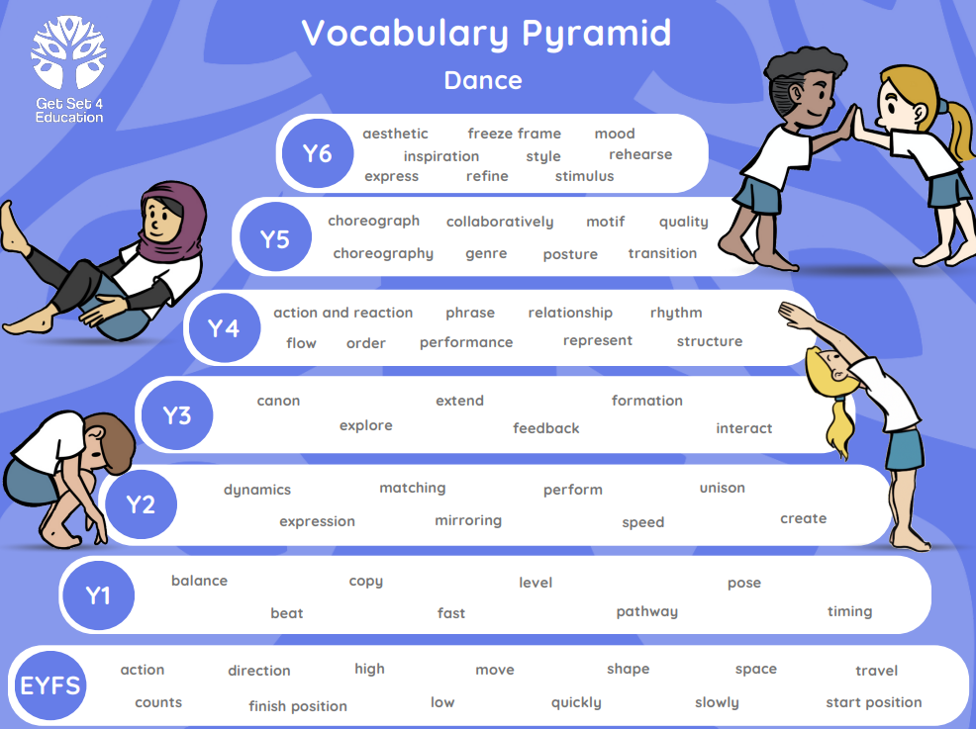
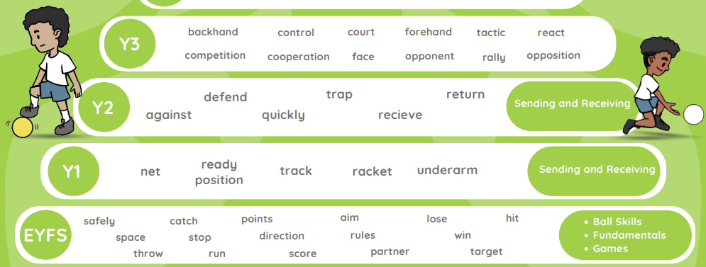
Vocabulary Progression
Athletics
Selection of Vocabulary
Dance
Repeated Vocabulary

Slide 7
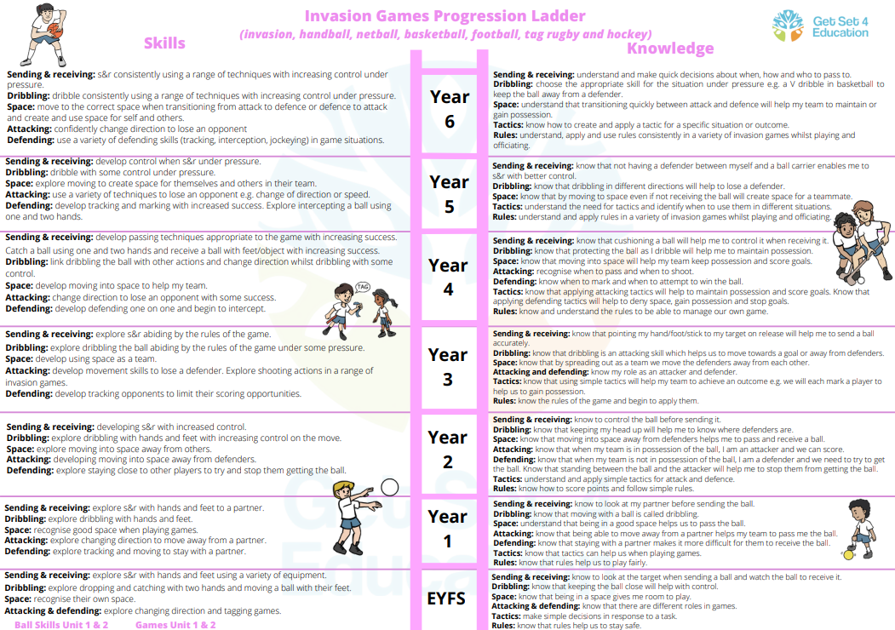
Progression of Skills

Slide 8
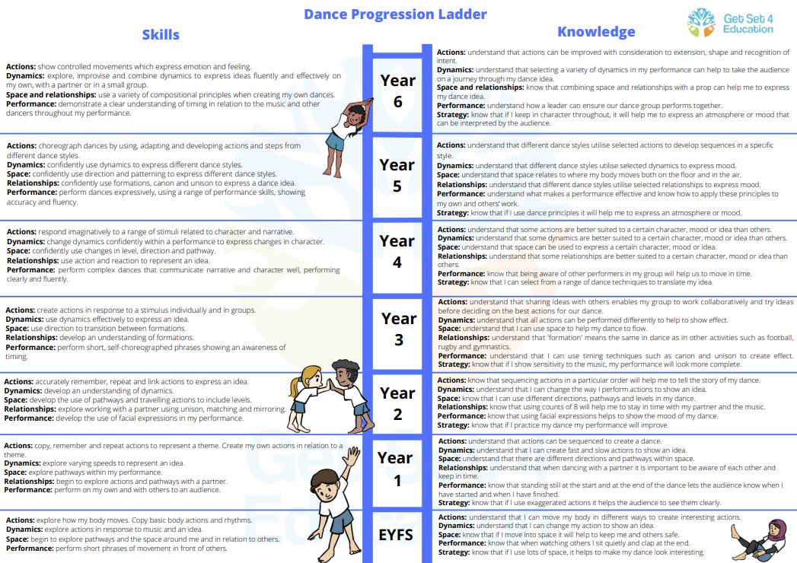
Progression of Skills

Slide 9
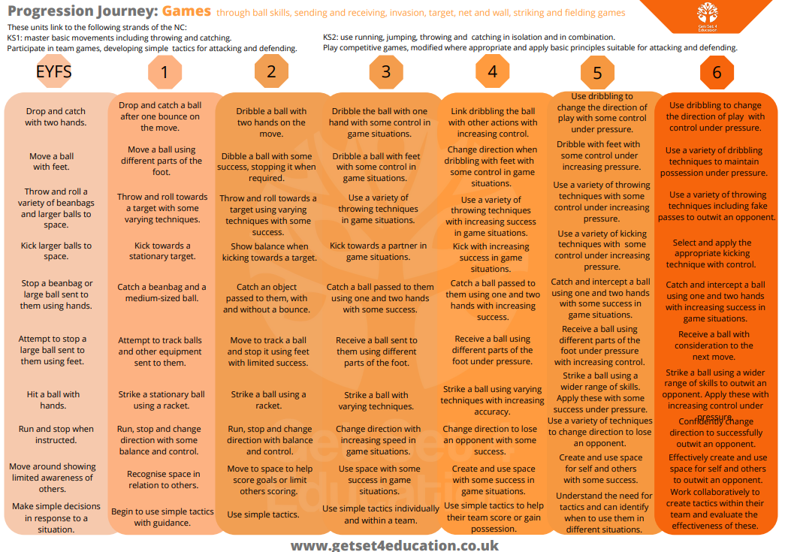
Progression of Skills

Slide 10
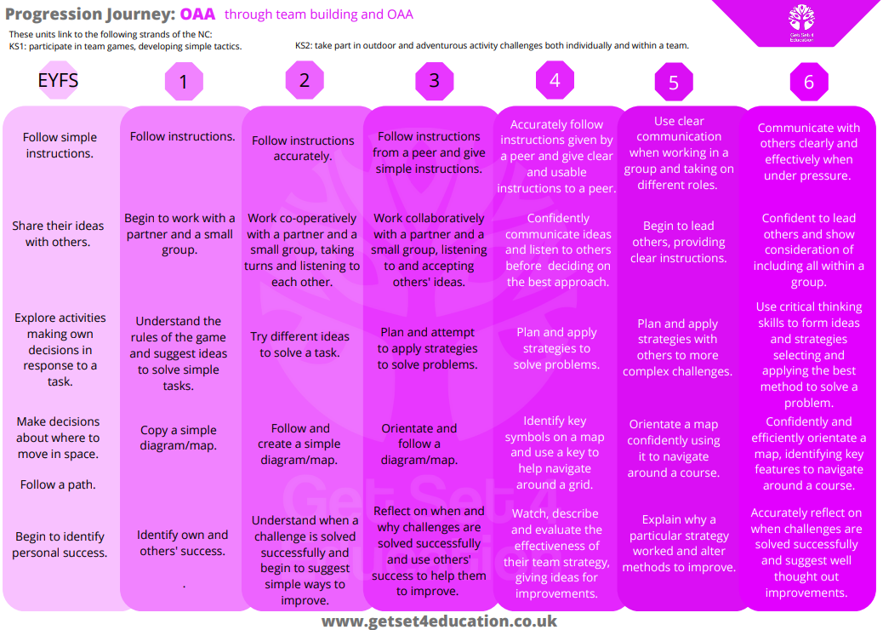
Progression of Skills

Slide 11
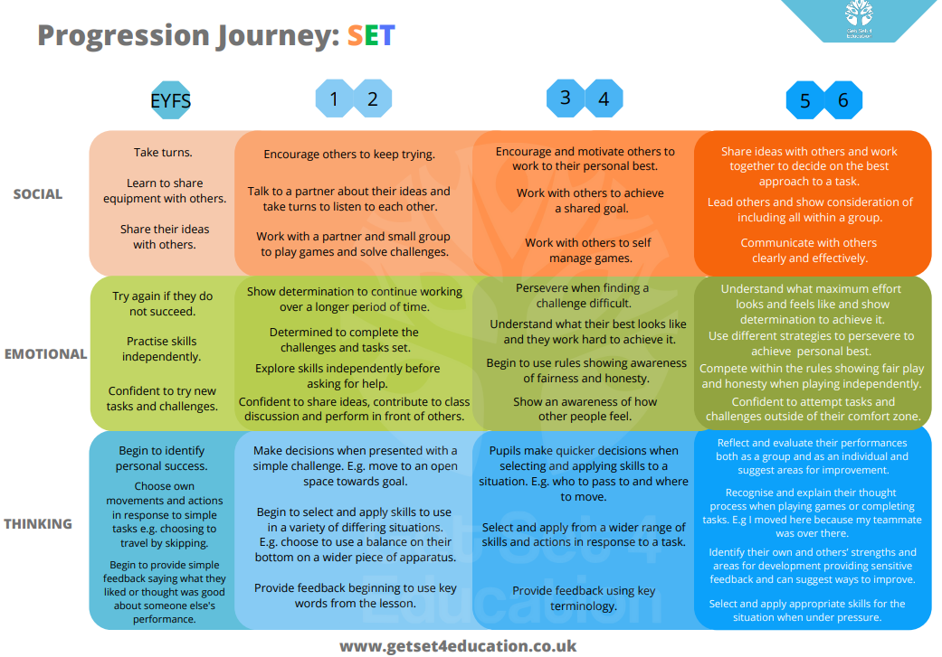


Progression of Skills

Slide 12

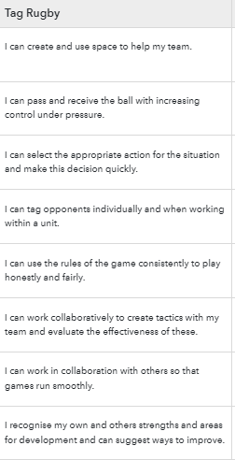
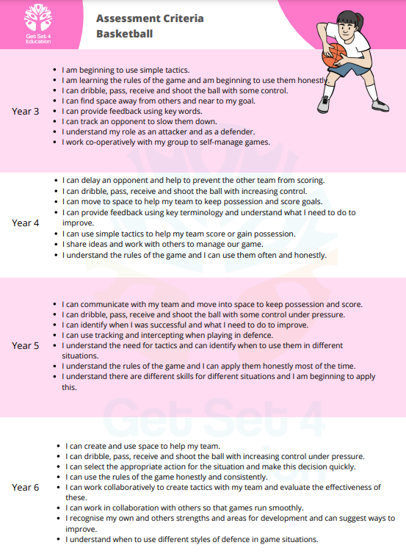
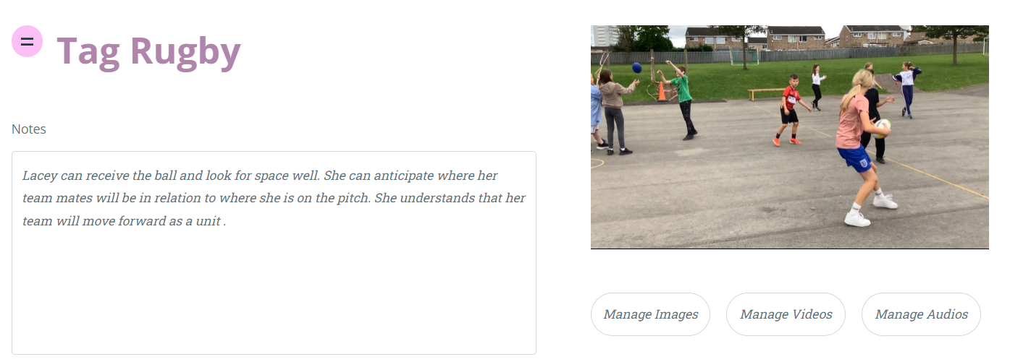
Assessment
Continuous Formative Assessment
Continuous formative assessment is carried out in every PE lesson through a variety of methods, such as:
Observation: Teachers regularly observe and record students' performance during practical activities, taking note of their application of skills, techniques, and understanding of rules and strategies.
Peer Assessment: Students are encouraged to provide constructive feedback to their peers, focusing on areas of improvement and celebration of strengths.
Questioning: Teachers employ targeted questioning to assess students' understanding of theoretical concepts related to PE.
Summative Assessment
Summative assessment, in PE takes place at regular intervals, using Family Fisher Trust, we evaluate students' overall attainment and progress. This includes:
Assessing Skills: Students are assessed on their proficiency in a range of skills, such as throwing, catching, running, jumping, and striking, based on predetermined criteria.
Assessments are shared with sports coaches and other teachers to inform the delivery of the next lesson/unit.
Portfolio Assessment
We use a portfolio approach to further enhance assessment in PE. The portfolio includes videos and accompanying notes to support evidence of students' progress and achievements. These videos may capture students performing specific skills, taking part in games, or engaging in various physical activities. The notes provide context, highlighting specific areas of strength and areas for development.

Slide 13

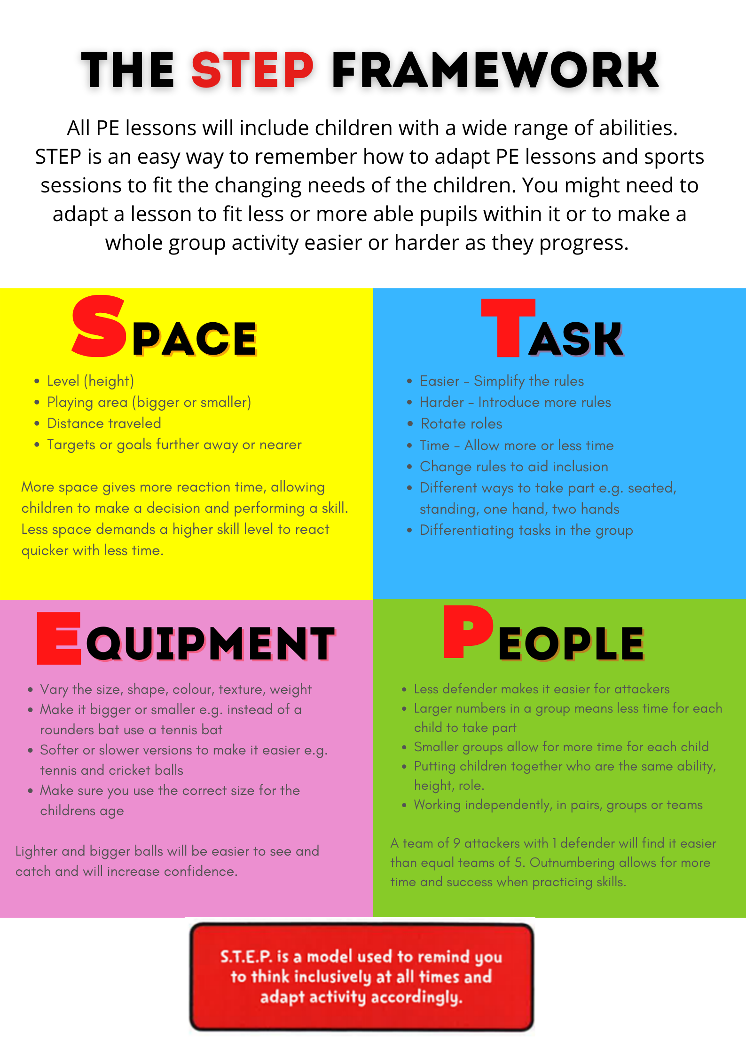
Inclusion
Adapted Activities
We recognise that students have different physical abilities and learning needs. Our PE curriculum incorporates adapted activities to ensure that all students are engaged and challenged at an appropriate level. We provide modifications and differentiated instruction to accommodate students with disabilities or specific needs, while still maintaining the integrity of the learning objectives.
Inclusive Team Sports
Collaborative team sports play a significant role in our PE curriculum, fostering teamwork, communication, and cooperation among students. We carefully select team sports that accommodate players with various skill levels and physical abilities, ensuring that all students can actively participate and contribute to the team's success.
Gender Equality
We actively promote gender equality in our PE curriculum. We provide equal opportunities for boys and girls to engage in a wide range of physical activities, including traditionally gendered sports. By challenging traditional gender stereotypes, we aim to empower all students and develop their confidence in participating in any activity they choose.
The STEP Model
We utilise the STEP model to deliver our PE curriculum.

