Slide 1


Subject Handbook
Maths

Slide 2

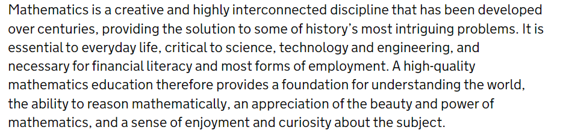
Our Maths Curriculum
Intent
At St John the Baptist, we take a mastery approach to the teaching and learning of mathematics. Essentially, our ethos is that all children can be successful in the study of mathematics. We do not accept that ‘some children cannot do maths’ or that children should be limited by prior attainment; maths is for everyone. We teach the skills to ensure our children are resilient learners who become life-long mathematicians. We aim to deliver an inspiring and engaging maths curriculum through high quality teaching.

Slide 3
Our Maths Curriculum
Implementation
Our EYFS at St John’s provides an engaging and encouraging climate for children’s early encounters with mathematics. This develops their confidence and their ability to understand and use maths and is the foundation for their future maths learning.
We are passionate about the teaching of early mathematics. We actively introduce mathematical concepts, methods, and language through a variety of engaging and stimulating practical experiences, both within the classroom and in the outside environment. We guide children to see connections of ideas within maths as well as with other subjects, developing their mathematical knowledge throughout the day and across the curriculum. We encourage children to communicate, explaining their thinking as they interact with maths in a deep and sustained way.
We ensure that children have sufficient practice to be confident in using and understanding numbers which provides a strong basis for more complex learning later on. Focus is placed on the use of concrete resources to develop deep structural knowledge and the ability to make connections, with the aim of ensuring that what is learnt is sustained over time.

Slide 4
Our Maths Curriculum
Implementation
We are committed to ensuring that all children are mathematically proficient and confident in the use of maths in their everyday lives. To achieve this, we teach for maths mastery designed to ensure all children develop a deep and sustainable understanding of age-appropriate mathematical concepts, which can be built upon in the future. We believe that every child can achieve and encourage the growth mindset ‘can do’ attitude. Pupils learn to think mathematically to find patterns, connections and relationships between different concepts.
Building on relevant educational research, our maths curriculum has been responsive to the concept of retrieval practice and we understand that children need regular opportunities to revisit prior learning in order to commit mathematical understanding to long term memory.
We teach maths using the White Rose Maths planning. It is based on a small-steps approach, which means the concepts are broken down to enable the children to acquire a deep, long-term, secure and adaptable understanding. It has been designed to support and challenge all pupils and is built on the belief that everyone can learn maths successfully, by building number fluency, confidence and understanding, step by step. By taking a Concrete, Pictorial, Abstract (CPA) approach, WRM allows children to tackle concepts in a tangible and accessible way. All ideas are built on previous knowledge and pupils have lots of opportunity to recognise relationships between topics.
Fluency comes from deep knowledge and practise. At early stages, explicit teaching of multiplication tables is important in the journey towards fluency and contributes to quick and efficient mental calculation. We teach multiplication both through progressive teaching sequences and through multiplication chanting and recall of the times tables appropriate for each year group.
At St John’s we teach multiplication tables in the following year groups so that children are proficient in the rapid recall of all multiplication tables up to 12×12 by the end of Year 4
– Year 2: 2s, 5s and 10s
– Year 3: 3s, 4s and 8s
– Year 4: 6s, 7s, 9s, 11s and 12s.
We also use Times Tables Rockstars as a tool to help pupils develop fluency in number facts and multiplication tables in school and at home.
Each half term children are given Key Instant Recall Facts (KIRFs) to practise and learn at home. We expect the majority of the children within a year group to be working towards these targets. It is important that children know these thoroughly and are able to recall the facts instantly for their year group. By helping to develop these skills, the children will be more able to access other areas of the maths curriculum such as calculation methods, problem solving and reasoning.

Slide 5
Our Maths Curriculum
Impact
When we plan our lessons and sequences of lessons, we structure the learning so that all pupils work through new content together as a whole group. Although we do not differentiate the learning task by reducing the level of difficulty for certain groups, the questioning and scaffolding that individual children receive in class will differ.
Teachers allow time for children to fully understand, explore and apply ideas, rather than accelerate through new topics. Pupils’ difficulties and misconceptions are identified through immediate formative assessment and addressed with rapid intervention. This approach enables pupils to truly grasp a concept.

Slide 6

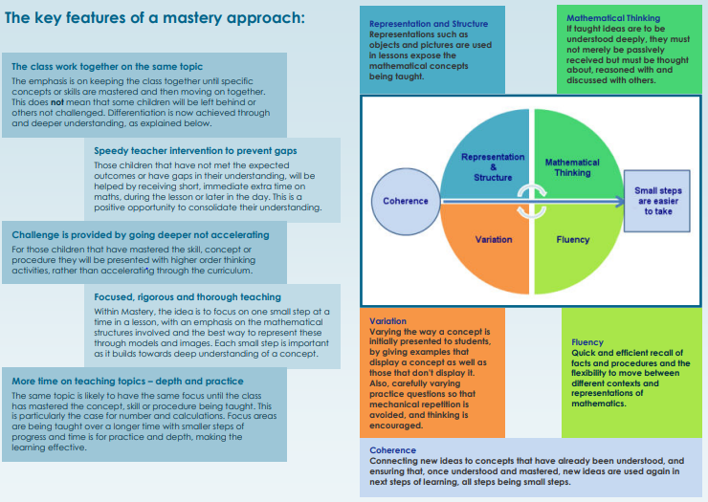
Curriculum Rationale
Mathematics is essential to everyday life, critical to science, technology and engineering, and necessary for financial literacy and most forms of employment. A high-quality mathematics education therefore provides a foundation for understanding the world, the ability to reason mathematically, an appreciation of the beauty and power of mathematics, and a sense of enjoyment and curiosity about the subject.
At St John the Baptist, we take a mastery approach to the teaching and learning of mathematics. Essentially, our ethos is that all children can be successful in the study of mathematics. We do not accept that ‘some children cannot do maths’ or that children should be limited by prior attainment; maths is for everyone. We teach the skills to ensure our children are resilient learners who become life-long mathematicians. We aim to deliver an inspiring and engaging maths curriculum through high quality teaching. In order to improve our mastery approach and improve the quality of our maths teaching, we base our teaching on the White Rose Maths curriculum plans.

Slide 7
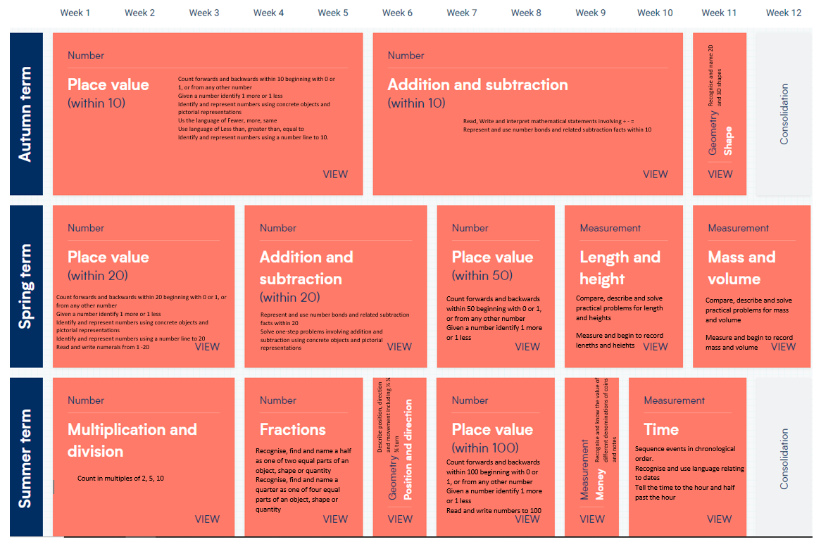
Curriculum Overview
Year 1

Slide 8
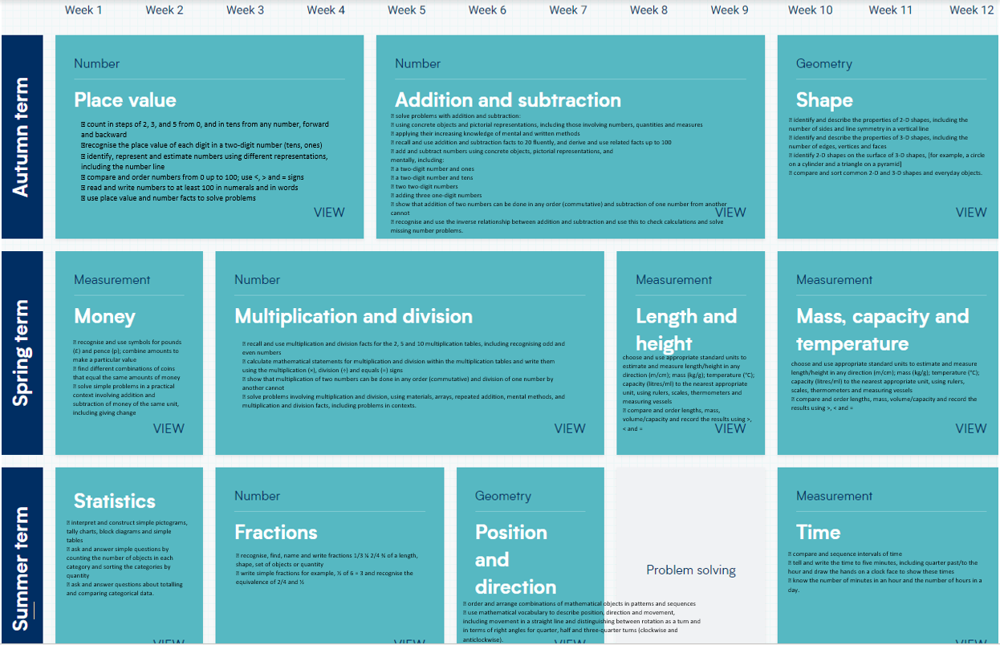
Curriculum Overview
Year 2

Slide 9
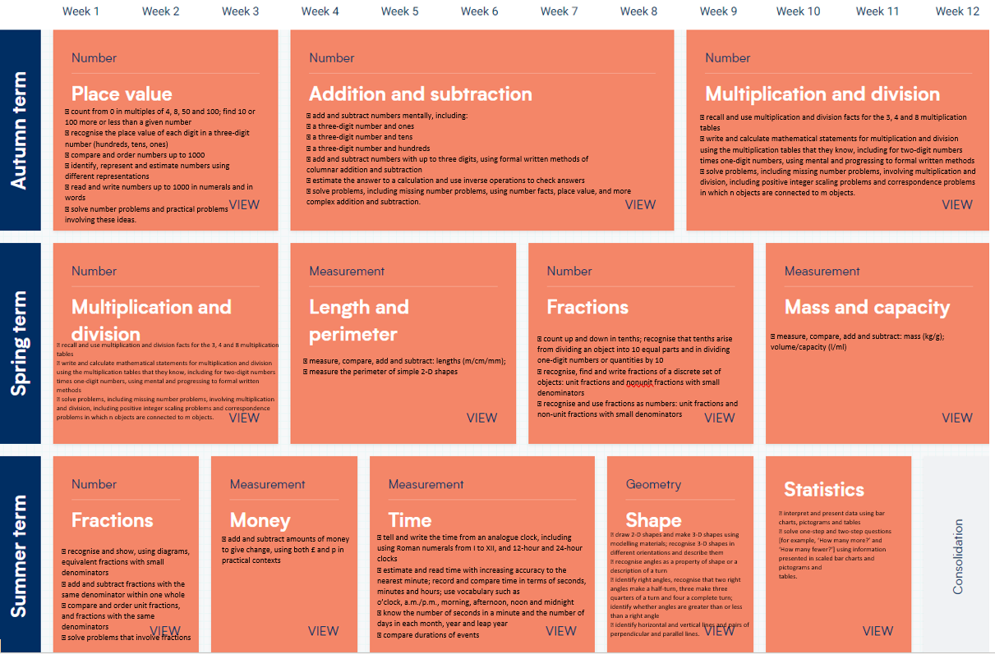
Curriculum Overview
Year 3

Slide 10
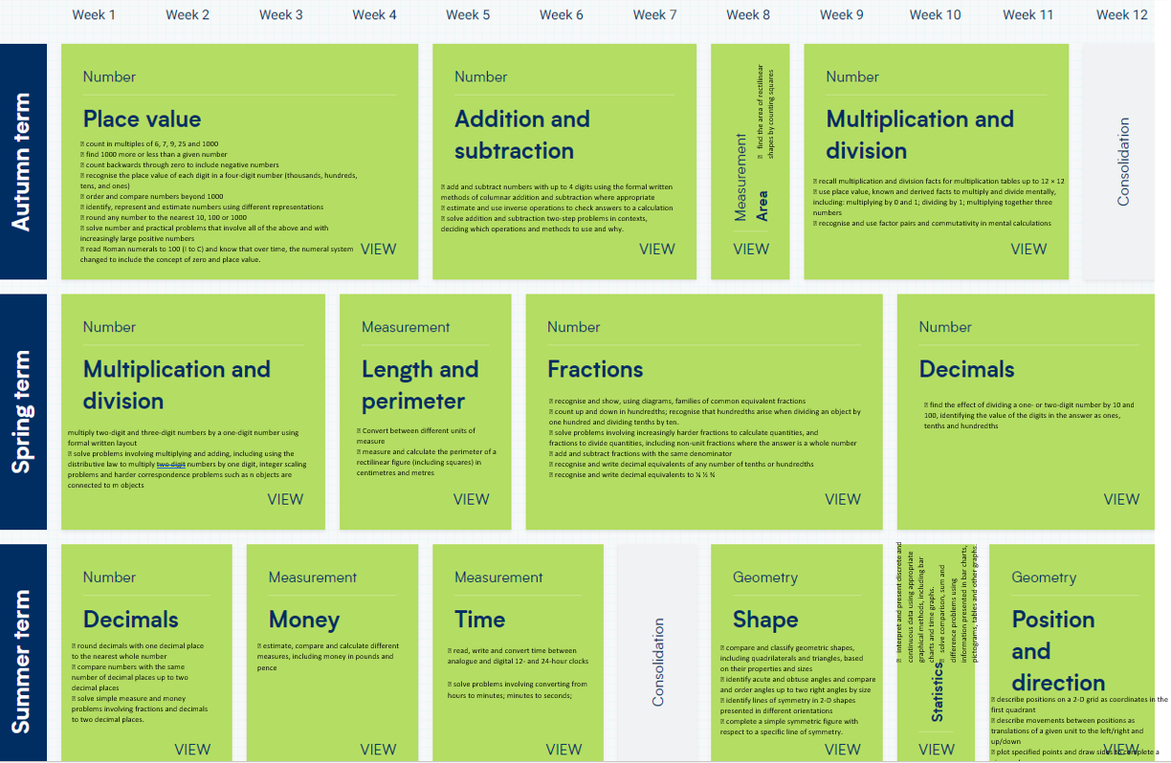
Curriculum Overview
Year 4

Slide 11
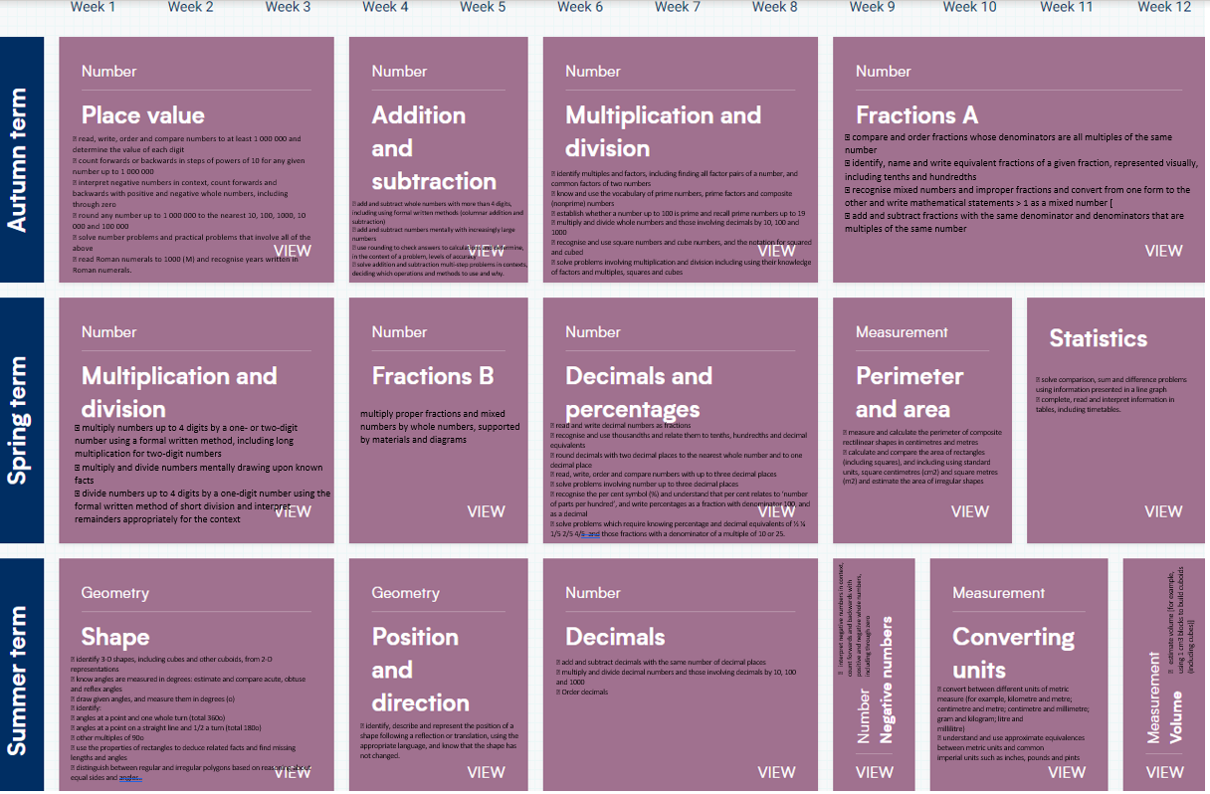
Curriculum Overview
Year 5

Slide 12
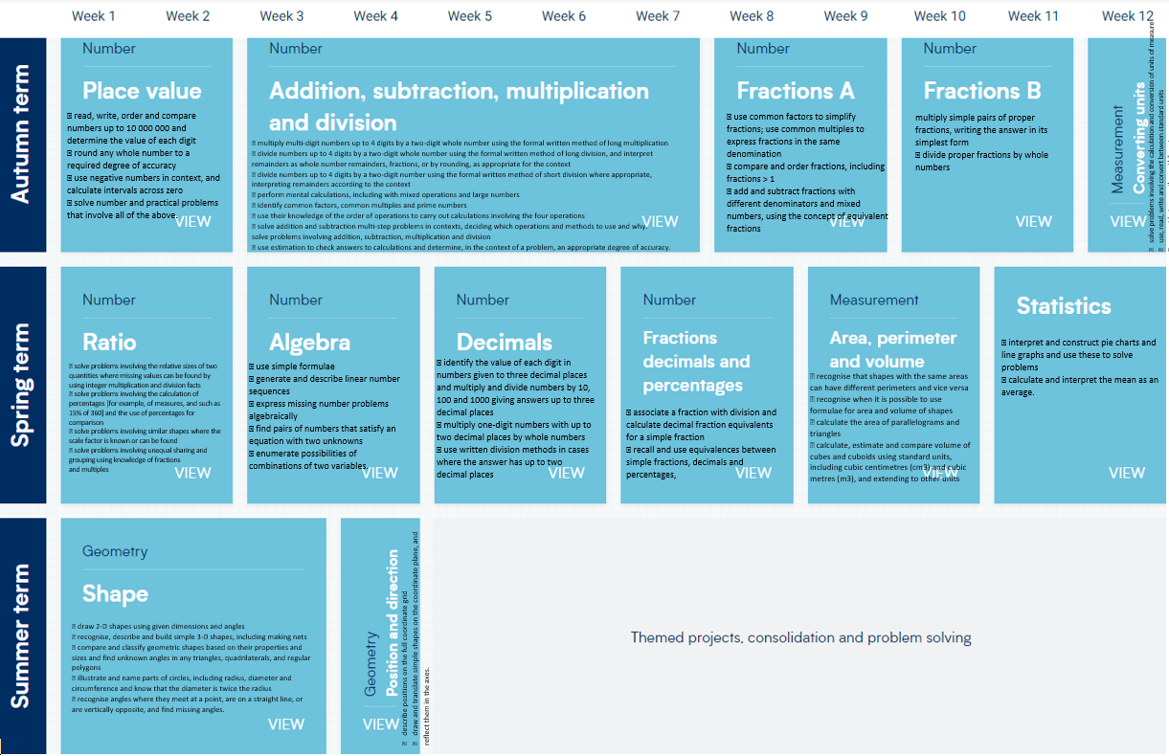
Curriculum Overview
Year 6

Slide 13
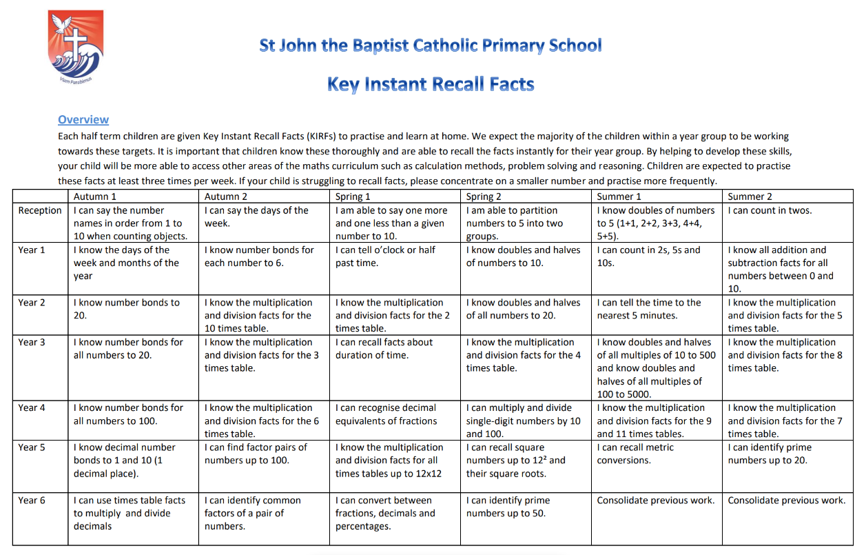
Key Instant Recall Facts Overview

Slide 14

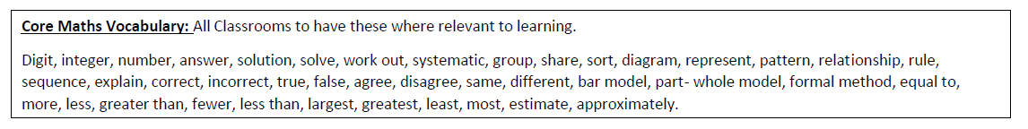
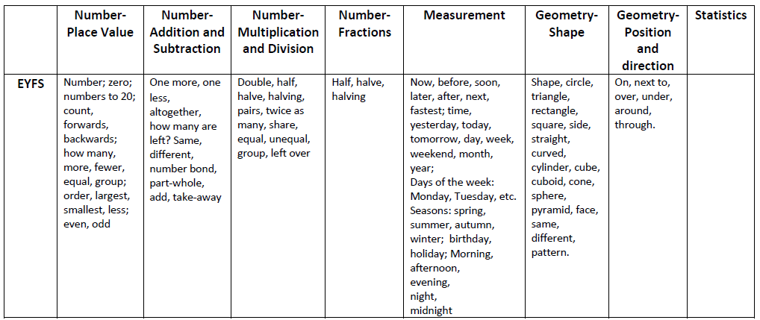
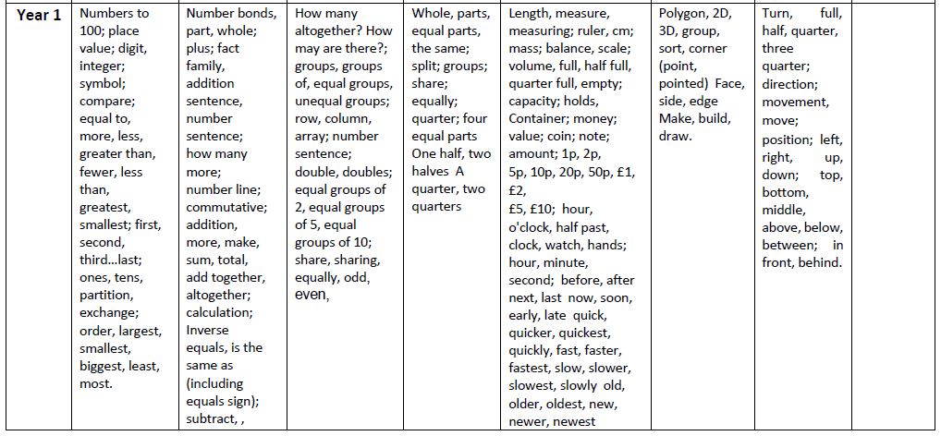
Progression of Vocabulary

Slide 15
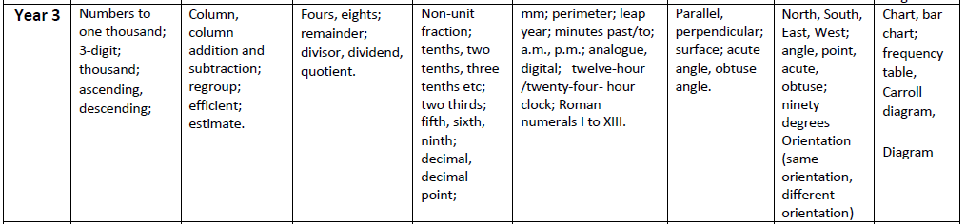
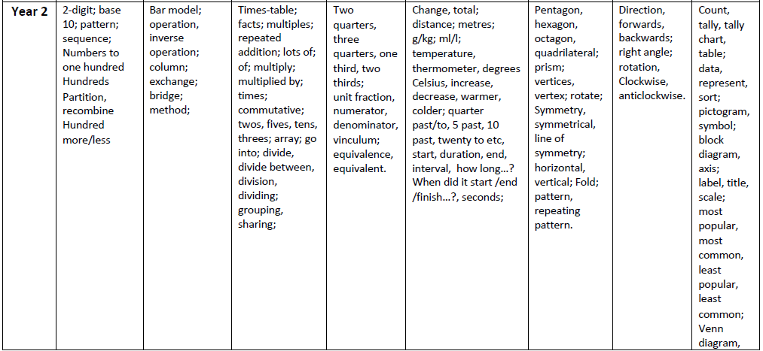
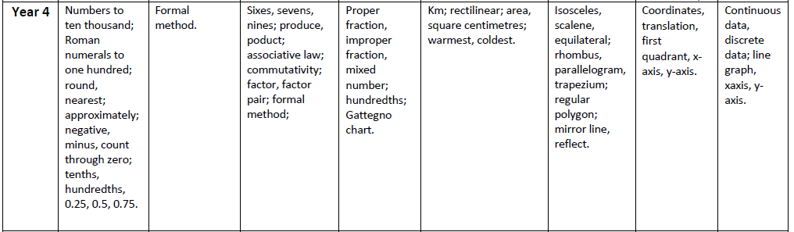
Progression of Vocabulary

Slide 16
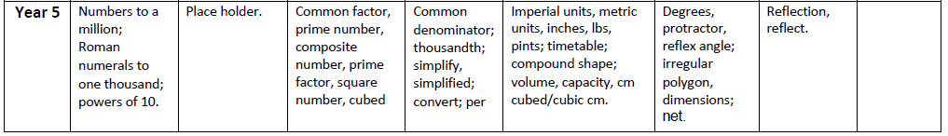
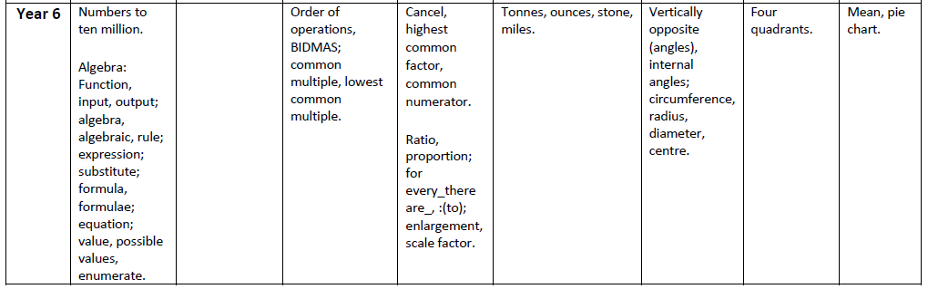
Progression of Vocabulary

Slide 17
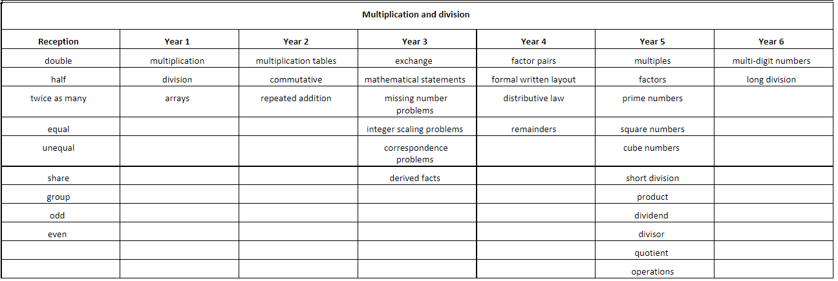
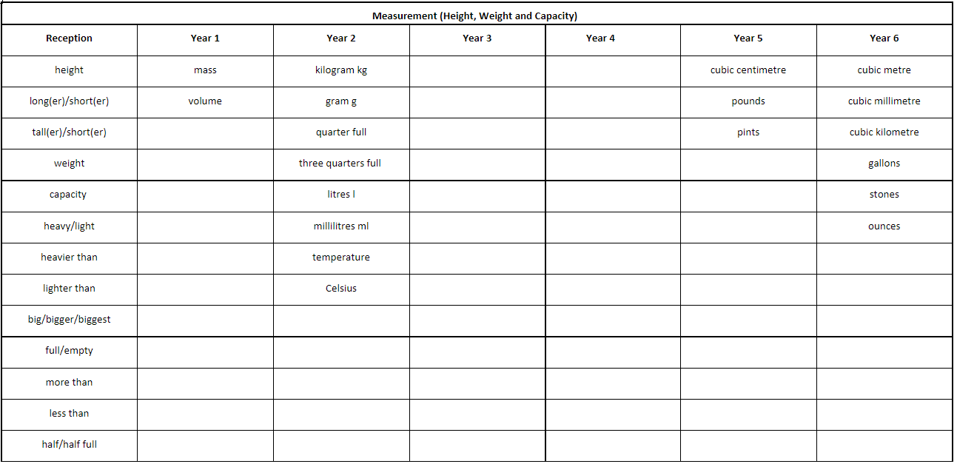
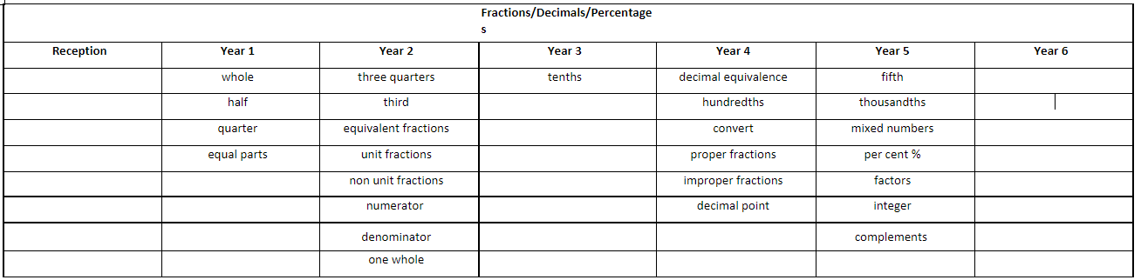
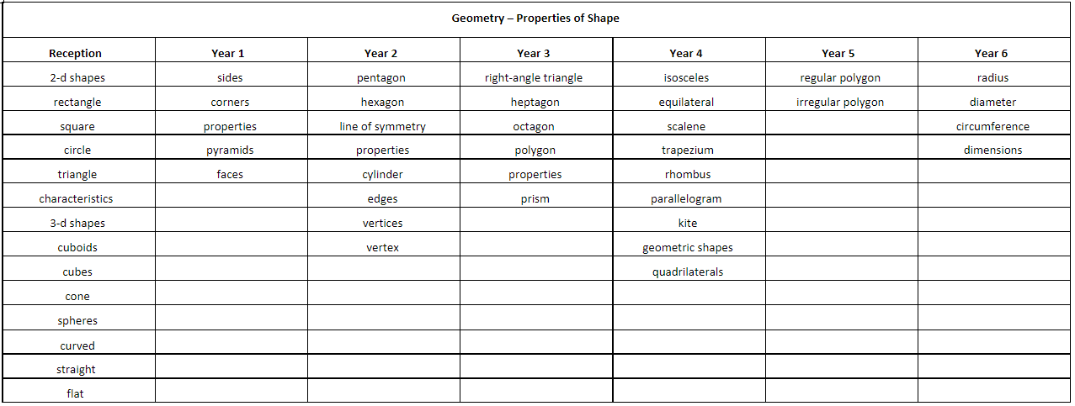
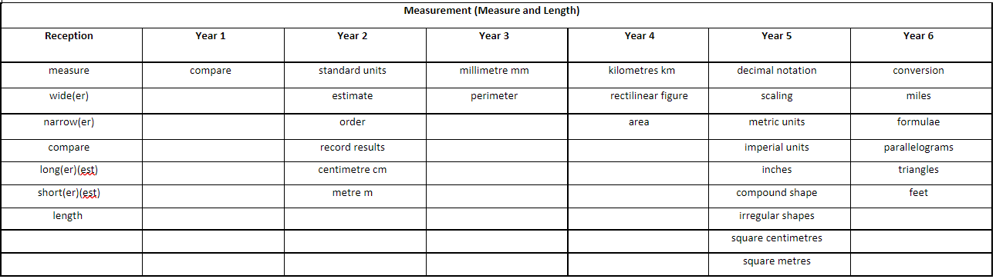
Progression of Vocabulary

Slide 18

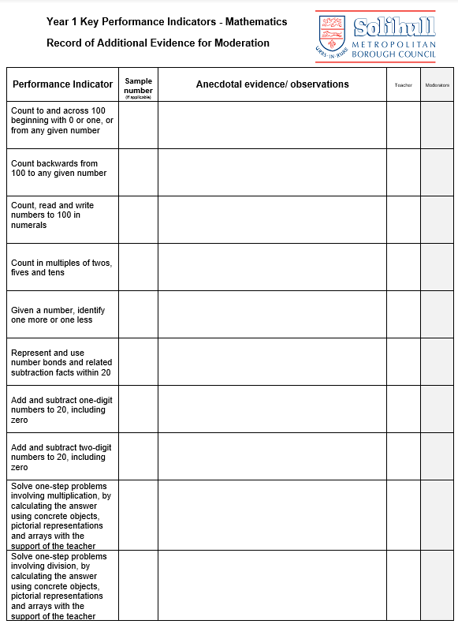
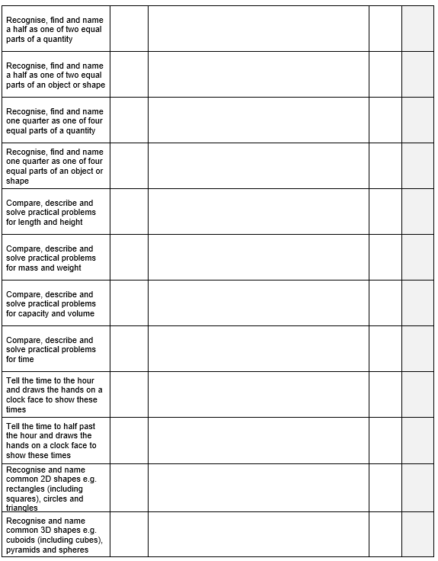
Assessment
Assessment for learning
The structure of the teaching sequence, ensures that children know how to be successful in their independent work. Guided practice provides further preparation for children to be able to apply the skills, knowledge and strategies taught during the independent phase. Common misconceptions are addressed within the teaching sequence and key understanding within each small step is reviewed and checked by the teacher and the children before progression to further depth.
Formative assessment
Short term assessment is a feature of each lesson. Observations and careful questioning enable teachers to adjust lessons and brief other adults in the class if necessary. The lesson structure is designed to support this process and the reflect task at the end of each lesson also allows for misconceptions to be addressed.
Summative assessment
At the end of each blocked unit of work, the children complete the end of unit assessment. The outcome of this is used by the teacher to ensure that any identified gaps in understanding can be addressed before the next unit is taught.
Teachers administer a termly WRM progress test which tests arithmetic, reasoning and problem-solving which specifically links to the coverage for that term. The results of these papers are used to identify children’s ongoing target areas. They are also used alongside the end of unit assessments, outcomes of work and Star Maths Assessments, to inform the whole school tracking of attainment and progress for each child on FFT Aspire.
Assessment data in maths is reviewed throughout the year to inform interventions and to also ensure that provision remains well-informed to enable optimum progress and achievement. End of year data is used to measure the extent to which attainment gaps for individuals and identified groups of learners are being closed. This data is used to inform whole school and subject development priorities for the next school year.
Teachers regularly meet to moderate teacher assessment judgements and these judgements are also moderated with other schools in the Local Authority or MAC.

Slide 19

Inclusion
Taking a mastery approach, adaptation occurs in the support and intervention provided to different children, not in the topics taught, particularly at earlier stages. Most children are taught the same content but the questioning and scaffolding individual children receive in class as they work through problems will differ, with some children challenged through more demanding problems, which deepen their knowledge of the same content before acceleration onto new content. Children’s difficulties and misconceptions are identified through immediate formative assessment and addressed with rapid intervention – commonly through individual or small group support later the same day.
A range of inclusion strategies are embedded in practice and teachers are aware of the special educational needs of the children in their class, as well as those who have English as an additional language.
Although the expectation is that the majority of children will move through the programmes of study at broadly the same pace, the National Curriculum states: ‘Decisions about when to progress should always be based on the security of children’s understanding and their readiness to progress to the next stage.’ If a child’s needs are best met by following an alternative plan, including coverage of the content from a previous year, this will be directed by the SENDCo, in collaboration with the class teacher and with the knowledge of SLT. Specific arrangements for the provision of children with SEND will be communicated to parents and carers during SEND reviews and by children’s Individual Plans which incorporate suitable targets for their ability.
The school is committed to ensuring the active participation and progress of all children in their learning. We provide equal access for all learners through curriculum balance, curriculum time and the use of resources. We strive hard and take all reasonable steps to meet the needs of all pupils, including those with special educational needs, those with disabilities, those with special gifts and talents and those with English as an additional language.

